Slide 1

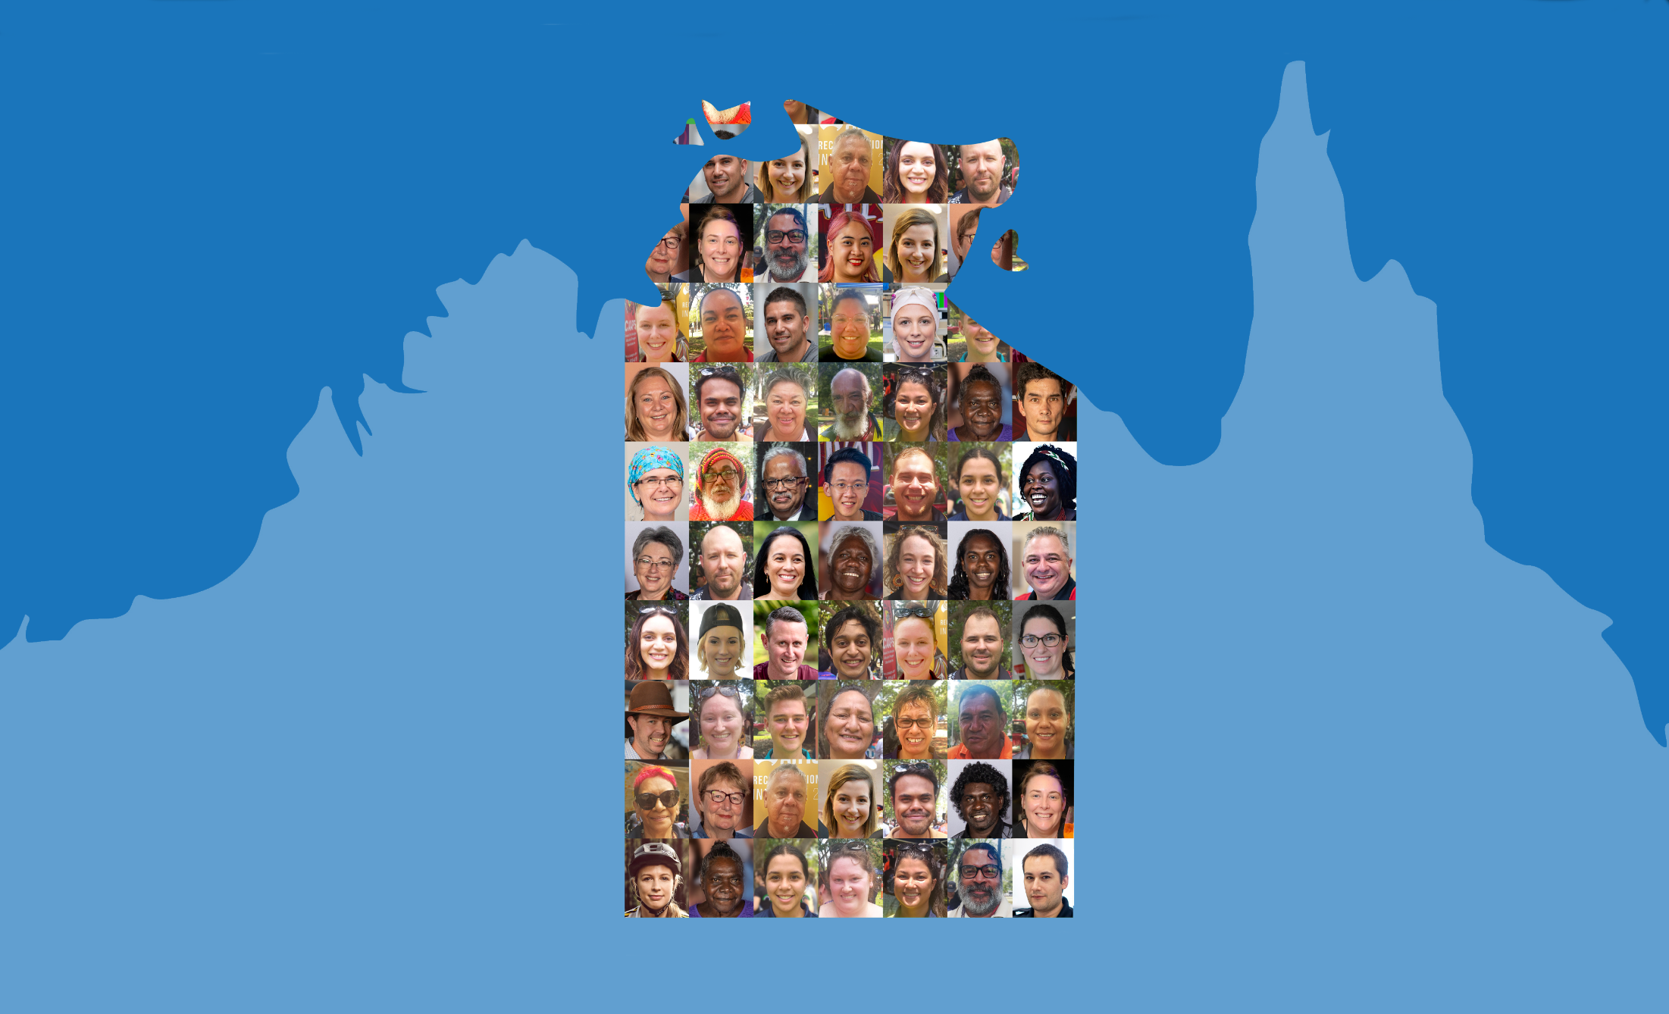

Northern Territory Electoral Commission
www.ntec.nt.gov.au

Slide 2
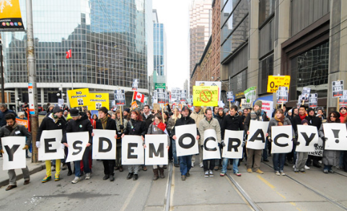
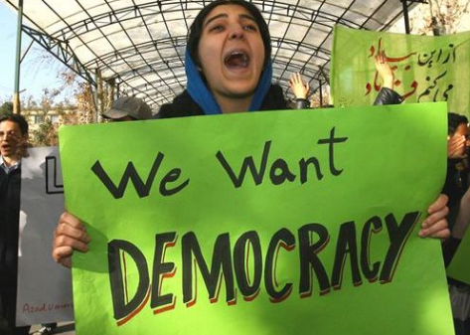
Democracy definition
Government by the people, or by their elected representatives
“Government of the people, by the people, for the people”
- Abraham Lincoln
Northern Territory Electoral Commission
www.ntec.nt.gov.au
Notes:
Ask students: “What is democracy? Can anyone give me a definition?” Give assistance and prompts if required. Show answer on click. Ask students what the most important word in the definition is → people.
Show the famous quote about democracy, read it out loud and tell students this is a very famous saying by a very famous leader. Who was he? Show answer on click.
Explain that in Australia we have democracy, but not all countries around the world are democracies. These are photos from countries that do not have democracy, and in some places that do not have democracy, it is actually illegal to march down the street and protest.

Slide 3
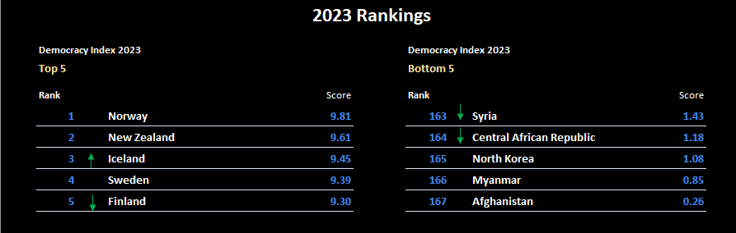
Democracy Index
14 Australia 8.66
Northern Territory Electoral Commission
www.ntec.nt.gov.au
Notes:
Tell students there is a group of international researchers that measure democracy around the world, and rate each country in order, to produce an annual ‘Democracy Index’. Including the features we just looked at, they have 60 indicators that they use to measure democracy in most countries in the world.
Ask students: “What countries do you think are at the top of the most recent index, i.e. what are the most democratic countries around the world, and where do you think Australia is ranked on the list?” Elicit a few ideas and confirm any countries they get right. Before showing results, also ask what country they think is ranked the least democratic country in the world.
Show results on click, including Australia (second click). May want to comment that New Zealand is ranked very high at #2, and increased their score over the last year. Australia dropped 15 places from 2021-22 and now sits at #15.

Slide 4
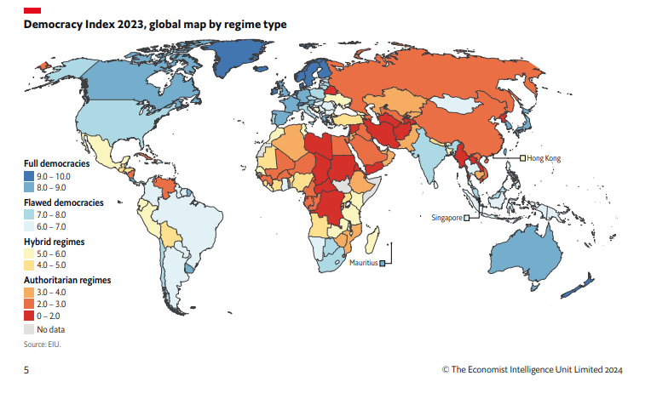
Northern Territory Electoral Commission
www.ntec.nt.gov.au
Notes:
Tell students this is a map that shows the ranking of all the countries that were measured (167 countries) in putting together the Democracy Index. Read out the 4 categories of democracies on the left hand side.
Interesting to point out:
The US is not considered a ‘full democracy’. There are 23 countries that measured over 8 out of 10 and are therefore ‘full democracies’. The USA ranked 25, on 7.92.
South Korea and Japan have recently improved to ‘full democracy’ status, and are the strongest democracies in Asia.
Most countries in Africa are ‘authoritarian’, as are Russia and China.

Slide 5
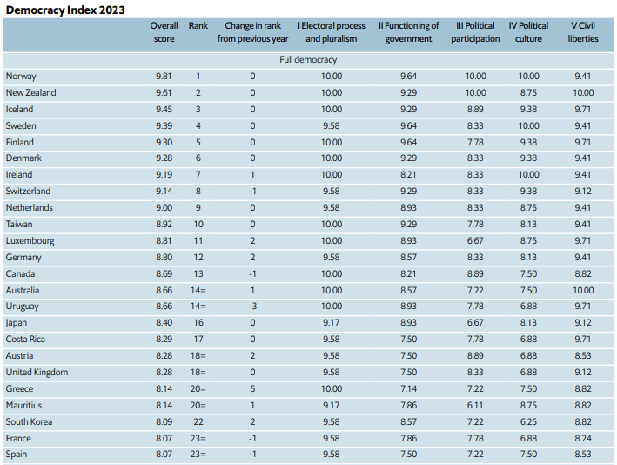
Democracy Index 2023 – Full democracies
Northern Territory Electoral Commission
www.ntec.nt.gov.au
Notes:
Tell students: these are the countries that scored over 8 out of 10, and are therefore considered to be ‘full democracies’. Australia’s scores across the 5 categories have been highlighted.
Electoral process and pluralism: the electoral process refers to how elections are run in that country. Pluralism refers to multi party systems and contested elections, which provides real choice for voters.
Functioning of government: Looks at the decision making structures of government, opportunities for real scrutiny, levels of corruption and influence from outside powers.
Political participation: this refers to the levels of ‘active citizenship’ by the people of that country including voting in elections, standing as a candidate, protesting, being involved.
Political culture: is all about what the people believe. Do they believe in democracy or are other systems better? It’s also about having a stable society without civil unrest.
Civil liberties: this is an American term, it means rights and freedoms, like freedom of speech, freedom of information, freedom of the media etc.
Looking at Australia’s scores: we do well in electoral systems and protecting rights and freedoms, lowest score is for political participation.

Slide 6
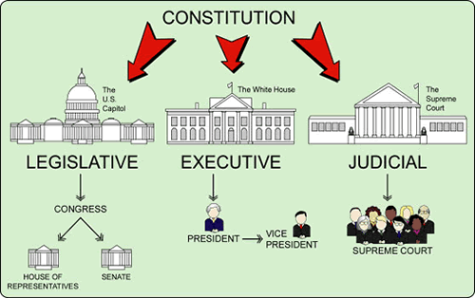
Democratic structures in Australia
ROANIPETSA FO WEPROS
SEPARATION OF POWERS
Northern Territory Electoral Commission
www.ntec.nt.gov.au
Notes:
Democratic structures in Australia
Tell students there are 4 main democratic structures in Australia that will be looked at in more detail. These structures are in place to keep governments accountable and to prevent the abuse of power.
Students are the guess the democratic structures by unscrambling the letters. (Need 2 clicks to show answer)
Separation of Powers: Once they have unscrambled the letters tell them there are 3 powers that are designed to be deliberately separate and independent of each other. Ask students what the 3 powers are.
Show picture on slide – this illustrates the separation of powers in America, it is different to ours in Australia.
Activity → students are to sort everything by which power it goes with. There is a heading (Executive, Legislative and Judiciary), a picture, a definition, how they are chosen, and different roles associated with each one.

Slide 7
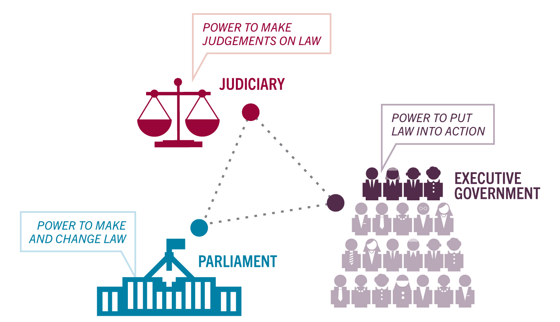
Separation of powers
Chosen by leader of government
Governor-General/Queen
Ministers
Cabinet
Government departments
Police, customs, health inspectors
Appointed by the executive
Judges
Magistrates
Elected by the people
Governor-General/Queen
Members of Parliament
Senators
Northern Territory Electoral Commission
www.ntec.nt.gov.au
Notes:
Show students the answer slide – go through correct answers

Slide 8
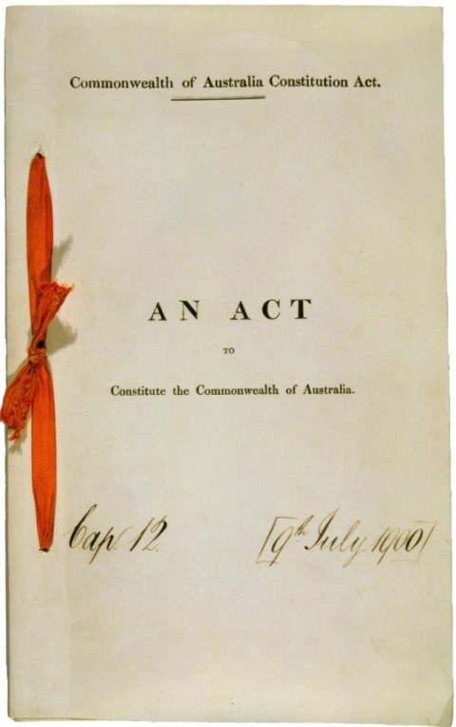
Democratic structures in Australia
HET UTINOCITNOTS
THE CONSTITUTION
Northern Territory Electoral Commission
www.ntec.nt.gov.au
Notes:
Students to unscramble letters
The Constitution: Ask students what is the Constitution? (Set of rules by which Australia is governed – governments and parliaments must follow these rules)
Activity → Students are given 12 statements about the Constitution, they need to sort them by whether they are true or false (there are 6 of each).

Slide 9
The Constitution
TRUE | FALSE
The Constitution is a set of rules by which Australia is run | The Constitution commenced 25 January, 1901
The Constitution can only be changed once parliament has passed it, and people have voted yes in a referendum | The federal parliament can change the Constitution at any time
Voting in constitutional referendums is compulsory in Australia | People living in Territories cannot vote in constitutional referendums
The Constitution allows the establishment of new states. This means the NT can become a state | Australia has 2 territories, but the Constitution mostly refers to states, so people in territories have less constitutional rights
The Constitution was approved by the people in a series of referendums held over 2 years | There have been 44 constitutional referendums since 1901, only half have passed
Only the High Court has the authority to interpret the Constitution | The federal parliament cannot interfere with state law making, but can interfere in territories
Northern Territory Electoral Commission
www.ntec.nt.gov.au
Notes:
Show students the answer slide – go through correct answers

Slide 10
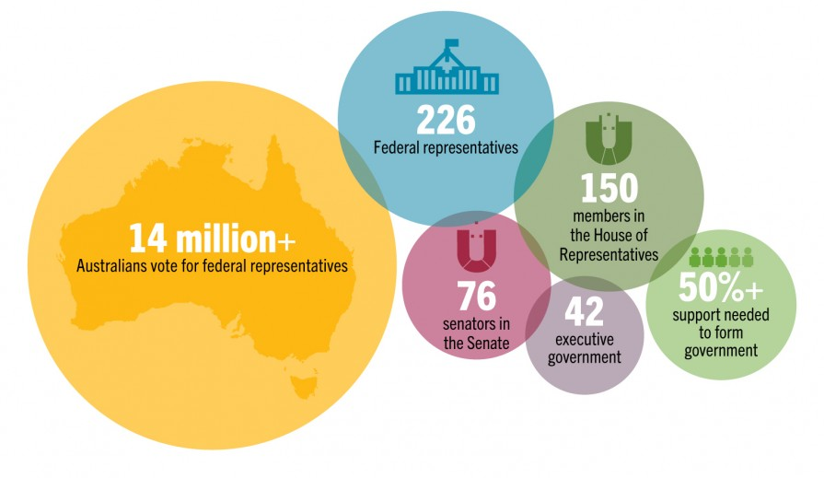
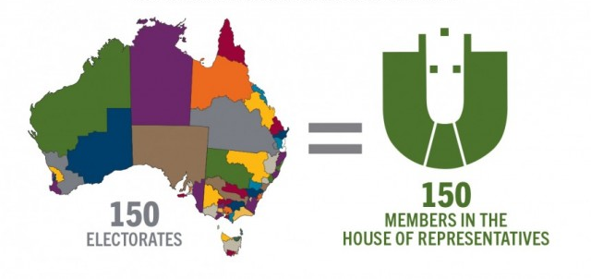
Democratic structures in Australia
REPRESENTATIVE GOVERNMENT
PENTVERTAISER MERGVENTON
Northern Territory Electoral Commission
www.ntec.nt.gov.au
Notes:
Students to unscramble letters
Representative Government: Tell students that in a democracy, governments are chosen by the people. Governments should reflect the people they represent and their views. Tell them we have 3 levels of government in Australia (ask what they are) and all three levels are elected.
Activity → Students are given a series of questions and answers (x 12 of each). They have to match the correct question with its answer.

Slide 11
Representative government
What is the House of Representatives? | The lower house of federal parliament….
What is the Senate? | The upper house of federal parliament...
What is a Legislative Assembly | A state level House of Representatives...
What is a Legislative Council? | Name usually given to upper house of state…
What is the only state with no upper house? | Queensland
How many territories have self-government? | Two
How many houses of parliament in NT/ACT? | One
How many local govt areas are there? | About 560
Which state/territory has no local govt? | ACT
Which levels of government are elected? | All of them
How many local govt areas in NT? | 17
What names are used for local govt in NT? | Cities, town councils, regional councils
Northern Territory Electoral Commission
www.ntec.nt.gov.au
Notes:
Show students the answer slide – go through correct answers
(questions and answers have been shortened for space)

Slide 12
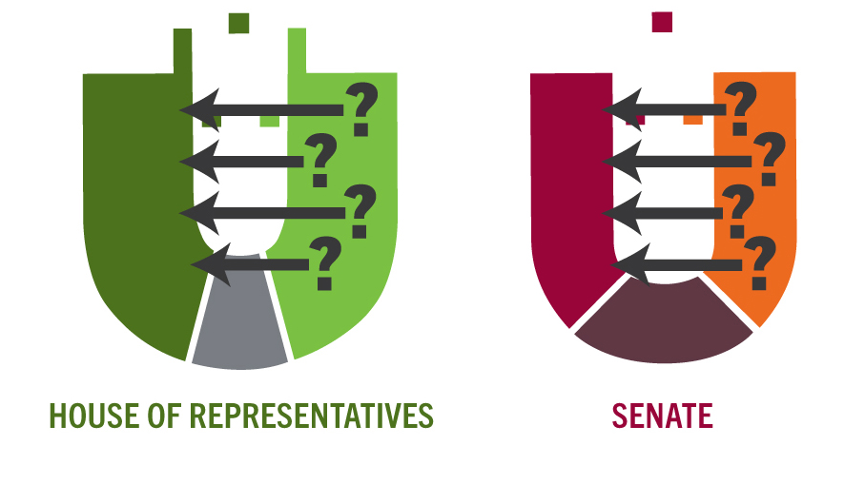
Democratic structures in Australia
BISEPSELRON MERGVENTON
RESPONSIBLE GOVERNMENT
Northern Territory Electoral Commission
www.ntec.nt.gov.au
Notes:
Students to unscramble letters
Responsible Government: tell students responsible government is a system where the executive is drawn from and accountable to the legislative, in other words, the government is held accountable by parliament. It is also referred to as a system of ‘checks and balances’. Tell students there are a number of mechanisms in place to keep government accountable, within parliament, but also outside of parliament.
Activity → Students given the names of the ways governments are held accountable, and they need to match them with their definition. There is also a definition for responsible government, and one for scrutiny of government.

Slide 13
Responsible government
Responsible government | System where executive is drawn from/accountable to legislative
Scrutiny of government | Any activity that involves examining and challenging government
Bicameralism | Two houses of parliament means dual scrutiny of bills.
Question time | Parliament can ask questions of government ministers
Scrutiny committees | Small groups of members that investigate bills and issues in detail
MPIs | Discussion in parliament about a government’s actions or policies
Bill debates | Passage of legislation involves bills being debated by all sides
Elections | Governments held accountable to the people through elections
Free media | Plays a role in bringing scrutiny to public attention
Northern Territory Electoral Commission
www.ntec.nt.gov.au
Notes:
Show students the answer slide – go through correct answers

Slide 14
Democratic structures in the NT | Undemocratic structures in the NT
NT has a fully elected Legislative Assembly, an elected executive and independent judiciary | NT has no Constitution (which is difficult to change) only the NT (Self-Government) Act (which is easy to change)
The NT (Self-Government) Act grants the NT state like (law and other decision making) powers | The NT (Self-Government) Act prevents NT control over 5 normally state decision making areas (like euthanasia)
Since 1977, NT electors can vote in Constitutional referendums. | NT votes in Constitutional referendums are not included in the ‘majority of states’ count (only ‘majority of votes’ count)
NT was part of SA from 1863 – 1911. During this time NT residents had representation in the SA Parliament. | In 1911 the NT was transferred to Commonwealth control. NT had no representation in the new federal parliament.
To form government a party or coalition must win 13 out of 25 seats in the NT Legislative Assembly | NT had no federal representation until 1922, but this member did not have full voting rights until 1968
NT Parliament has 5 Aboriginal members (20%) which is close to the 25 - 30% of Aboriginal people in NT population | NT had no local decision making authority until 1947, and then only a partially elected council until 1974.
NT Parliament is almost half women, and 6 out of 9 cabinet ministers are female (highest in any Australian cabinet) | The federal parliament (with 4 NT members out of 225) can overturn any decision made by NT Parliament, at any time
NT Legislative Assembly and council elections are set dates every 4 years | NT has 2 senators (states have 12) serving a variable 3 year term linked to House of Reps (fixed 6 year terms for states)
Territorians can be actively involved by voting, submitting responses to inquiries, petitions, viewing parliament etc. | Unicameral parliament – no upper house to scrutinise
Democratic Structures in the Northern Territory
Northern Territory Electoral Commission
www.ntec.nt.gov.au
Notes:
ACTIVITY: Democratic structures in the NT
Students (working in small groups) will be given a list of statements that describe these four democratic structures and how they exist (or don’t exist) in the Northern Territory. The NT is not a state and so these structures look different in the governing of the Territory, although some of the statements are from the past and things have changed. There are 2 headings: DEMOCRATIC and UNDEMOCRATIC, and students should now have a thorough understanding of democracy from the first activity! They just need to put each statement under a heading, there should be 10 statements under each heading.
*This activity is available online or we can send you a hard copy version (laminated). Just contact us at ntec@nt.gov.au or 1800 698 683
Show answers on click.

Slide 15
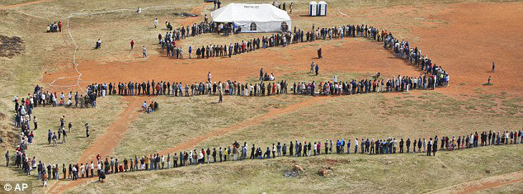
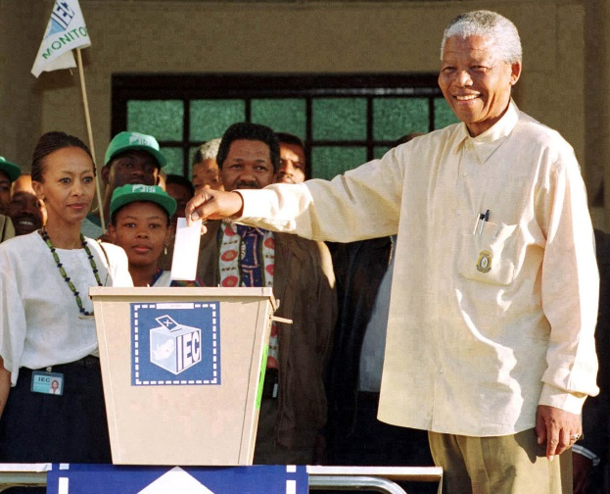
Democratic elections
FREE
FAIR
OPEN
REGULAR
CONTESTED
Northern Territory Electoral Commission
www.ntec.nt.gov.au
Notes:
A democratic election is one that is (show on click) Free, fair, open, regular and contested. Starting from the bottom one, elicit from students what a contested election is? (There is an actual ‘contest’, where voters have a real choice of candidates and/or political parties).
Ask students how often elections should be to be regular? How regular are parliamentary elections in the NT? (Set date every 4 years.) Council elections in the NT? (Set date every 4 years.) What about federal elections (lower house every 3-4 years, upper house every 6 years). Regular elections mean government is held accountable to the people for it’s decisions.
Click to show first picture. Tell students this is a famous image from the first open election held in a certain country in 1994. It is now a very famous and symbolic election where millions of people previously denied the right to vote, finally voted for the first time. What is the country? If they need a clue, show the second picture. Ask who is this man who won the election?

Slide 16
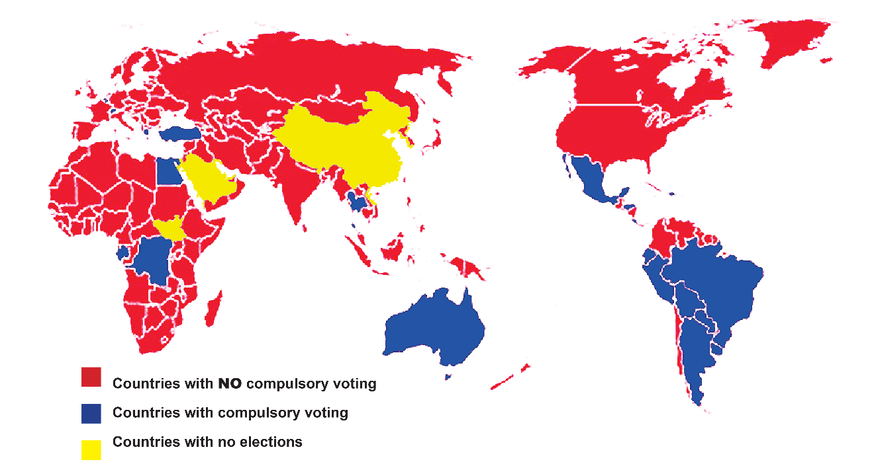
Open elections
Universal suffrage
Minimal limitations on voting, full voting services
Compulsory voting
Northern Territory Electoral Commission
www.ntec.nt.gov.au
Notes:
Ask students: Thinking about that South African election, what do you think an ‘open’ election is defined as? (Everyone can vote). Go through each dot point:
Universal suffrage - What does this mean? → universal = applicable to everyone, suffrage = the right to vote
(although obviously there are some restrictions to voting, what are they? → 18 years or over, Australian citizens)
Minimal limitations – there should be no barriers to anyone in accessing voting services. For example, in the USA voting is always held on a Tuesday (and only one day) and you must show photo ID to vote. In Australia voting is traditionally a Saturday, but we have 2 weeks of early voting too, and you do not need to show photo ID. In the NT there are many Aboriginal people living in remote areas that do not have a birth certificate, certainly don’t have photo ID, but they can still vote.
Compulsory voting: this means by law people must vote, and there is a penalty for not voting. This map shows other countries in the world that have compulsory voting (22 countries). If people have to vote, then full voting services must be provided, so compulsory voting tends to improve voting services. E.g. in Australia we have early voting, postal voting, mobile voting where services are taken into remote areas, aged care centres, hospitals and jails.

Slide 17
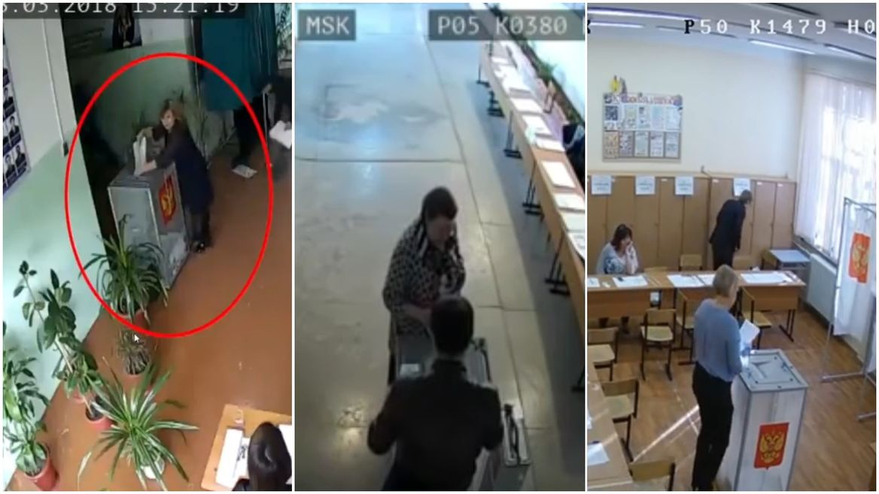
Fair elections
Everyone has one vote, and all votes are treated equally
All candidates are treated equally
There are laws and regulations to ensure there is no cheating in elections:
Electoral Act
Electoral Regulations
Local Government Act (c8)
Local Government
(Electoral) Regulations
Northern Territory Electoral Commission
www.ntec.nt.gov.au
Notes:
There are a lot of rules and laws in place for elections. This is to ensure that all voters are treated the same and all candidates are treated the same (show dot points) and to prevent cheating or ‘rigging’ of elections.
Show pictures. Tell students these are photos taken from CCTV footage from a national election in March showing electoral officials ‘stuffing’ extra papers into the ballot boxes. The Electoral Commission of this country said they cancelled all votes from voting centres where they received reports of ballot-stuffing. Has anyone seen this footage? (Easy to find on YouTube). What country was this from? (Russia) Who won that presidential election? (Vladimir Putin).

Slide 18
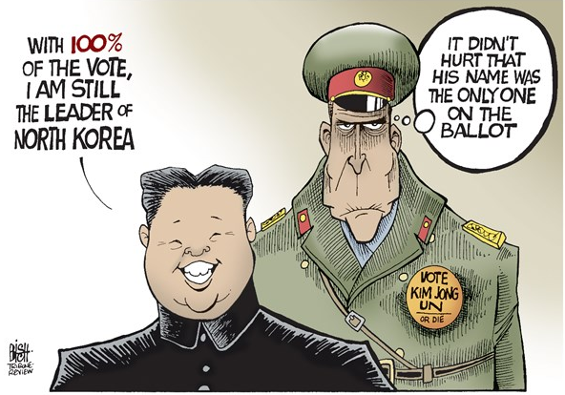
Free elections
Voters are free to choose whoever they want without fear of intimidation
Protections for voters
Secret ballot
Challenging for electronic voting
Northern Territory Electoral Commission
www.ntec.nt.gov.au
Notes:
Ask students: “What do I mean by a ‘free’ election?” Let them know it is not about the cost of elections as elections are expensive and are paid for with taxpayers money. Show answer on click.
Go through the dot points. Tell students in countries that don’t have free elections, people are pressured to vote a certain way. It can be as simple as a boss saying “if you don’t vote for this person, you’re fired.” And in some countries you vote in front of other people, either hands up in a room, or in front of voting officials – so it’s easy to find out who you voted for.
Electronic voting: keeping voters anonymous is proving challenging for electronic voting. If you wanted to vote online, say through your phone, you still need to get your name ticked off, or identified, but then you have to separate this from your actual vote. It’s difficult. There are other barriers too (hacking, cybersecurity, system being able to accommodate millions of votes in a short time period.)
North Korean elections: Click in picture. In North Korea you may be surprised to hear that they do have elections, however, there is only one name on the ballot papers (as chosen by the government). Voters are expected to agree with the nomination, by ticking the box (using a voting screen), but they are allowed to disagree. If you disagree, you have to go over to a special desk manned by officials, and get a red pen, cross out the name in red, then put the ballot paper in a special ‘no’ ballot box. Ask students: “is this a free election?” Tell students North Korea tends to get 100% turnout to their elections.

Slide 19

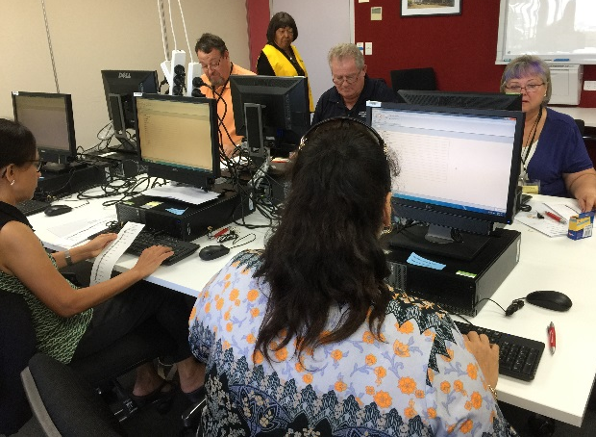
Voting systems
First past the post
Preferential
Proportional
representation
Northern Territory Electoral Commission
www.ntec.nt.gov.au
Notes:
Tell students we are now going to look at voting systems. While there are a few different voting systems, we will be looking at these 3:
First past the post, preferential and proportional representation (read them out on each click).

Slide 20

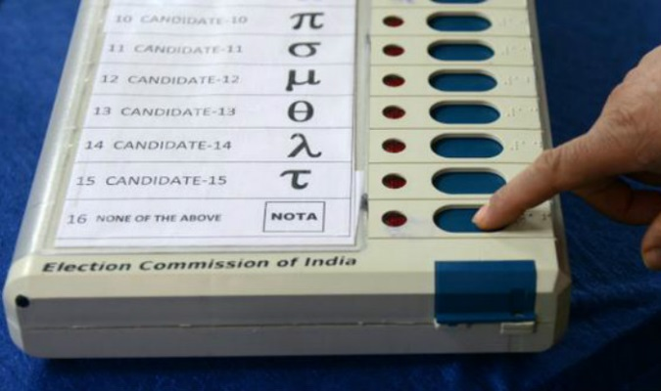
First past the post
Voters just have to mark the ballot paper once, next to the candidate of their choice.
The candidate with the most votes wins.
Used for government elections in almost one third of all countries including Canada, UK, India, Indonesia and the USA.
First past the post is no longer used in Australia (replaced in 1918).
Northern Territory Electoral Commission
www.ntec.nt.gov.au
Notes:
Tell students: The term ‘first past the post’ is a horse-racing term (pointing to picture) where there’s a post at the finish line and they use this to determine the winner. Obviously the first horse past that post, even by a nose, wins the race. It doesn’t matter how fast or slow the race is.
Ask students: how do you think we determine the winner of a first past the post election? (Most votes wins.)
Go through each dot point.
Point out bottom picture: tell students this is a voting machine that is used in India for their elections. India uses first past the post voting and voters just have to choose one person and push the button next to that person’s name to vote for them. The last button says “NOTA” or ‘none of the above’, and this a legitimate vote in Indian elections!

Slide 21
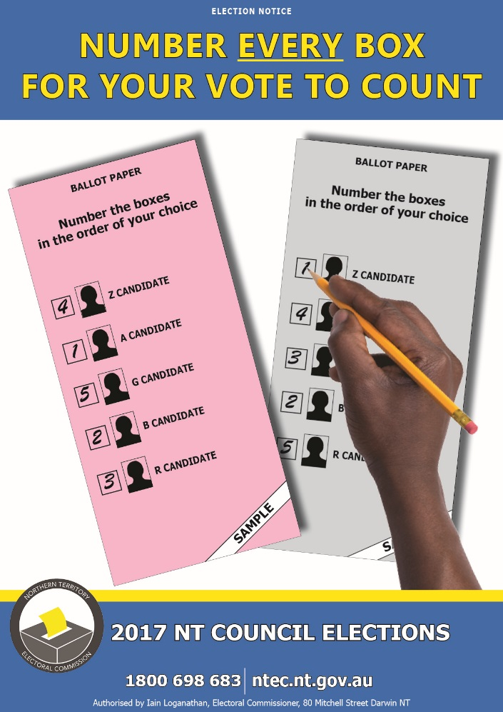
Full preferential voting
Voters must put a number against every candidate, in the order of their choice, starting with 1.
A candidate must get more than half the total formal votes to win (50% +1).
Used for most lower house elections in Australia (except TAS and ACT), and is a distinctly Australian system.
NT Legislative Assembly elections use optional preferential voting.
Northern Territory Electoral Commission
www.ntec.nt.gov.au
Notes:
Full preferential voting: go through each dot point, but really stress the first one as this is how students will need to vote in government elections once they are 18 years old. Point to the picture and show the examples. Ask students if this is how they have voted in past school elections (it usually is, but sometimes schools use first past the post).
Third dot point – some other countries refer to full preferential voting as the “Australian system”.

Slide 22
Proportional representation
Proportional representation is used for multi-member electorates.
Used for the federal senate, most state upper houses and many local government councils.
Voters must put a number against every candidate, in the order of their choice, starting with 1 (same as preferential).
A candidate must achieve the ‘quota’ (or proportion of formal votes) in order to win one of the positions available.
Total number of formal votes
Quota = + 1
Number of candidates to be elected + 1
Northern Territory Electoral Commission
www.ntec.nt.gov.au
Notes:
Go through each dot point:
Multi-member electorates mean electors are voting for more than one person to represent their area. All councils in the NT are multi-member electorates.
The senate and most state upper houses are multi member also. Ask students how many representatives does the NT get in the federal senate? (2) How many senators do states get? (12)
For voters, your instructions are the same as for preferential elections, number every square in the order of your choice.
It is the counting process that is different, although parts of it are similar to counting votes in a preferential election. Instead of an absolute majority of 50% + 1, any winning candidate has to reach a ‘quota’ which is calculated by this formula. Again, this is similar to preferential.
The counting process is complicated though, and results are usually scanned or entered into computers and then calculated by special vote counting software.

Slide 23

Counting votes
Full preferential voting – vote counting activity
Proportional representation – vote counting activity
Northern Territory Electoral Commission
www.ntec.nt.gov.au
Notes:
VOTE COUNTING ACTIVITY #1: students to count ballot papers using preferential voting system
On our website you can find pre-filled in mock ballot papers to print off and use for this vote counting activity. Otherwise you are welcome to run your own mock election, and then count those ballot papers.
Instructions for running your own election and for counting the votes can also be found on our website: Teachers instructions for mock elections and vote counting (Legal Studies).
VOTE COUNTING ACTIVITY #2: students to read results from proportional representation election
On our website you will find results sheet - proportional representation and instructions - how to read proportional representation results. Counting votes using the proportional representation system is complicated and done by computers. Students do not need to know this, but this information is provided for your interest.

Slide 24


Questions?
For further information ntec.nt.gov.au
Facebook.com/NTElectoralcommission
@NTElecComm
Northern Territory Electoral Commission
www.ntec.nt.gov.au

