Slide 1

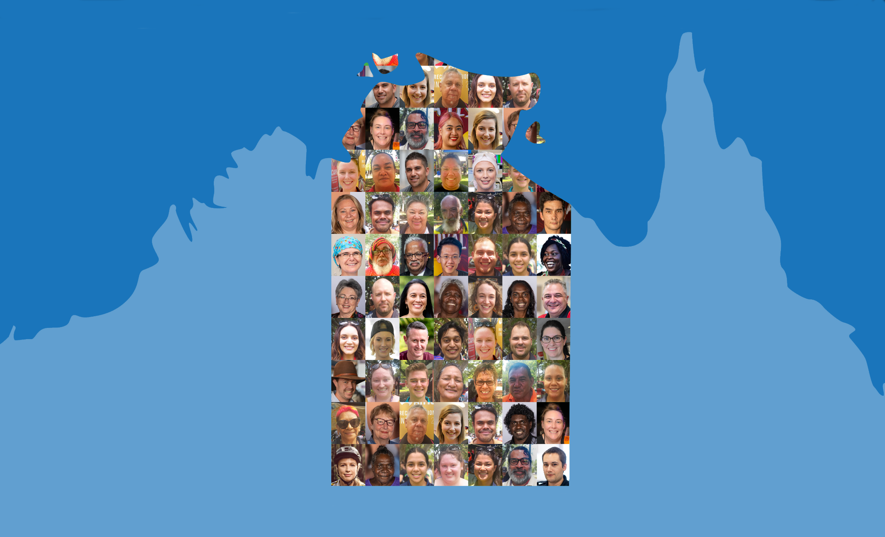

Northern Territory Electoral Commission
www.ntec.nt.gov.au
Notes:
Tell students: “Today we will be talking about voting, but it’s a special kind of voting where you give your opinion to a question, rather than voting for a person or a representative. We are going to start with me asking a few questions to you, specifically, as Year 7 students”

Slide 2
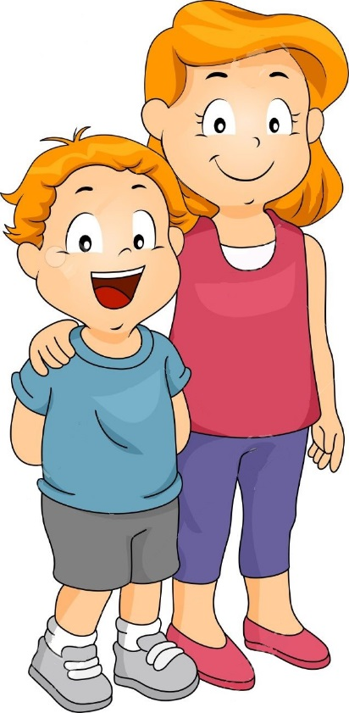

Answer YES or NO
Year 7 should be part of primary school
Territory
Primary Schools
Years T - 7
Year 7
Year 2
Northern Territory Electoral Commission
www.ntec.nt.gov.au
Notes:
Tell students they are YES or NO questions.
Read out the statement. Ask students: “Hands up for ‘yes’…. Hands up for ‘no’.” Confirm results

Slide 3

Answer YES or NO
Middle school should have exams for each year group just like senior school
Year 7
Northern Territory Electoral Commission
www.ntec.nt.gov.au
Notes:
Read out statement/question.
Ask students: “Hands up for ‘yes’…. Hands up for ‘no’.”
Confirm results

Slide 4

Answer YES or NO
School uniform should be optional in
middle school
Year 7
Year 2
Northern Territory Electoral Commission
www.ntec.nt.gov.au
Notes:
Read out statement/question.
Ask students: “Hands up for ‘yes’…. Hands up for ‘no’.”
Confirm results

Slide 5

What do we call this kind of vote?
R
e
f
e
r
e
n
d
u
m
Northern Territory Electoral Commission
www.ntec.nt.gov.au
Notes:
Ask students: “What do we call this type of vote, where you answer yes or no to answer a question?”
If required, click in some clues, ‘R’ then ‘m’.
Confirm if they have all heard this word before (usually they have).

Slide 6
Definition of referendum
REFERENDUM: a vote in which all the people in a country or area give their opinion about an important political or social question (dictionary definition)
CONSTITUTIONAL REFERENDUM: a vote on any proposed change to a country’s Constitution.
Northern Territory Electoral Commission
www.ntec.nt.gov.au
Notes:
Tell students: “This is the definition of a referendum,” read out definition in full. (After ...‘country or area’ you could elaborate and say “for example the NT, who have had a referendum just for people in the NT).
Tell students: “Then there is a constitutional referendum, which is [read out definition in full]”. “To understand this, you need to know…” (next slide)

Slide 7
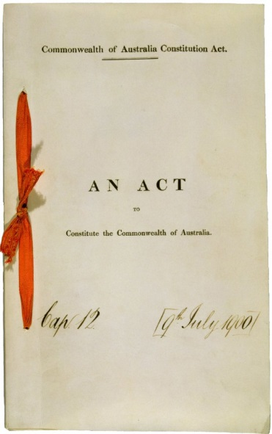
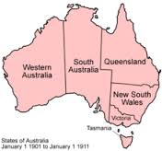
What is the Constitution?
AUSTRALIAN CONSTITUTION
The Australian Constitution is the set of rules by which
Australia is run.
FEDERATION
Federation was the process by which 6 separate British colonies agreed to unite to form the Commonwealth of Australia. This happened
1 January, 1901.
Northern Territory Electoral Commission
www.ntec.nt.gov.au
Notes:
Ask students: “What is the Constitution?” Confirm answer with click to show definition. (Students may say it’s the law, or a book of laws, let them know this isn’t correct, though many people think this.). Show picture. (Note: the picture is of the Constitution of the Commonwealth of Australia Act, which was the act (law) that passed through British Parliament which installed the Constitution in Australia.)
Ask students: “When did we get the Constitution?” (1901) “What happened in Australia at the time, that gave us the Constitution?” (Federation). Show formal definition of federation. Show picture.
Ask students: “What’s interesting about this picture?” (No NT, or NT is part of SA).
Elaborate: NT became part of SA in 1863 when SA bought the NT from NSW. Not too long after, SA no longer wanted the NT under their control (too expensive) but did not have any options. The Constitution has a special section (s126) that allows the states to ‘surrender’ any territories to Commonwealth control. SA did this in 1911, and NT is still under Commonwealth/federal control, although we now have self-government.

Slide 8
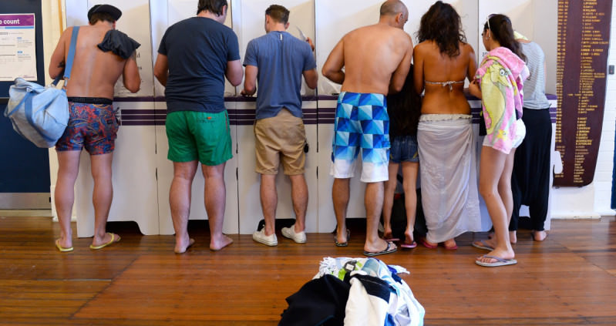
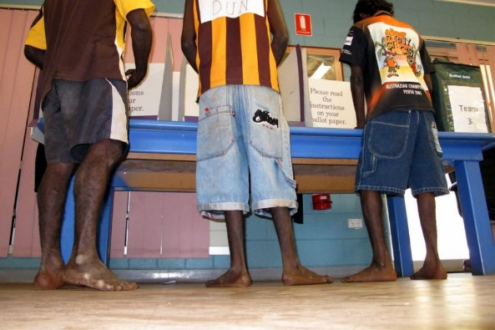
Definition of referendum
REFERENDUM: a vote in which all the people in a country or area give their opinion about an important political or social question
CONSTITUTIONAL REFERENDUM: a vote on any proposed change to a country’s Constitution
PLEBISCITE: a referendum, sometimes called an advisory referendum, that does not affect the Constitution.
Northern Territory Electoral Commission
www.ntec.nt.gov.au
Notes:
Tell students: “Back to our definitions. We know about referendums, and constitutional referendums, but there’s another word that’s used... ‘plebiscite’. Has anyone heard of this word?”
Show definition, tell students: “Plebiscite is the same as a referendum [read out referendum definition again] these words are interchangeable.”
Elaborate: Sometimes people just say referendum when they really mean a constitutional referendum, and these are different.
Show pictures: When we have constitutional referendums, and for some regular referendums, these are treated like every other election. People go into voting centres to cast a vote, where they write down their opinion to the referendum question.

Slide 9
Differences between….
Constitutional Referendums
Only for proposed changes to the Constitution
Bill must passed by both houses of parliament first, then the people vote, then given Royal Assent if passed.
Parliament bound by result of vote
Compulsory for all eligible voters
Voters must write YES or NO to the proposed change
Plebiscites
Can be a question about anything, usually a political or social question
People vote first (to inform debate), then voted on by parliament, then given Royal Assent if passed.
Parliament not bound by result of vote
May or may not be compulsory
How to answer question may vary
Northern Territory Electoral Commission
www.ntec.nt.gov.au
Notes:
Tell students: “Let’s look at how constitutional referendums are different to regular referendums, which we’ll call plebiscites to be very clear.”
Click through each one individually, reading them out in full.
For the second point, first ask students how laws are made, the basic steps → bill proposed, debated, voted on, if gets majority is passed. For most states and at the federal level – but not NT – bill then goes to a second house for the same process. Once passed by both houses it must be given ‘royal assent’ by the Queen’s representative. In NT this is the Administrator – who can only give assent, not ‘royal’ assent as the Governor-General can or state governors.)
The go through the second point highlighting this important difference between constitutional referendums and plebiscites.

Slide 10
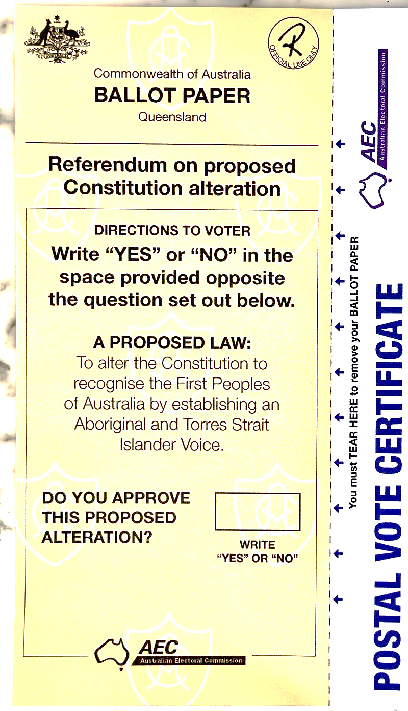
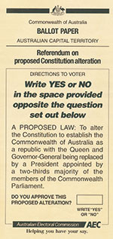
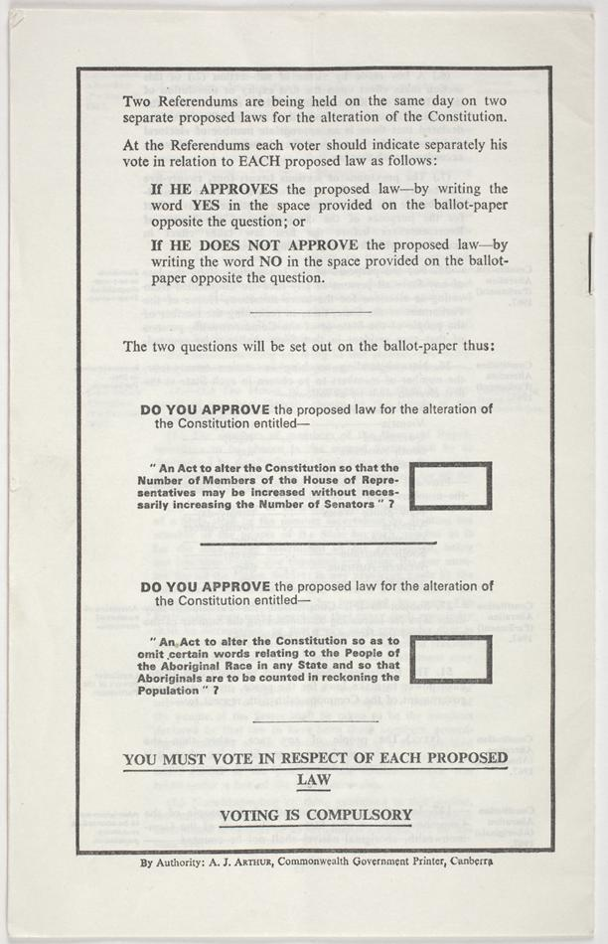
Some examples – Constitutional Referendums
Voice 2023
Republic 1999
Aboriginal people counted 1967
Northern Territory Electoral Commission
www.ntec.nt.gov.au
Notes:
Tell students: “Let’s look at some real life examples of constitutional referendums”.
Voice referendum: This was the first constitutional referendum in Australia in over 20 years.
Ask students: “What was the result of this constitutional referendum? Are we a republic?” (No)
Republic and Preamble: Prior to the voice referendum, the next most recent constitutional referendum was held in 1999. The change was about Australia becoming a republic, which means independent of Britain, and the King would no longer be our head of state. (Students may have further questions about what being a republic means.)
Ask students: “What was the result of this constitutional referendum? Are we a republic?” (No)
1967 referendum: The Constitutional includes information about counting the national population or the ‘census’ and originally stated that Aboriginal people were not to be included in this count “…Aboriginal natives shall not be counted”. The referendum in 1967 proposed removing this exception to include Aboriginal people in any population calculations.
Ask students: “What was the result of this referendum?” Are Aboriginal people included in the census? (Yes)
This referendum is now seen as significant in the history of Aboriginal rights. It sometimes confused with Aboriginal people being given right to vote (this happened by law in 1962 – at federal elections) and Aboriginal people being granted citizenship (this happened, along with everyone else, in 1949 when Australian citizenship was introduced.)

Slide 11
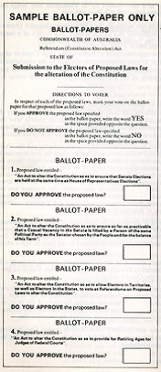


Some examples – Constitutional Referendums
1977 Referendums
An Act to alter the Constitution so as to allow electors in Territories, as well as electors in the States, to vote at referendums on proposed laws to alter the Constitution.
Northern Territory Electoral Commission
www.ntec.nt.gov.au
Notes:
In 1977 there was a constitutional referendum asking if people living in Territories (there are 10 territories in Australia) should be allowed to vote in referendums. They were not included in the Constitution originally because the Constitution is very focused on the states, and the relationship between the states and the federal parliament. There is very little mention about territories. This means people living in Australian territories have different constitutional rights to those in states.
Ask students: “What was the outcome of this referendum?” Yes, Territorians can vote in referendums, but ironically they did not vote in this one in 1977.
(Territory referendum votes are counted differently though, but this is explained on a later slide.)

Slide 12
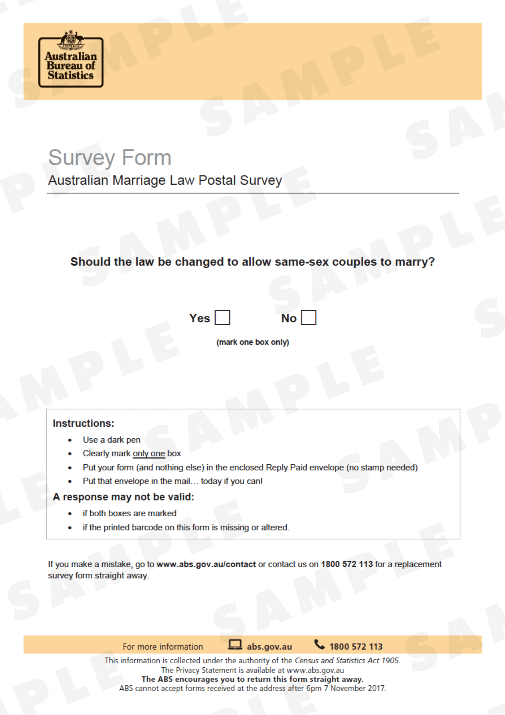
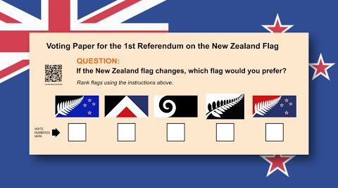
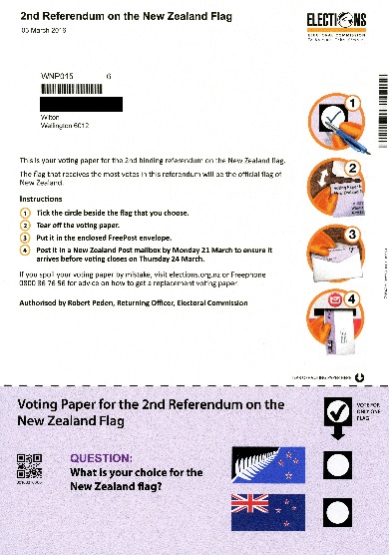
Some examples – referendums/plebiscites
Northern Territory Electoral Commission
www.ntec.nt.gov.au
Aboriginal people counted 1967
Notes:
Here are some examples of recent referendums/plebiscites (and different ways of voting).
Left: Ask students if they know of the most recent non-constitutional referendum held in 2016 about changing a law in Australia (give hint, it was about definition of marriage). It was called the ‘same sex marriage survey’ as was done as a national postal vote. This was an optional referendum, not compulsory. Instead of writing yes or no, voters had to tick the relevant box.
Top right: In 2015 NZ held a referendum about a new NZ flag. Anyone could put through ideas, from which 5 were chosen for the people to choose from. Voters were to vote preferentially in order of 1,2,3,4,5.
Bottom right: In 2016 the second phase was for voters to choose from the winner of the first referendum and the existing NZ flag. This was a postal vote and the picture on the slide is the actual letter sent to voters. Voters had to tick their preferred option. Ask students what the result was. (Existing NZ flag)

Slide 13
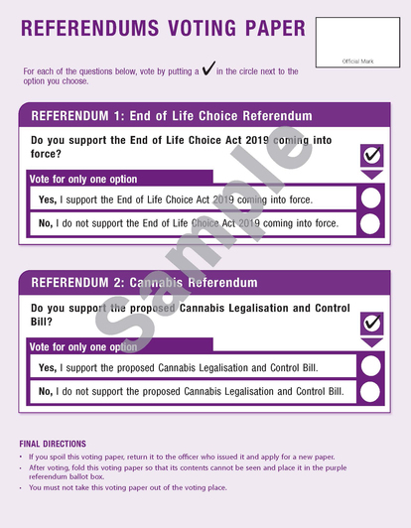
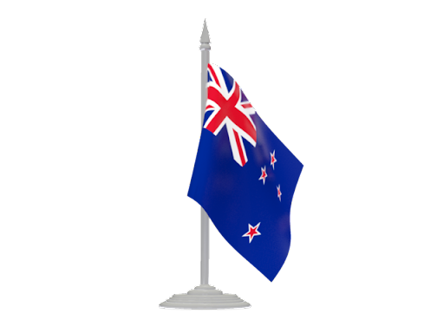
Some examples – referendums/plebiscites
Outcome of referendums
End of Life Choice referendum:
65.9% - Yes
34.1% - No
(law came into effect 7 November 2021)
Cannabis referendum:
48.8% - Yes
51.2% - No
Turnout for the referendums was 82%
Northern Territory Electoral Commission
www.ntec.nt.gov.au
Notes:
New Zealand had more recent referendums in 2020 – held at the same time as their parliamentary elections.
End of Life Choice referendum: in 2019 the NZ parliament passed a bill to make voluntary euthanasia legal (if terminal illness and less than 6 months to live). The bill passed with the condition that the law would only come into force if agreed to by the people in a referendum. The question asked was “Do you support the End of Life Choice Act 2019 coming into force?” This referendum was binding as parliament had already passed the bill.
This is the first euthanasia referendum in the world.
Cannabis referendum: A proposed bill had been drafted to legalise the sale, use, possession and production of recreational cannabis. The referendum asked “do you support the proposed Cannabis Legislation and Control Bill?” This referendum was not binding as the bill had not passed through parliament yet.

Slide 14
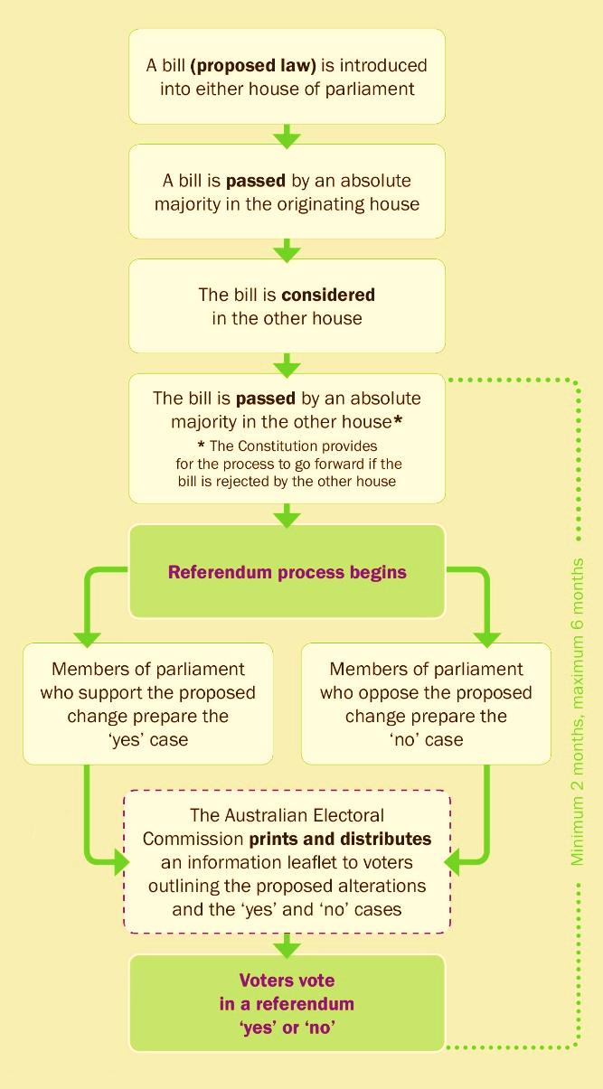
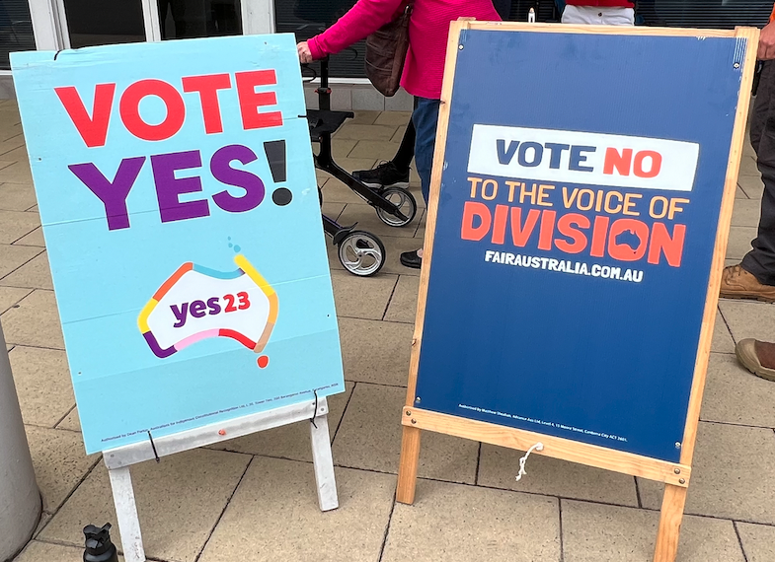
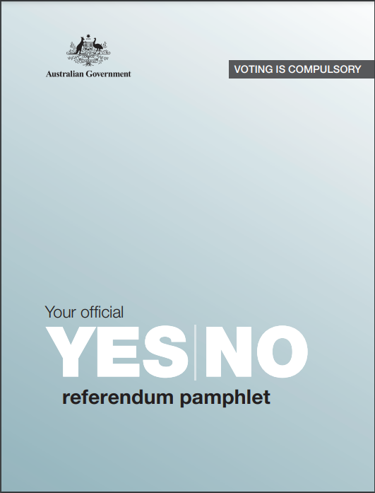
Constitutional referendums
There is a process that must be followed in order to change the Australian Constitution
Northern Territory Electoral Commission
www.ntec.nt.gov.au
Notes:
An earlier slide touched on this already…
There is a process by which constitutional referendums must go through. First the constitutional change goes through federal parliament as a bill. The bill is introduced and later debated and voted on. If it passes, it then goes to the other house for debate and a vote. If it is passed by the second house, it does not go straight to royal assent, instead the referendum process begins. It is up to those members of parliament who voted yes for the change to prepare a ‘yes case’ (reasons why voters should vote yes) and those members of parliament who voted no prepare the ‘no case’. This information is sent out to all voters so that they are fully informed about both sides of the debate. A referendum election is then held where voters either write yes or no to the proposed change. This must be held within 2 – 6 months after the bill passed in parliament.
The last click will bring examples of the yes and no campaigns from the Voice referendum, as well as the official pamphlet from the AEC that provides information for both sides.

Slide 15
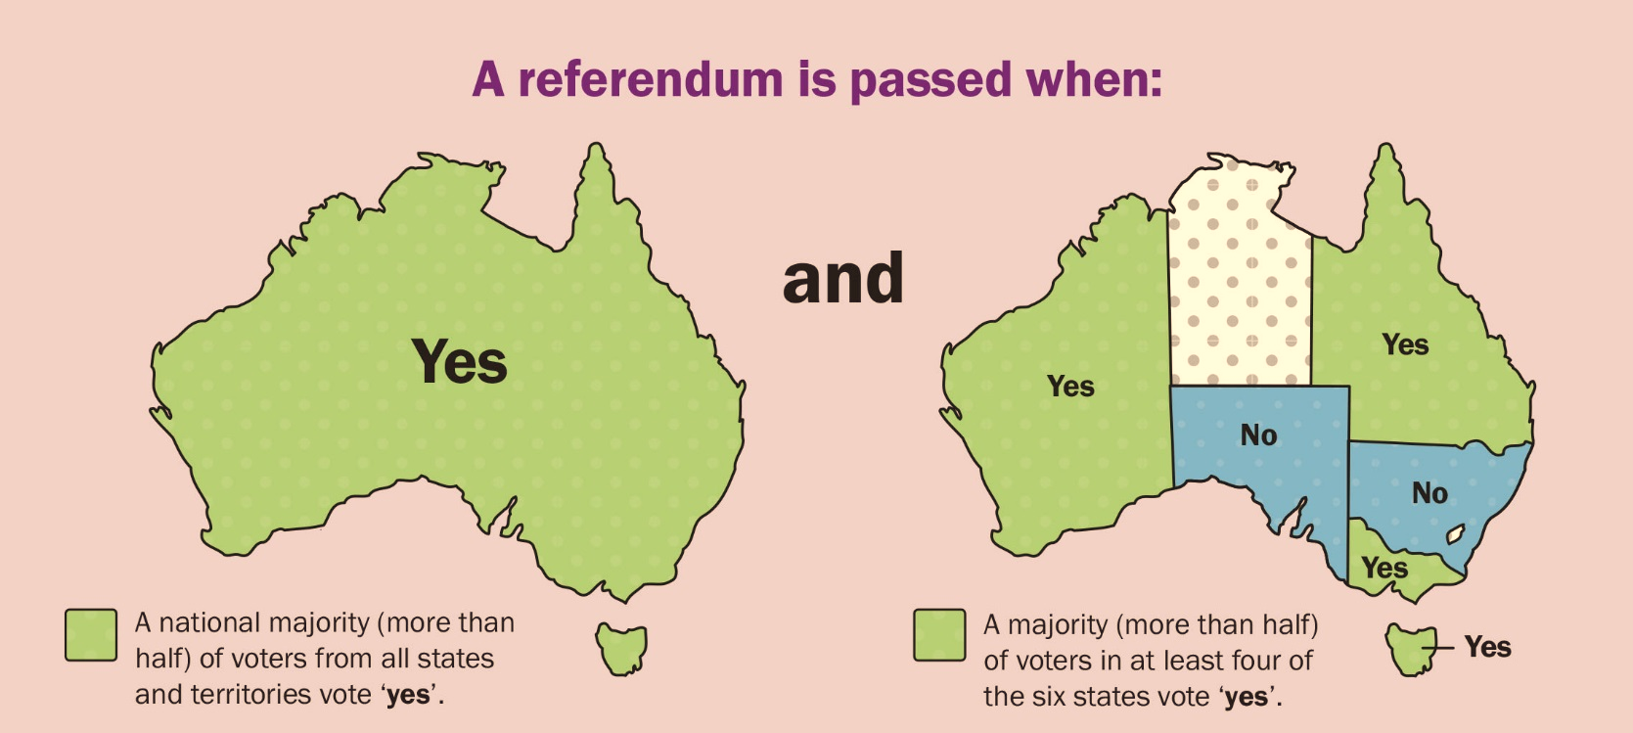
Double Majority
For a constitutional referendum to be successful it must be approved by a DOUBLE MAJORITY of voters:
A national majority of all voters from all states and territories
A majority of voters in a majority of states (i.e. at least 4 out of 6 states)
Northern Territory Electoral Commission
www.ntec.nt.gov.au
Notes:
Tell students that once the voting has been done, it is time to count the votes, and there are two stages to the counting process. This is because for a referendum vote to pass, you need what is a called a ‘double majority’. On each click explain the 2 yes majorities needed to pass a referendum (majority meaning more than half):
A majority of voters (from across Australia as a whole) who voted yes
AND a majority of states (4 out of 6) who resulted in a majority yes vote (show picture)
Both of these must be achieved for the referendum to pass, and therefore for the constitutional change to be made.
Ask students: “What’s interesting about the states’ map?” NT (nor ACT) are counted with the majority of states, this is states only, but we are counted in in the first part, looking at the majority of Australia as a whole. This is because the Constitution really only talks about the states, and not territories, and this is one of the differences between states and territories.

Slide 16
Which referendums passed?
PROPOSAL | YEAR | NATIONAL % OF YES VOTES | STATES WITH MAJORITY OF YES VOTES
Give Commonwealth power over essential services | 1926 | 43% | NSW, QLD
Give Commonwealth power to legislate on social services | 1946 | 54% | ALL
Include Aboriginal people in population counts (census) | 1967 | 91% | ALL
Have Senate and House of Rep elections at the same time | 1977 | 62% | NSW, VIC, SA
Make Australia a Republic with President as head of state | 1999 | 45% | NONE
Introduce an Aboriginal and Torres Strait Islander Voice | 2023 | 40% | NONE (ACT – 61% YES)
Of the 45 Constitutional Referendums in Australia, only 8 have passed
Northern Territory Electoral Commission
www.ntec.nt.gov.au
Notes:
ACTIVITY: Tell students here are the results of past constitutional referendums in Australia. They need to tell you which ones passed because they achieved the required ‘double majority’. Go through each one individually, asking students “did it pass?” [Only 2 (social services) and 4 (Aboriginal count) passed.]
Show last sentence and read it out loud. Tell students it is deliberately difficult to pass referendums, the Constitution wasn’t designed to be changed easily and often, only when it really is what the people/society want.

Slide 17

Mock referendum
Should fireworks be legal for personal use on special days?
Northern Territory Electoral Commission
www.ntec.nt.gov.au
Notes:
MOCK REFERENDUM ACTIVITY - Tell students it is now time to vote in pretend/mock referendum to see how they work.
The question they will be voting on is (show on click) whether fireworks should be legal for personal use on special days.
(Don’t forget second click for the animated gif!)
Ask students: Where else in Australia are fireworks legal like what we have on firecracker night here in the NT (where you can buy your own, and let them off at home or around your neighbourhood)? (No other state or territory has legal fireworks like we do. Still have fireworks displays though, run by professionals.)
Tell students: This referendum is a national question that is being run in all states and territories in Australia (pretend of course). ‘Special days’ just means that in addition to Territory Day there would be other set days like maybe New Year’s Eve, Australia Day etc. It will only involve set days, and not just any day you like. So the only big change for us (NT) would be extra ‘firecracker nights’ a year.

Slide 18
Yes and No cases
YES Fireworks should be legal on special days
Traditional Territory Day celebration
Already restrictions for safety
Most people responsible
Good for economy
NO Fireworks should NOT be legal on special days
Already banned across Australia
Dangerous
People don’t follow the rules
Bad for dogs and dog owners
Northern Territory Electoral Commission
www.ntec.nt.gov.au
Notes:
Tell students: “Remember in the referendum process the members of parliament for each side prepare information for the public about the ‘yes case’ and the ‘no case’. It is now time for you to be informed about both cases.”
Ask for 4 volunteers: 2 for the yes case and 2 for the no case. Hand each pair either the yes or no prompt cards (available on our website). Each pair will alternate and read out the 4 dot points for either the yes or no case. Have the students read the yes case first, then show the summary on first click, then hear the no case, then click in the no summary. Let students know it is now time to vote!
VOTING: Before handing out the ballot papers (available on our website) remind/ask students how they need to vote → write down the words YES or NO in the box on the ballot paper. Have a voting area with screens/partitions for a private vote, and let students know this is where they go to vote (you may want to discuss secret voting). Have a ballot box and put it in a separate space to the voting area to help clear students out. Tell students to put their completed ballot paper in the ballot box. They may ask if they need to fold it, it is up to them, but for privacy they may like to fold it once (only once as it is easier to count with less folds)

Slide 19
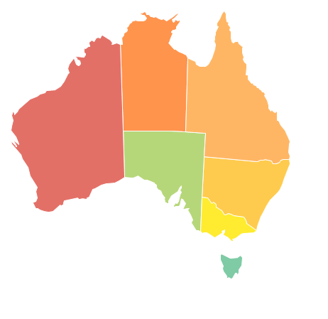
Referendum results
A double majority is required for this referendum
NATIONAL % VOTES
51% YES
49% NO
% VOTES BY STATE/TERRITORY
check white board
87% YES
90% YES
55% NO
65% YES
95% YES
62% NO
86% NO
Northern Territory Electoral Commission
www.ntec.nt.gov.au
Notes:
Before you click further on this slide count the votes first (just show the heading). Get 2 students to do the count.
COUNT: First separate the votes into 2 piles → yes and no. If there are any informal votes (like “maybe” or blank ones) these need to be taken out. Then count each pile. Write the results up on white board: total yes votes, total no votes, informal votes (if any), total votes. Convert the results to a percentage. (Yes votes/total votes x 100, no votes/total votes x 100, informal votes/total votes x 100.) Circle either the yes or no % with the winning majority (over 50%).
RESULTS: On first click, remind students that a double majority is required. Tell them we’ll first look at the national vote, as this referendum was done across Australia. Show result. It’s close! Tell students that so far there is a majority yes vote, we now need to check the state votes. Click to show map. Tell students they can use the circled % amount on the white board as the result for all NT. Ask if the double majority was reached. (They usually say yes straight away, BUT it’s a trick ☺, only 3 states have a majority yes, the other yes votes are from territories and therefore do not count.)
The overall result is a no, because a double majority was not reached (4 states with yes vote required).

Slide 20


Questions?
For further information ntec.nt.gov.au
Facebook.com/NTElectoralcommission
@NTElecComm
Northern Territory Electoral Commission
www.ntec.nt.gov.au

