Slide 1

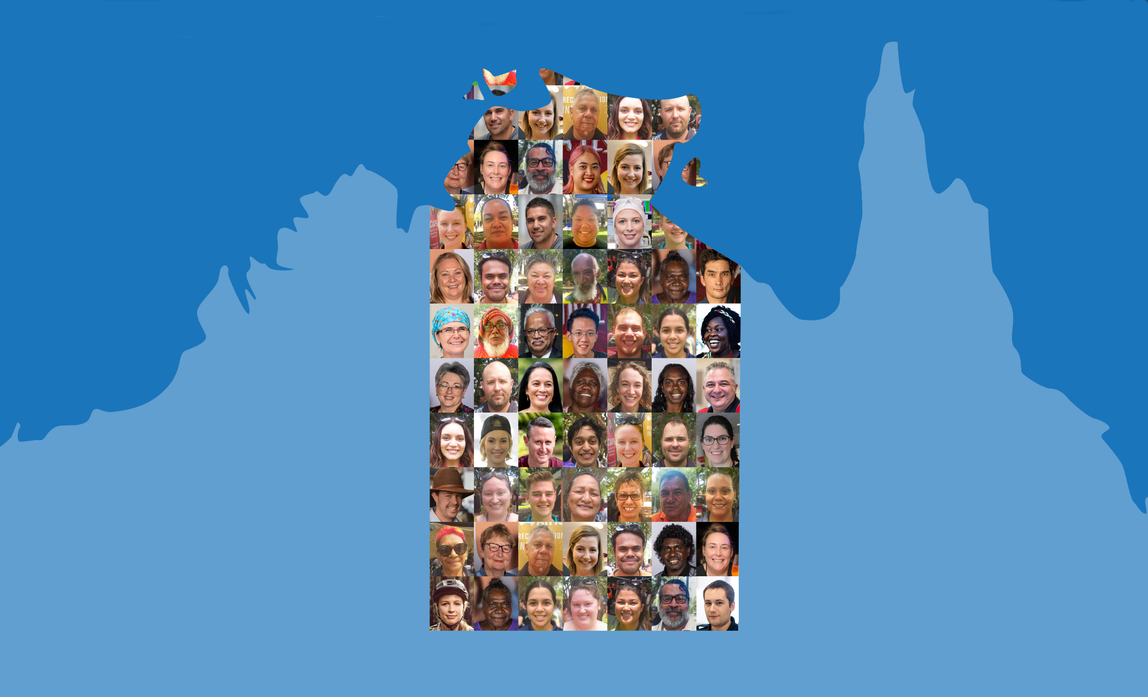

Northern Territory Electoral Commission
www.ntec.nt.gov.au

Slide 2
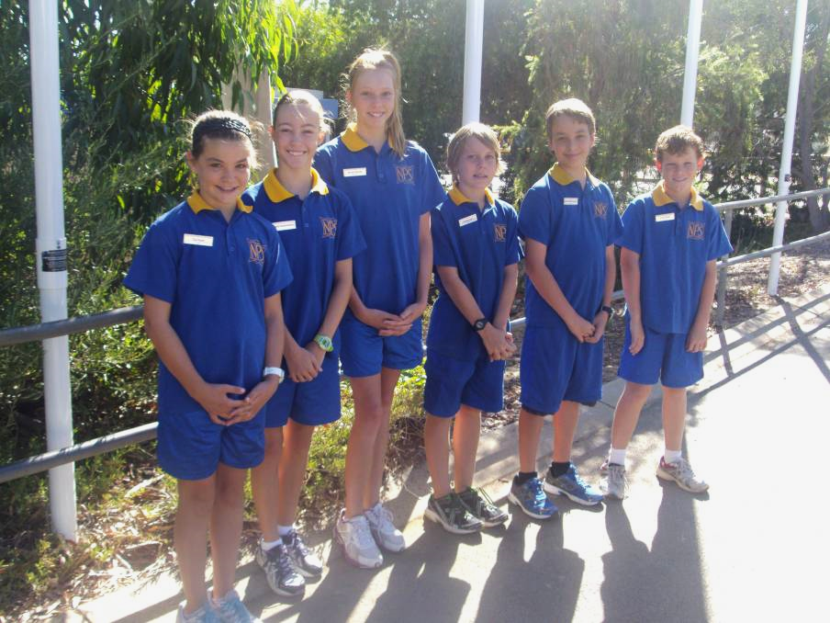
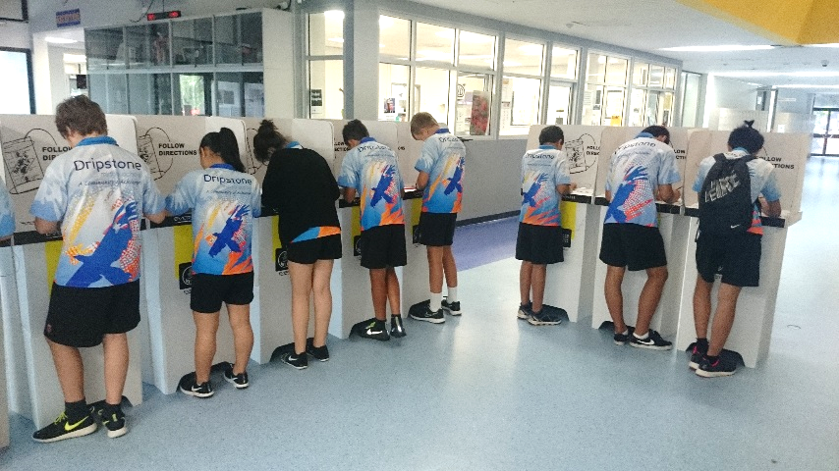
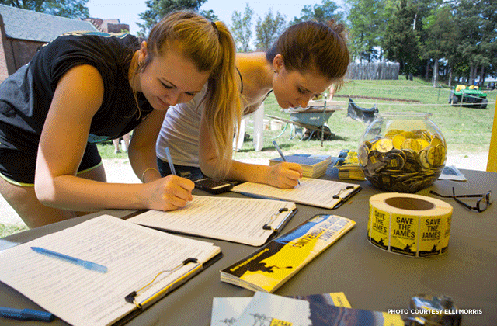
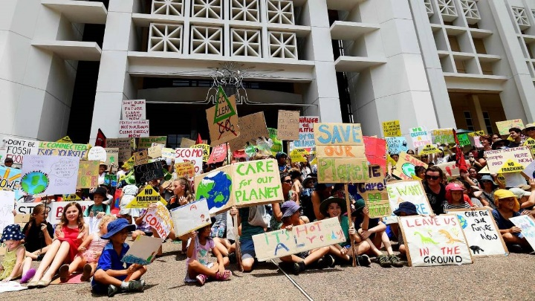
Have you ever participated in….?
Northern Territory Electoral Commission
www.ntec.nt.gov.au
Notes:
Start by asking students if they have ever… (each picture will come through with click)
1st picture: “Voted in a school based election?” – maybe for student representatives or house captains?
2nd picture: “Run as a candidate or been voted in as a student representative or house captain?”
3rd picture: Start by asking students what are these girls doing? (Signing a petition.) Ask what a petition is. Then ask “has anyone ever signed a petition?”
4th picture: Ask students what are these students doing? (Protesting/doing rally or march) Ask “has anyone ever participated in a protest/rally/march?” Ask “what issue were you protesting?”

Slide 3
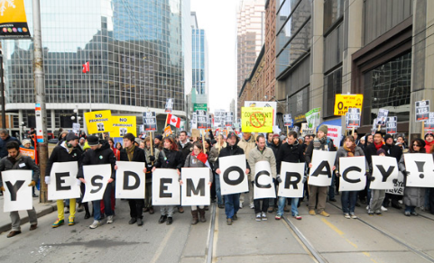
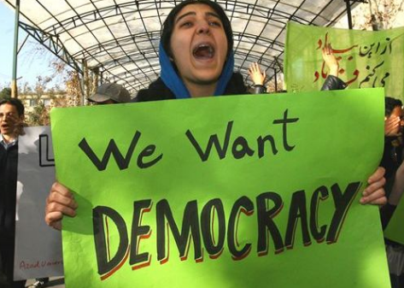
Democracy definition
Government by the people, or by their elected representatives
“Government of the people, by the people, for the people”
- Abraham Lincoln
Northern Territory Electoral Commission
www.ntec.nt.gov.au
Notes:
Ask students: “What is democracy? Can anyone give me a definition?” Give assistance and prompts if required. Show answer on click. Ask students what the most important word in the definition is → people.
Show the famous quote about democracy, read it out loud and tell students this is a very famous saying by a very famous leader. Who was he? Show answer on click.
Explain that in Australia we have democracy, but not all countries around the world are democracies. These are photos from countries that do not have democracy, and in some places that do not have democracy, it is actually illegal to march down the street and protest.

Slide 4
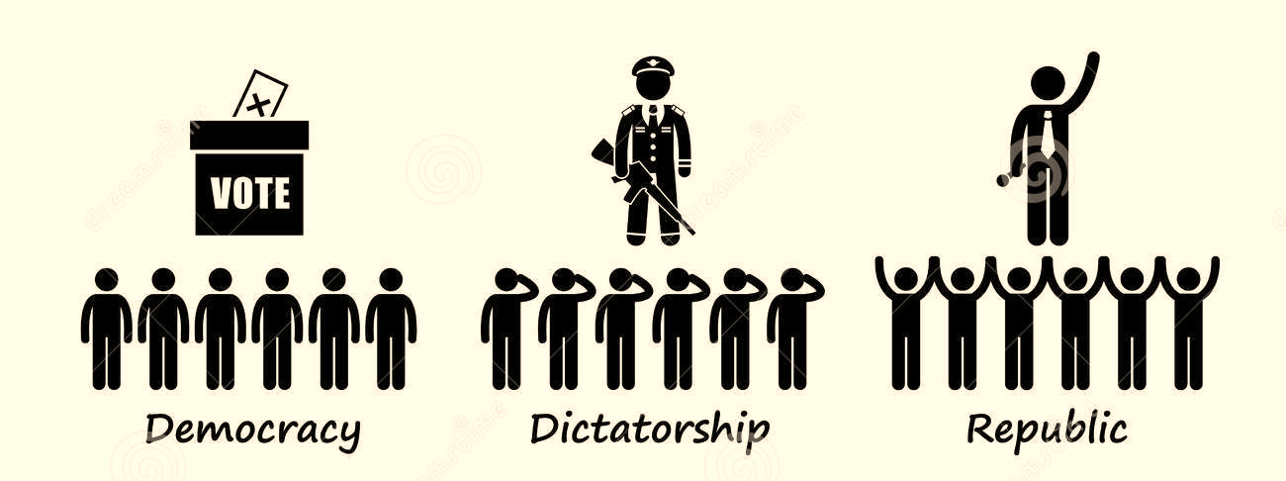
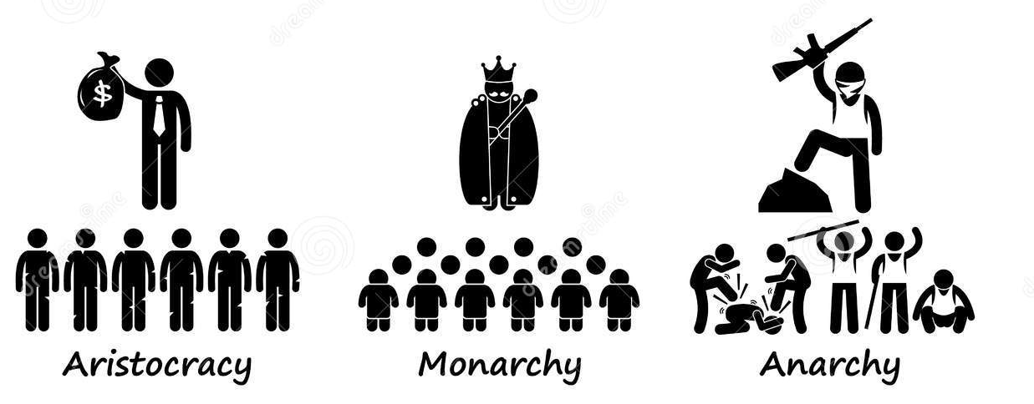
Features of a democracy
RIGHTS and FREEDOMS
RULE OF LAW
MAJORITY RULE
DEMOCRATIC ELECTIONS
Everybody must follow the law and everyone is equal before the law
Free, fair, open and contested elections that are held regularly
Powers to make choices about how you live your life and be treated fairly
Decisions are made when more than half agree, but minority groups are protected
Northern Territory Electoral Commission
www.ntec.nt.gov.au
Notes:
Tell students there is more to democracy than just voting, democracy is made up of….
Read through each feature on the left.
ACTIVITY: Tell students you will bring up a definition on the right side and they must match it to the correct feature on the left. Go through each one individually.

Slide 5
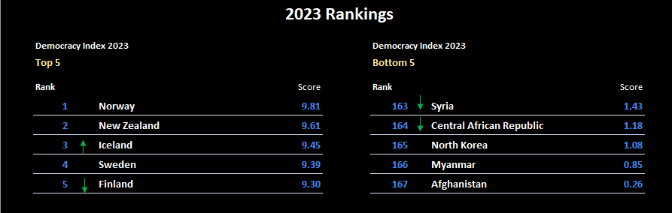
Democracy Index
14 Australia 8.66
Northern Territory Electoral Commission
www.ntec.nt.gov.au
Notes:
Tell students there is a group of international researchers that measure democracy around the world, and rate each country in order, to produce an annual ‘Democracy Index’. Including the features we just looked at, they have 60 indicators that they use to measure democracy in most countries in the world.
Ask students: “What countries do you think are at the top of the most recent index, i.e. what are the most democratic countries around the world, and where do you think Australia is ranked on the list?” Elicit a few ideas and confirm any countries they get right. Before showing results, also ask what country they think is ranked the least democratic country in the world.
Show results on click, including Australia (second click). May want to comment that New Zealand is ranked very high at #2, and increased their score over the last year. Australia dropped 15 places from 2021-22 and now sits at #15.

Slide 6
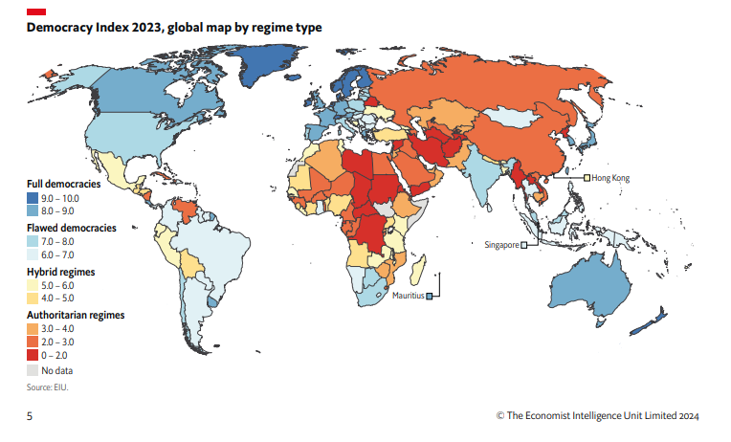
Northern Territory Electoral Commission
www.ntec.nt.gov.au
Notes:
Tell students this is a map that shows the ranking of all the countries that were measured (167 countries) in putting together the Democracy Index. Read out the 4 categories of democracies on the left hand side.
Interesting to point out:
The US is not considered a ‘full democracy’. There are 23 countries that measured over 8 out of 10 and are therefore ‘full democracies’. The USA ranked 25, on 7.92.
South Korea and Japan have recently improved to ‘full democracy’ status, and are the strongest democracies in Asia.
Most countries in Africa are ‘authoritarian’, as are Russia and China.

Slide 7
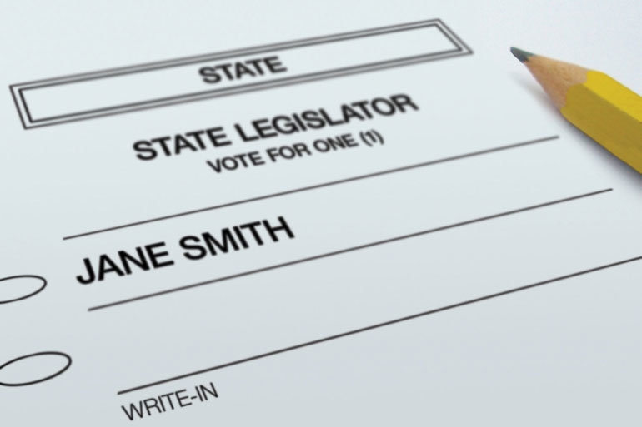
Democratic elections
FREE
FAIR
OPEN
REGULAR
CONTESTED
Northern Territory Electoral Commission
www.ntec.nt.gov.au
Notes:
Tell students: One of the areas measured is how democratic the countries’ elections are. A democratic election is one that is [click in list]:
Free, fair, open, regular, and contested (read out loud).
Starting at the bottom, ask students: What is a contested election? Show picture. (One where there is multiple candidates to choose from, and that voters have ‘real choice’). Ask students: what happens if only one person puts their hand up for a position? They automatically get that position. Do we run an election? No. Ask: have ‘the people’ chosen their representative in this case? No, so we want multiple candidates where possible. Let students know that sometimes there are uncontested elections in the NT, especially in remote areas with a smaller population.
Ask students: How regular do elections need to be? How regular are they in the NT? (NT parliament every 4 years, NT councils every 4 years, at federal level it’s every 3-4 for House of Reps and every 6 years for the Senate, except for NT senators, they are every 3-4 years with House of Reps). Elections need to be regular so that governments are actually held accountable to the people for the decisions that they make.

Slide 8
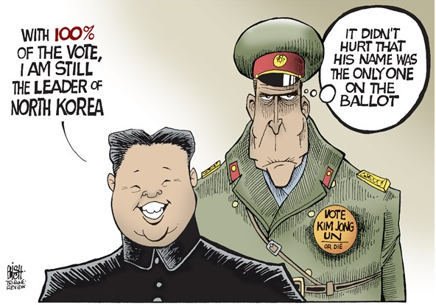
Free elections
Voters are free to choose whoever they want without fear of intimidation
Protections for voters
Secret ballot
Challenging for electronic voting
Northern Territory Electoral Commission
www.ntec.nt.gov.au
Notes:
Ask students: “What do I mean by a ‘free’ election?” Let them know it is not about the cost of elections as elections are expensive and are paid for with taxpayers’ money. Show answer on click.
Go through the dot points. Tell students in countries that don’t have free elections, people can be pressured to vote a certain way. It can be as simple as a boss saying “if you don’t vote for this person, you’re fired.” And in some countries you vote in front of other people, either hands up in a room, or in front of voting officials – so it’s easy to find out who you voted for.
Electronic voting: keeping voters anonymous is proving challenging for electronic voting. If you wanted to vote online, say through your phone, you still need to get your name ticked off, or be identified, but then you have to separate this from your actual vote. It’s difficult. There are other barriers too (hacking, cybersecurity, system being able to accommodate millions of votes in a short time period.)
North Korean elections: Click in picture. In North Korea you may be surprised to hear that they do have elections, however, there is only one name on the ballot papers (as chosen by the government). Voters are expected to agree with the nomination, by ticking the box (using a voting screen), but they are allowed to disagree. If you disagree, you have to go over to a special desk manned by officials, and get a red pen, cross out the name in red, then put the ballot paper in a special ‘no’ ballot box. Ask students: “is this a free election?” Tell students North Korea tends to get 100% turnout to their elections.

Slide 9
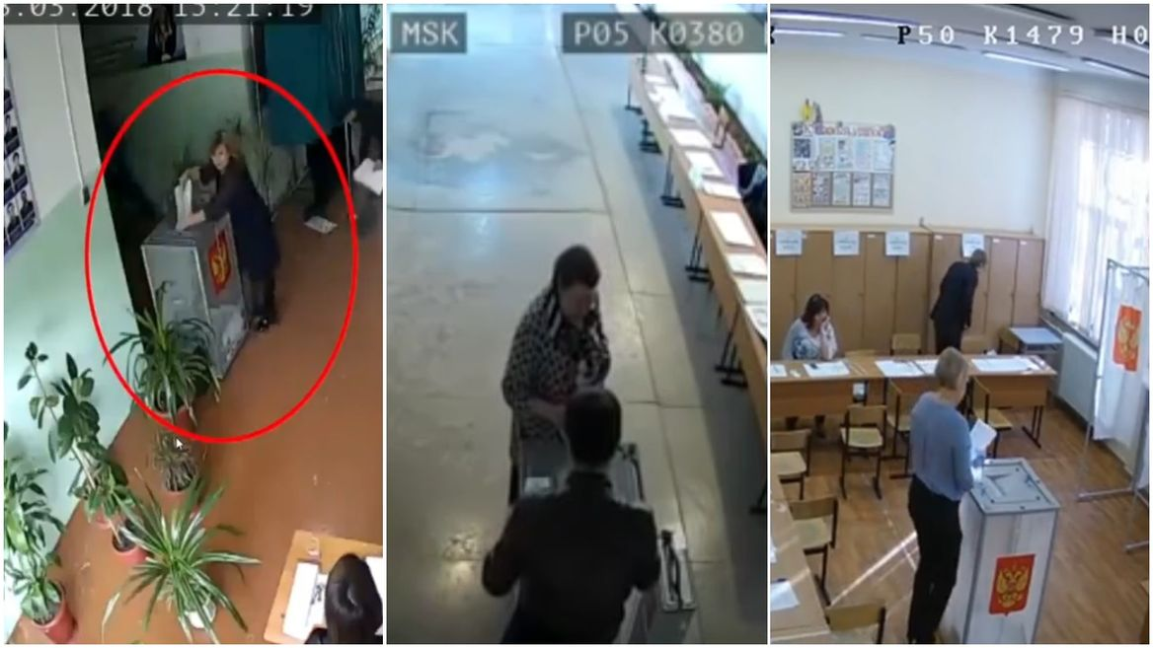
Fair elections
Everyone has one vote, and all votes are treated equally
All candidates are treated equally
There are laws and regulations to ensure there is no cheating in elections
Northern Territory Electoral Commission
www.ntec.nt.gov.au
Notes:
You may like to elicit from students what is meant by a ‘fair’ election.
Go through each of the dot points separately.
Show pictures. Tell students these are photos taken from CCTV footage from a national election in March showing electoral officials ‘stuffing’ extra papers into the ballot boxes. The Electoral Commission of this country only confirmed 2 cases of ‘ballot-stuffing’ and say they cancelled all votes from these voting centres. (Although these photos show 3 potential violations.) Has anyone seen this footage? (easy to find on YouTube). What country was this from? (Russia) Who won that presidential election? (Vladimir Putin).

Slide 10
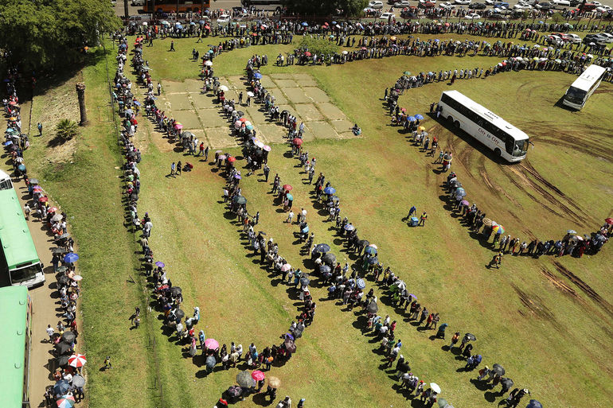
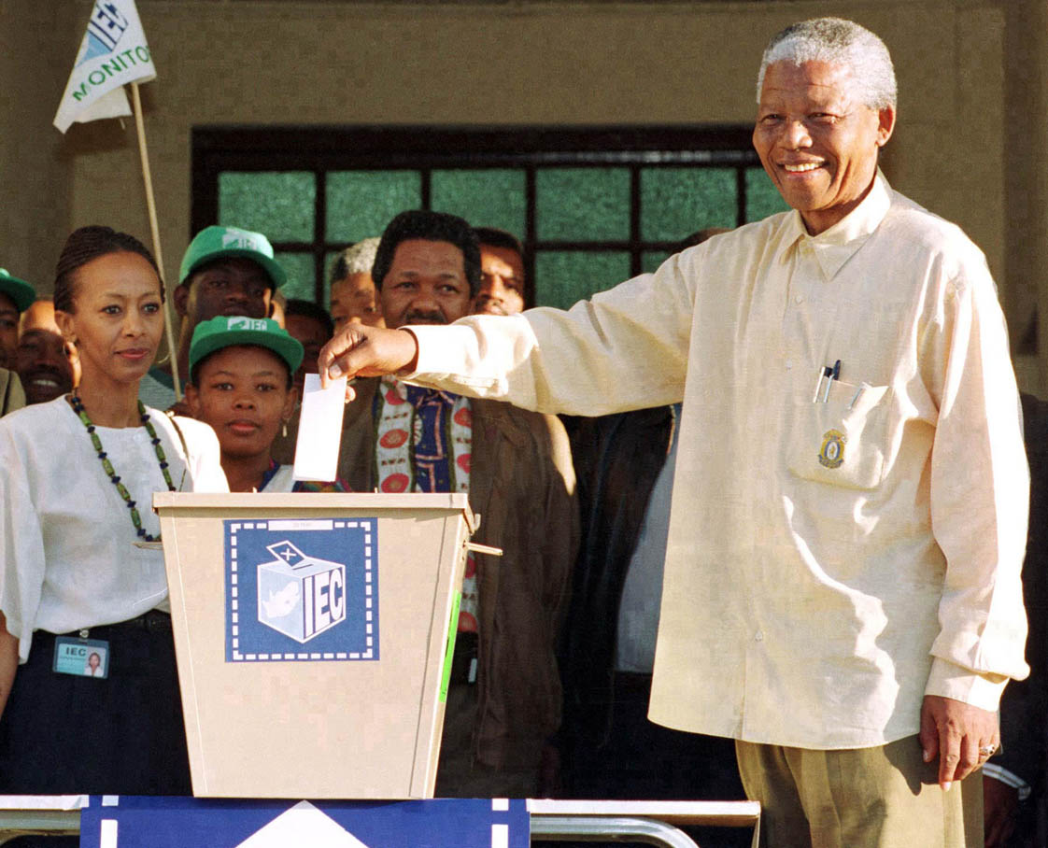
Open elections
Universal suffrage
Minimal limitations on voting, full voting services
Compulsory voting
Northern Territory Electoral Commission
www.ntec.nt.gov.au
Notes:
Ask students: “What do we mean by an ‘open’ election?” → Everyone has the opportunity to vote
Tell students: this means there should be universal suffrage (first click). Ask students what this means → Suffrage is the right to vote, universal means it’s the same for everyone, so universal suffrage means everyone can vote: men and women, people from any backgrounds or race.
Show picture on second click. Ask students if they know what country this photo is from? Its from a very famous election in 1994 where for the first time everyone in that country could vote. (If students need clues tell them it’s an African country where previously only the white people there could vote). Answer: South Africa. Ask if the know which famous leader was elected at that election (Nelson Mandela, show picture on click).
Second dot point: minimal limitations on voting. Tell students one of the reasons the USA does not rate as highly in the democracy index as other countries is that there are limitations on voting there. For example, voting is almost always on a Tuesday. Only available for one day, during the week. Not everyone can get out of work to vote. The US are often criticised for not providing voting centres on the outskirts of towns (where poorer people live) and you must have an acceptable photo ID, which again, many poorer people may not have.
Compulsory voting dot point: one of the advantages of compulsory voting means that if everyone is expected to vote, you need to provide extensive voting services. So in Australia we have 2 weeks of early voting, you do not need ID, you can vote via the post, and there is mobile polling which goes out to remote areas, hospitals, aged care facilities and jails. Show picture, Australia is not the only country with compulsory voting. All the countries in blue have it, the countries in yellow do not vote. Most countries offer optional voting.

Slide 11
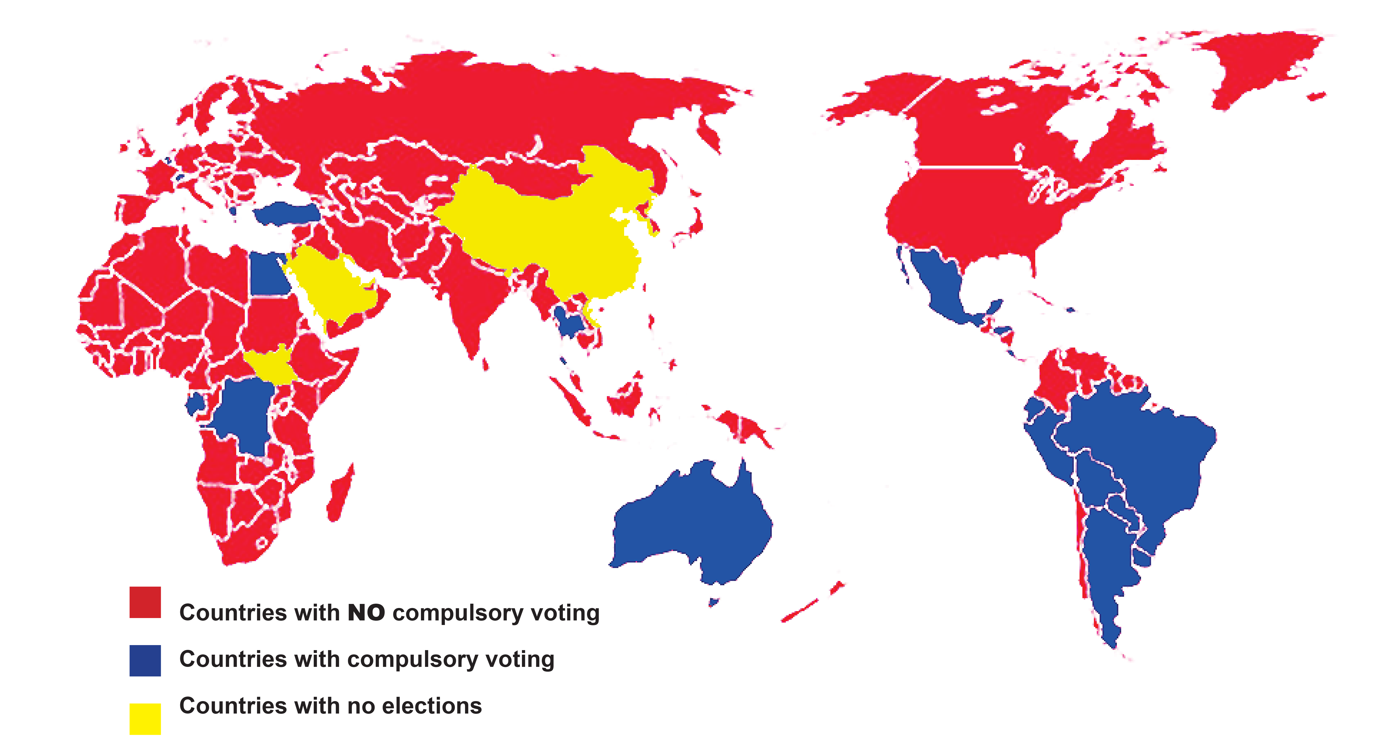
Voting is compulsory in Australia
When voting is optional these groups of people often do not vote:
- poor people
- young people
- Indigenous people
- migrants.
Compulsory voting helps
to protect these groups.
Northern Territory Electoral Commission
www.ntec.nt.gov.au
Notes:
Tell students Australia is not the only country with compulsory voting.
Elaborate: Most South American countries have compulsory voting, and a few other countries. There are about 22 countries that make voting compulsory. Most countries have optional voting, a there are some countries with no voting.
Elaborate: Compulsory voting is advantageous in countries with a diverse population like Australia. Research shows that when voting is optional certain groups of people consistently don’t vote in large numbers and can be therefore left out of the decision making process. Some of these groups are the minority groups we were just talking about: young people, Aboriginal people, migrants and, in large numbers, poor people do not vote. Compulsory voting also improves voting services, making elections as “open” as possible, and therefore more democratic.

Slide 12
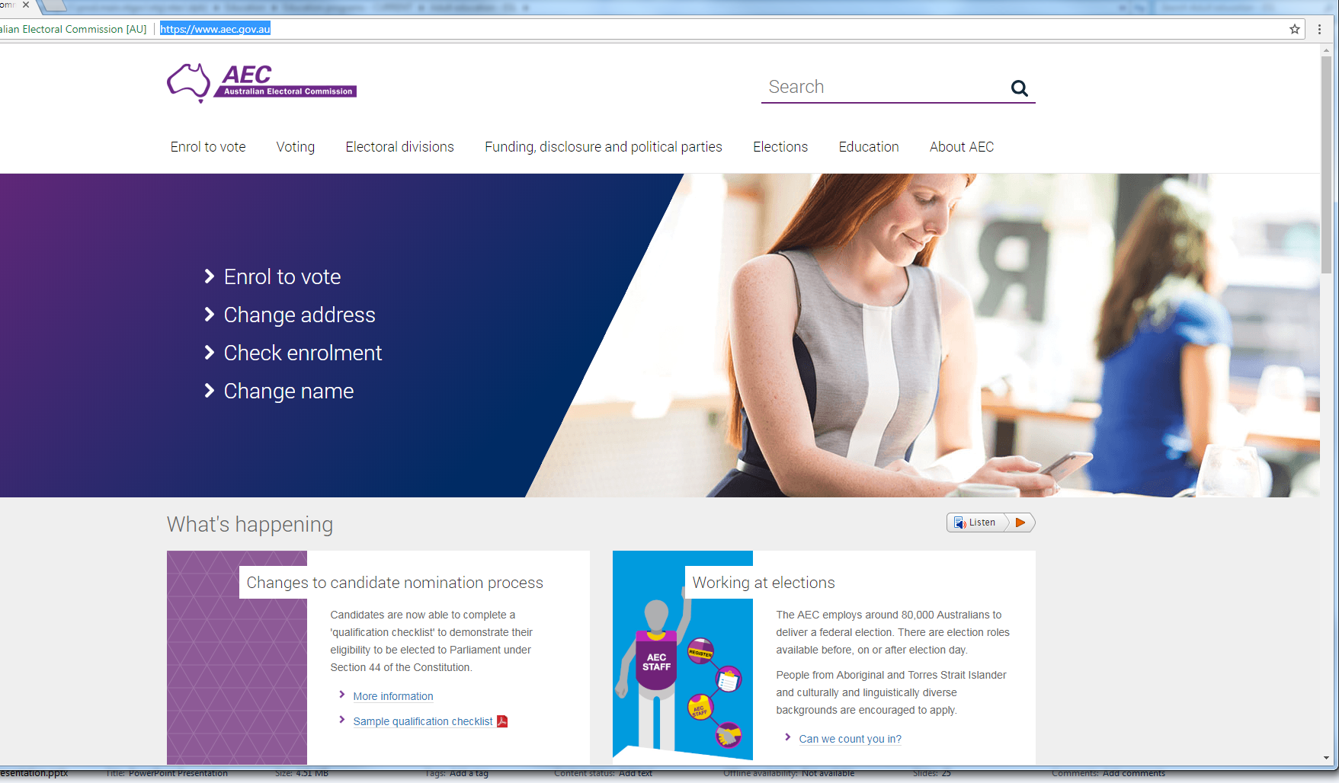
Who can vote?
In order to vote you must be:
18 years old
An Australian citizen
Enrolled correctly
→ Online: www.aec.gov.au
→ Enrolment form
Northern Territory Electoral Commission
www.ntec.nt.gov.au
Notes:
Ask students: “Who can vote in Australian government elections?” Let them know there are only 2 main criteria. Bring up on clicks.
Tell students: In order to vote you must be enrolled to vote. Ask students: How old do you have to be to enrol? (16 years old)
How to enrol: to enrol the first time you have to sign your enrolment form. This is easier done on a paper form which you can get from post offices, members’ offices, our offices etc. (We can send you some if you are doing this program with 16 year olds – just get in contact: ntec@nt.gov.au, 1800 698 683). If you have a device that you can sign onto, you can do it online.
Tell students: Whenever you change your details (like your address, or maybe your name) you need to update your enrolment. This is very easy to do online as you don’t need to sign for updates. (But you do need ID like a driver’s license)

Slide 13
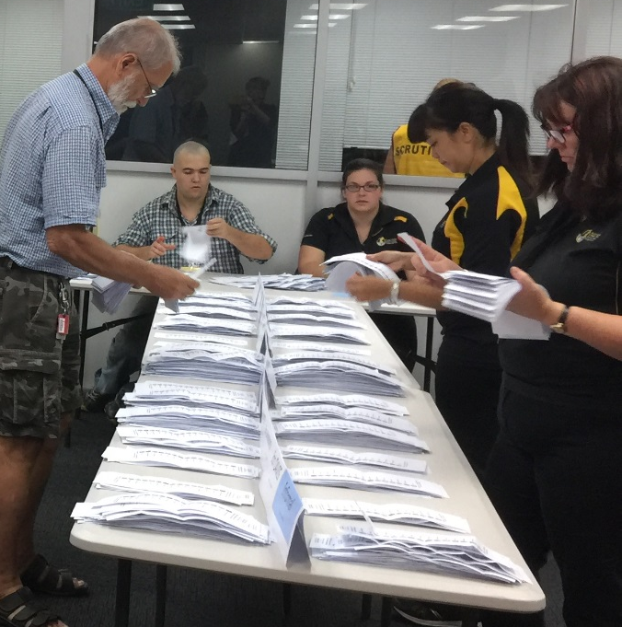
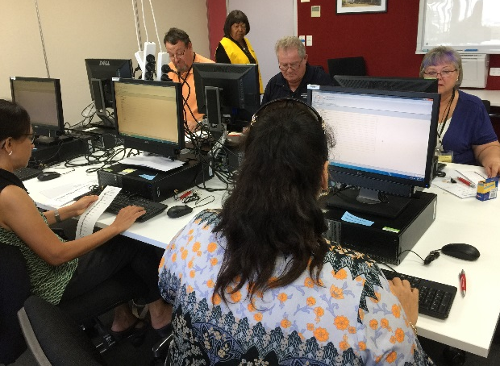
Voting systems
First past the post
Preferential
Proportional
representation
Northern Territory Electoral Commission
www.ntec.nt.gov.au
Notes:
Tell students we are now going to look at voting systems. While there are a few different voting systems, we will be looking at these 3:
First past the post, preferential and proportional representation (read them out on each click).

Slide 14

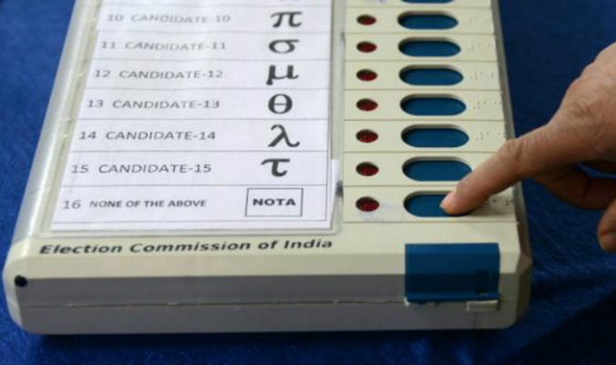
First past the post
Voters just have to mark the ballot paper once, next to the candidate of their choice.
The candidate with the most votes wins.
Used for government elections in almost one third of all countries including Canada, UK, India, Indonesia and the USA.
First past the post is no longer used in Australia (replaced in 1918).
Northern Territory Electoral Commission
www.ntec.nt.gov.au
Notes:
Tell students: the term ‘first past the post’ is a horse-racing term (pointing to picture) where there’s a post at the finish line and they use this to determine the winner. Obviously the first horse past that post, even by a nose, wins the race. It doesn’t matter how fast or slow the race is.
Ask students: how do you think we determine the winner of a first past the post election? (Most votes wins.)
Go through each dot point.
Point out bottom picture: tell students this is a voting machine that is used in India for their elections. India uses first past the post voting and voters just have to choose one person and push the button next to that person’s name to vote for them. The last button says “NOTA” or ‘none of the above’, and this a legitimate vote in Indian elections!

Slide 15
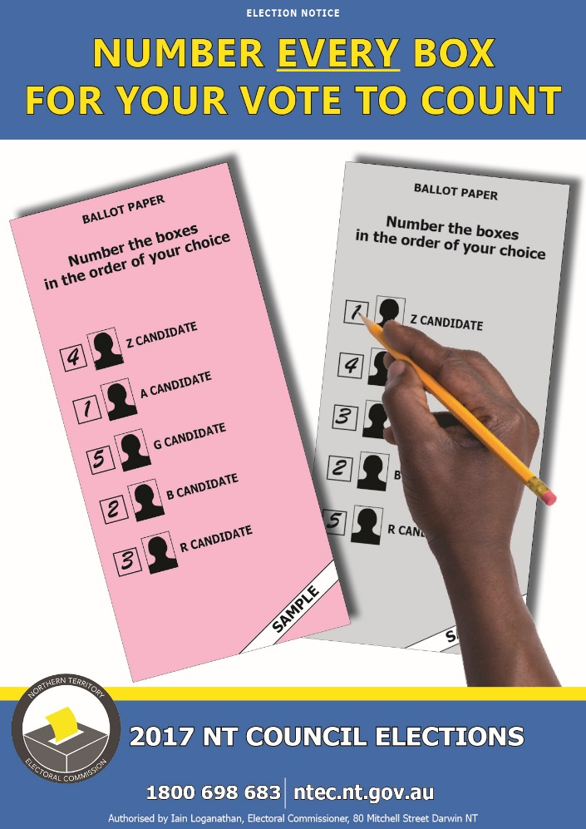
Full preferential voting
Voters must put a number against every candidate, in the order of their choice, starting with 1.
A candidate must get more than half the total formal votes to win (50% +1).
Used for most lower house elections in Australia (except TAS and ACT), and is a distinctly Australian system.
Some other countries call full preferential voting the ‘Australian system’.
Northern Territory Electoral Commission
www.ntec.nt.gov.au
Notes:
Full preferential voting: go through each dot point, but really stress the first one as this is how students will need to vote in their mock election at the end of the presentation (tell them this) and of course when they are adults and voting in real government elections. Point to the picture and show the examples. Ask students if this is how they have voted in past school elections (it usually is, but sometimes schools use first past the post).
Third dot point – some other countries refer to full preferential voting as the “Australian system”.

Slide 16
Proportional representation
Proportional representation is used for multi-member electorates.
Voters must put a number against every candidate, in the order of their choice, starting with 1 – same as preferential voting
Used for the federal senate, most state upper houses and many local government councils including all NT councils.
For federal elections you are given 2 ballot papers: one for House of Representatives and one for the Senate.
Senate voting: You can vote above the line (for a political party) OR below the line (for individual candidates).
ALWAYS READ THE INSTRUCTIONS ON THE BALLOT PAPER
Northern Territory Electoral Commission
www.ntec.nt.gov.au
Notes:
Proportional representation: go through each dot point. They are mostly self-explanatory, but here are some extra notes:
Dot point 1: All NT councils are multi-member electorates (but NT Parliament just has one member per electorate).
Dot point 2: voting is exactly the same as for full preferential systems. Voters need to number every square in the order of their choice. It’s just the way the votes are counted that is different. Most voters wouldn’t even know there’s a difference.
Dot point 5 (blue): There is a picture of a senate voting paper on the next slide to really demonstrate this.
Dot point 6 (red): Let students know if this sounds too confusing, they should just always remembers to read the instructions on the ballot paper. All ballot papers have simple voting instructions on them.

Slide 17

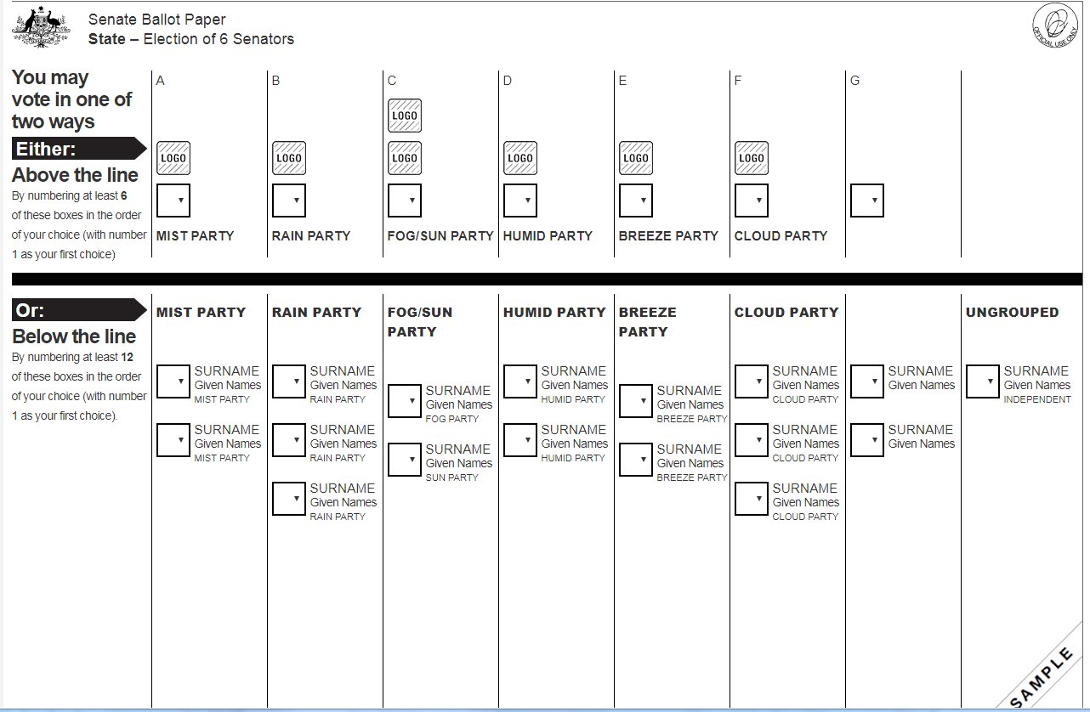
Senate elections
Northern Territory Electoral Commission
www.ntec.nt.gov.au
Notes:
Important part of showing this sample is to stress that students EITHER vote above the line OR below the line. Not both!
Also - that the voting is different above and below the line. Point out to students that there are instructions on the left hand side. Read these out loud so students understand the number of boxes you have to fill out (in preferential order) is different above the line to below the line.
Let students know most people vote above the line, but you don’t have to.

Slide 18
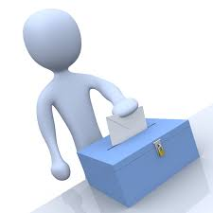
Next elections
The Northern Territory Parliament election will be:
August 2024
The Local Government (council) Elections will be:
August 2025
The next federal election is due before:
27 September 2025
Mock election – right now!
Northern Territory Electoral Commission
www.ntec.nt.gov.au
Notes:
Tell students they will be voting soon, so here are the dates of the next elections:
NT Parliament: these are a set date every four years, so we already know the date.
NT Councils: These are the same, a set date every four years (exactly a year after the NT Parliament elections)
Federal elections: federal elections must be held somewhere between 3 – 4 years after the last one, but it is up to the government of the day to say when it will be. They often call an election at a time they think is most favourable to them winning again. The date given is an educated guess.
If students are 18 years old by these elections, they’ll need to be enrolled, and they’ll need to vote.
Time for a mock election – refer to Teacher instructions for vote and count

Slide 19
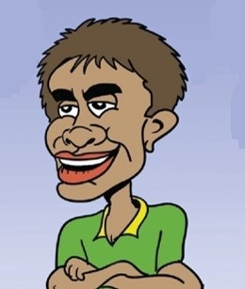

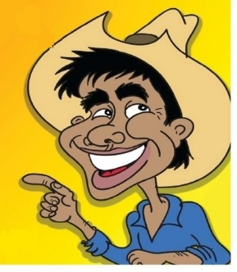

Pretend election
Who will you vote for?
Mr Jobs
Ms Education
Mr Environment
Ms Fix Crime
Northern Territory Electoral Commission
www.ntec.nt.gov.au
Notes:
Tell students: “It’s time to vote! We will have our own pretend election now and you will all vote.”
Set the scene: Let’s pretend that we are voting for someone in the NT Parliament – they will make laws and decisions for the NT. Your ballot paper will have four choices and each of these pretend people have one main area that they want to improve while they are in parliament.
(Bring up each one separately on clicks – elaborate on them if you like)
Tell students they will need to vote and put everyone in order. Students should put the people in order of what their main area is and what they, as voters, think is the most important thing for themselves, their family, and their community.
Remind students they should write number 1 next to the person whose area they think is the most important, number 2 for second most important, then 3, then 4. They must number every box, and don’t write any names on the ballot papers, just numbers.
Ballot papers for this election are on our website. Refer also to the Teacher instructions on vote and count on our website – the instructions and sample results table reference the pretend election used in the PowerPoint for younger students. The instructions are the same though for any preferential election. Scroll down to very last page to get blank results table for this election.

Slide 20


Questions?
For further information ntec.nt.gov.au
Facebook.com/NTElectoralcommission
@NTElecComm
Northern Territory Electoral Commission
www.ntec.nt.gov.au

