Slide 1

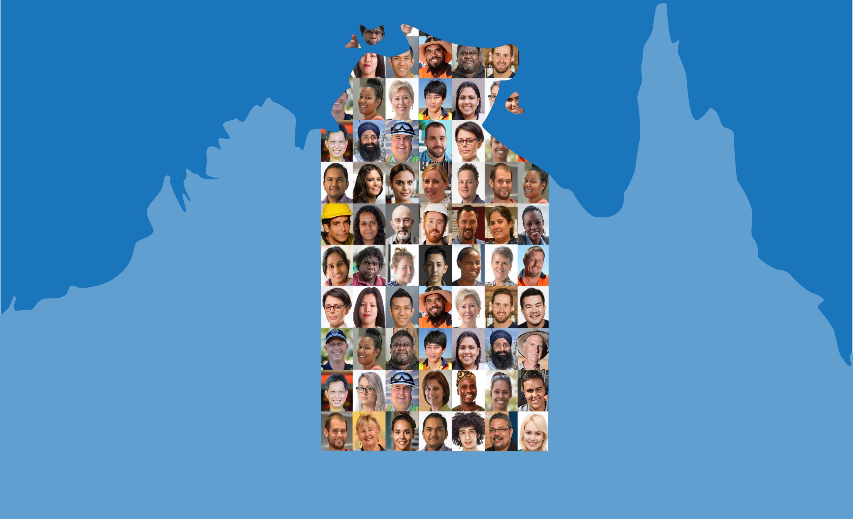

Northern Territory Electoral Commission
ntec.nt.gov.au

Slide 2

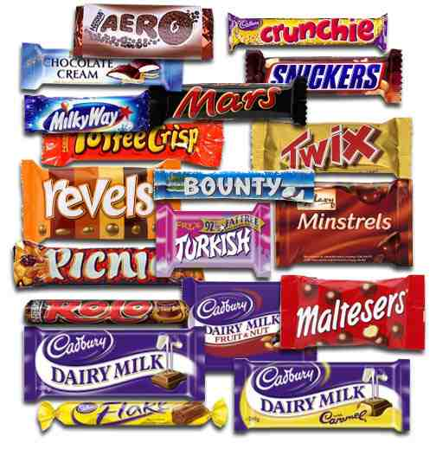

Pick your favourite
Northern Territory Electoral Commission
ntec.nt.gov.au

Slide 3

What did you just do?
V
o
t
e
e
c
t
E
l
t
o
E
e
c
i
n
l
Northern Territory Electoral Commission
ntec.nt.gov.au

Slide 4
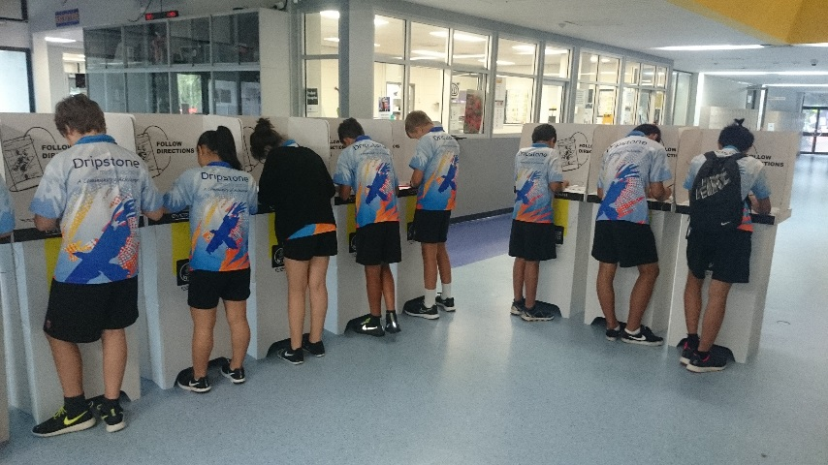
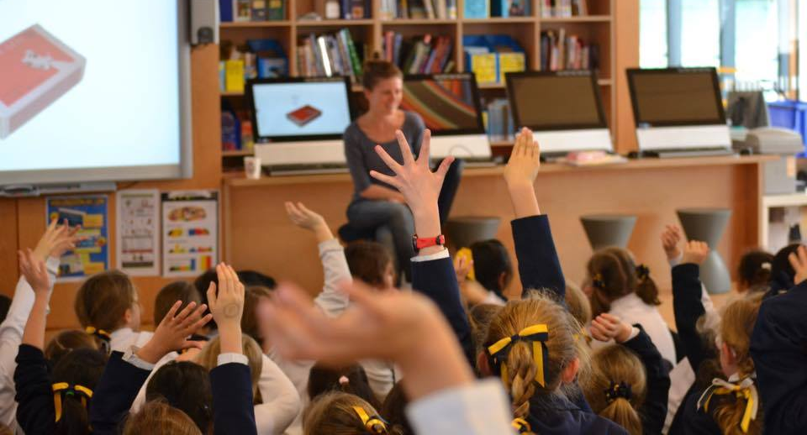
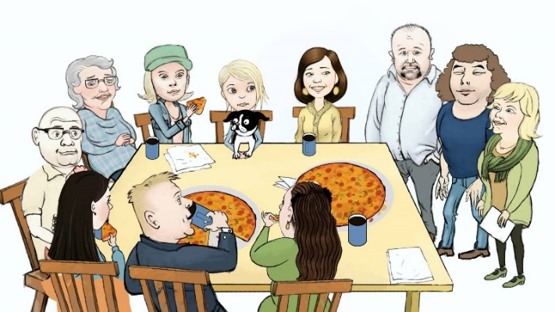
You could say voting is part of Australian culture – we start young
Northern Territory Electoral Commission
ntec.nt.gov.au

Slide 5
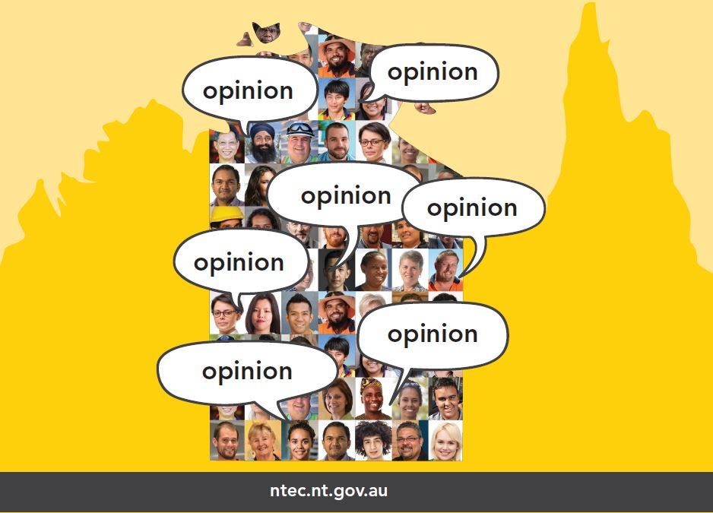
Group decision making
In Australia, how are important decisions made for communities?
A. One person (the leader) makes decisions for everyone in the community
B. The richest family in the community makes decisions for everybody
C. A small group of people (not voted for) make all the community’s decisions
D. Everyone in the community has a say in community decisions
Northern Territory Electoral Commission
ntec.nt.gov.au

Slide 6
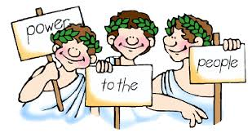
What do we call this type of group decision making?
D
e
m
o
c
r
a
c
y
From the Greek words Demos meaning people and Kratis meaning power
Northern Territory Electoral Commission
ntec.nt.gov.au

Slide 7
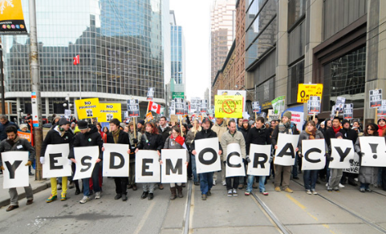
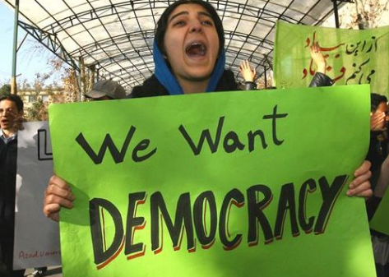
Definition of democracy
Government is the system by which a country is controlled and organised
A. Government by a single ruler or group of people with no say from anyone else
B. Government by the people or by their elected representatives
C. Government by a King or Queen, who is usually born into the role. May have unlimited or limited powers.
D. Government where all decisions, including laws, are based on a religion, the rulers are usually religious leaders
Northern Territory Electoral Commission
ntec.nt.gov.au

Slide 8
Features of a democracy
A. Freedoms of speech, expression, information, religion, assembly and association (including political parties)
B. Rule of law: Everyone is equal before the law and no one is above the law
C. Majority rule with protections for small groups (minorities) and individuals
D. Free, fair and open elections that are held regularly
Free, fair and open elections that are held regularly
Northern Territory Electoral Commission
ntec.nt.gov.au

Slide 9
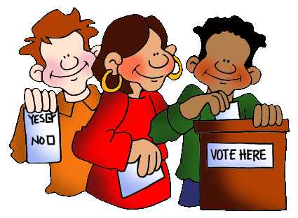
Democratic elections
FREE
FAIR
OPEN
REGULAR
Each person is free to choose who they want to vote for
There are rules to stop cheating in elections
Everyone must have the opportunity to vote
Elections have a timetable, usually every 3 – 6 years
Northern Territory Electoral Commission
ntec.nt.gov.au

Slide 10
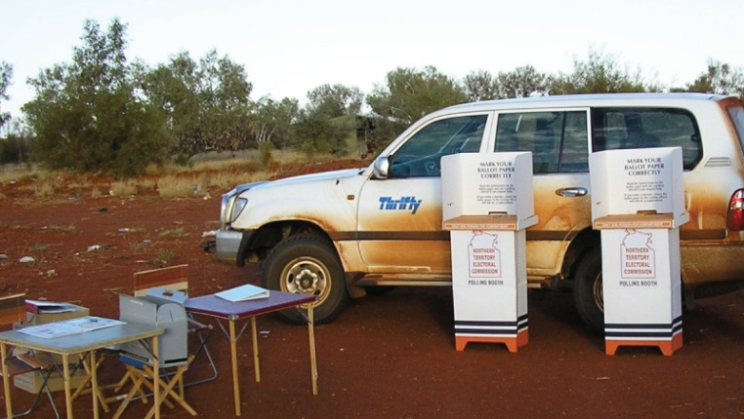
Who can vote?
In order to vote you must be:
18 years old – you can enrol at 16 years
An Australian citizen
Lived at your home address for one month
Voting is compulsory
in Australia
Northern Territory Electoral Commission
ntec.nt.gov.au

Slide 11
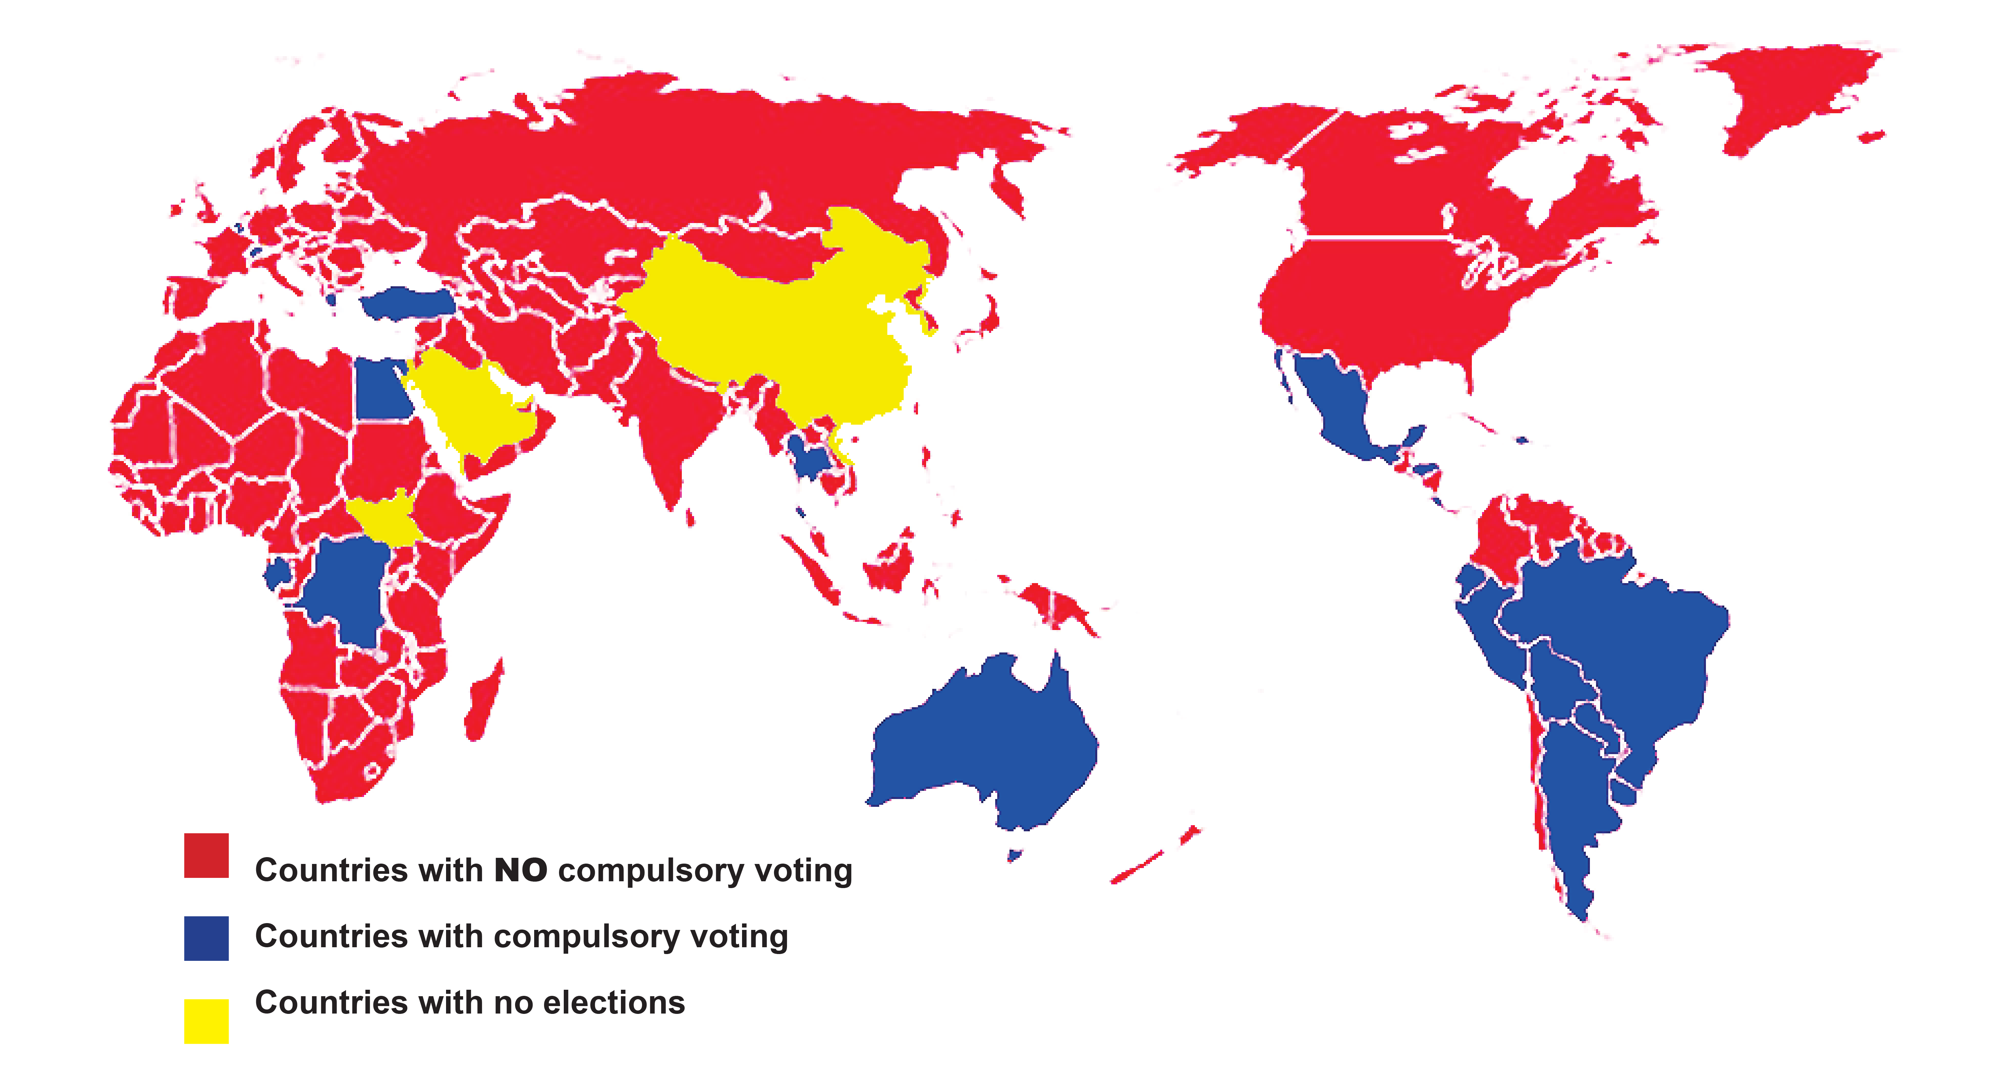
Compulsory Voting
Northern Territory Electoral Commission
ntec.nt.gov.au

Slide 12
Compulsory voting in Australia
WHO
WHAT
WHEN
WHERE
HOW
All Australian citizens aged over 18 years
The law says all eligible voters MUST vote
Compulsory voting first in QLD in 1915, for ALL voters since 1984
In all states/territories, in all types of elections
If you do not vote, you will be fined
Northern Territory Electoral Commission
ntec.nt.gov.au

Slide 13
Why have compulsory voting?
When voting is optional it is usually certain groups that do not vote: poor people, young people, Indigenous people and migrants. Compulsory voting helps to protect these groups.
If everyone has to vote, then political parties have to think about policies that cover everyone.
‘Healthier’ democracy – the outcome of the election should correctly show the people and parties most people wanted.
Forces people to learn about how government and politics works.
Citizen’s responsibility – like paying tax and being on a jury.
Northern Territory Electoral Commission
ntec.nt.gov.au

Slide 14
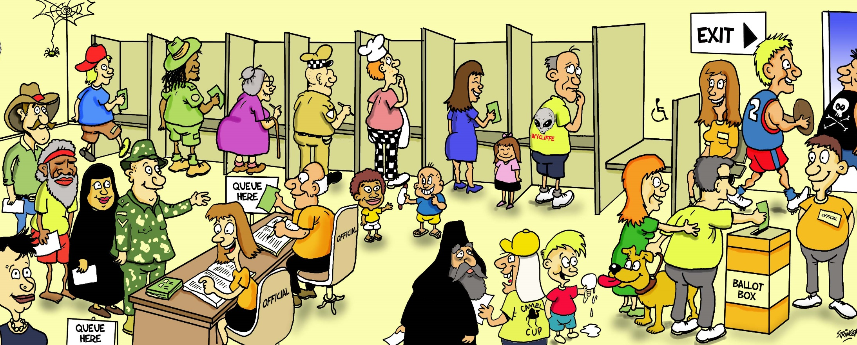
All votes are secret
Don’t put your name on the ballot paper
Northern Territory Electoral Commission
ntec.nt.gov.au

Slide 15
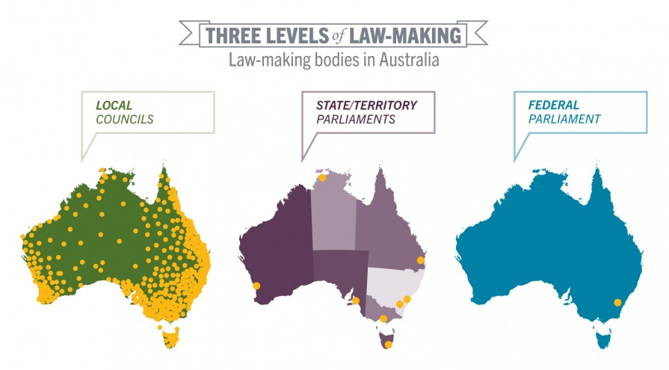
Levels of government
Northern Territory Electoral Commission
ntec.nt.gov.au

Slide 16
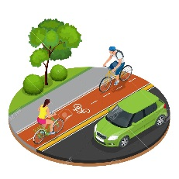




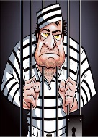


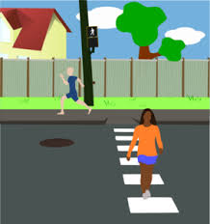




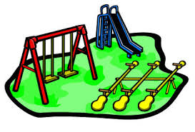




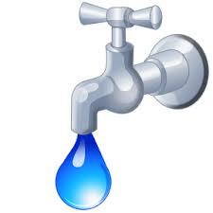








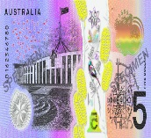

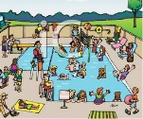
What does each level do?
Australian Government
NT Government
Local Councils
Northern Territory Electoral Commission
ntec.nt.gov.au

Slide 17
Government responsibilities
AUSTRALIAN FEDERAL GOVERNMENT
Airports and air safety
Communications – phones, post, TV, radio, internet
Defence
Foreign affairs and trade
Immigration and customs
Income tax, GST, income support (Centrelink)
Aboriginal Affairs
Money
Passports
Northern Territory Electoral Commission
ntec.nt.gov.au

Slide 18
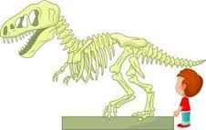

Government responsibilities
STATE/TERRITORY GOVERNMENT
Arts and Museums
Courts and Prisons
Education and schools
Health and hospitals
Housing
Parks and Wildlife
Police, Fire and Emergency Services
Power and Water
Public transport, including taxis
Roads (main) and railways
Northern Territory Electoral Commission
ntec.nt.gov.au

Slide 19

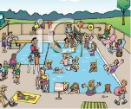
Government responsibilities
LOCAL COUNCILS
Footpaths and cycle paths
Libraries and community halls
Local roads
Parking
Parks and sports ovals
Playgrounds
Pet and animal control
Rubbish and recycling collection
Swimming pools (public)
Northern Territory Electoral Commission
ntec.nt.gov.au

Slide 20


Voting systems
First past the post
Preferential
Hmm, what order do I want?
Northern Territory Electoral Commission
ntec.nt.gov.au

Slide 21
First past the post
SAM
MAYA
CARINA
LEE
TOTAL
30
25
10
35
100
BALLOT PAPER
SAM
MAYA
CARINA
LEE
1
65 voters out of 100 did not want Lee to win
Northern Territory Electoral Commission
ntec.nt.gov.au

Slide 22
Full preferential voting
ABSOLUTE MAJORITY
The winner must get more than half of the total
number of formal votes cast
Put a number in every box
Do not use Ticks or Crosses
Do not put your name on the ballot paper
Northern Territory Electoral Commission
ntec.nt.gov.au

Slide 23
Full preferential voting
BALLOT PAPER
BALLOT PAPER
BALLOT PAPER
SAM
MAYA
CARINA
LEE
2
SAM
MAYA
CARINA
LEE
1
SAM
MAYA
CARINA
LEE
4
3
4
1
4
2
3
1
3
2
Northern Territory Electoral Commission
ntec.nt.gov.au

Slide 24

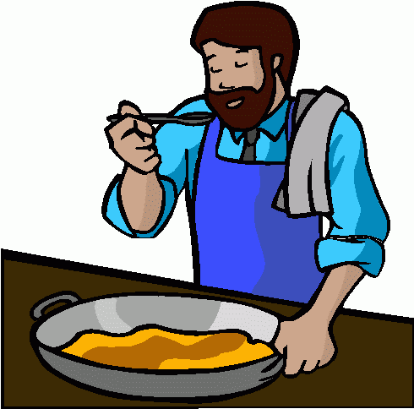




Practising how to vote
What is your favourite thing to do when you have free time?
Read
Cook
Be active
Watch TV or movies
Go online
Northern Territory Electoral Commission
ntec.nt.gov.au

Slide 25


Questions?
For further information ntec.nt.gov.au
Facebook.com/NTElectoralcommission
@NTElecComm
Northern Territory Electoral Commission
ntec.nt.gov.au

