Slide 1

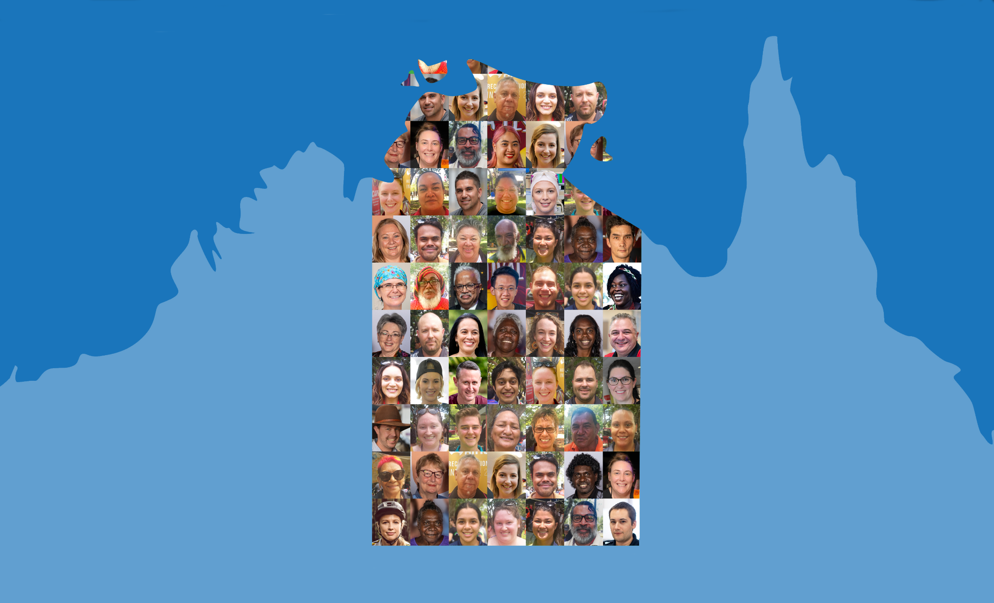

Northern Territory Electoral Commission
www.ntec.nt.gov.au

Slide 2
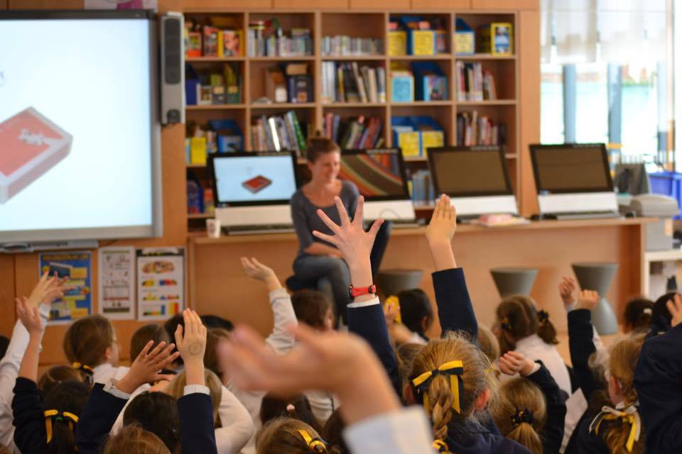
Northern Territory Electoral Commission
www.ntec.nt.gov.au
Notes:
Ask students: “Have you ever voted before?”
Refer to picture: “Maybe you’ve done a class vote, or a family vote?”
Ask for examples

Slide 3

Group decision making
What is the fairest way to make important decisions for a community?
A. One person (the leader) makes decisions for everyone in the community
B. The richest family in the community makes decisions for everybody
C. A small group of people (unelected) make all the community’s decisions
D. Everyone in the community has a say in community decisions
Northern Territory Electoral Commission
www.ntec.nt.gov.au
Notes:
Ask students: “What is the best way to make group decisions?”
Read through each of the multiple choices options, ask class what they think.
At the end add: “It’s important that everyone has a say, even if everyone can’t get the choice they want”

Slide 4
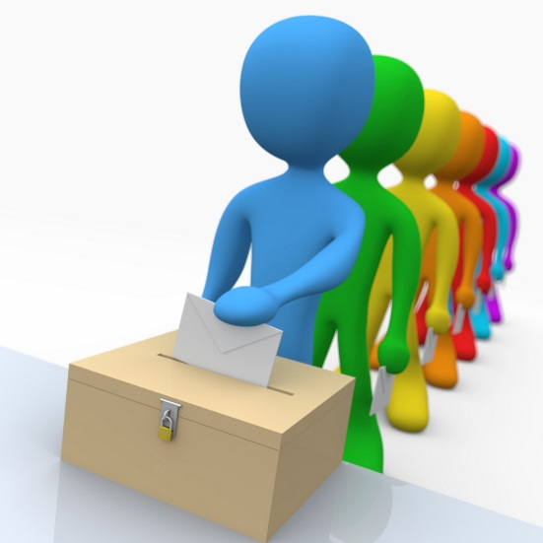
Examples of group decision making
Class vote
Students representative/leadership council
School Council
Committees – for sports clubs,
child care centres etc.
Local councils, governments
and parliaments
Northern Territory Electoral Commission
www.ntec.nt.gov.au
Notes:
Go through each example individually.
At #2, ask if anyone is a student representative currently.
Tell students: Most of these groups are elected by the people they are making decisions for.

Slide 5
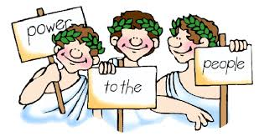
What do we call this type of group decision making?
D
e
m
o
c
r
a
c
y
From the Greek words Demos meaning people and Kratos meaning power
Northern Territory Electoral Commission
www.ntec.nt.gov.au
Notes:
Ask students: “What do we call this type of group decision making?”
To elaborate: “In Australia, everyone can have a say about who our decisions makers are. That’s because we have this kind…(point to the lines for the letters)…of government system, where the people choose the decision makers by voting”. Ask if any one knows this word.
(Give clues of ‘d’, ‘y’ and ‘c’ if required, on click)
To elaborate on Greek translation: “Democracy, or demos kratos, basically means ‘people power’, so it’s the people who have the power to choose who is in government, and who makes the big decisions.”

Slide 6
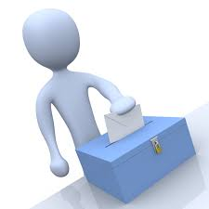
Democratic elections
Free, fair and open elections that are held regularly
FREE
There are rules to stop cheating
FAIR
Everyone can vote
OPEN
Elections are held every 3 to 6 years
REGULAR
Each person is free to vote for whoever they want
Northern Territory Electoral Commission
www.ntec.nt.gov.au
Notes:
Tell students: “In a democracy, voting must be done properly. When we define ‘democratic’ elections this means (click to bring up definition) and read out loud ”Free, fair, open elections that are held regularly.”
Ask students: “What do I mean by free, fair, open, and regular? Tell students that the definitions of these words will come up on the right hand side of the slide, and they need to match the definition with the correct word on the left?” Go through each one individually and elaborate where possible:
Fair: “you can only vote once, you can’t stuff in lots of ballot papers (although this has happened in other countries!), all candidates are treated the same”
Open: “we try very hard to get to everyone to vote, in remote communities, in hospitals, even people in jail.”
Regular: “you can’t have one group of decision makers in charge for a long time, like 20 years, the people need to have a say regularly, and this is about every 3-6 years”.
Free: “nobody sees how you vote, so you can’t get bullied to vote for someone, and you should be able to choose who you want”

Slide 7
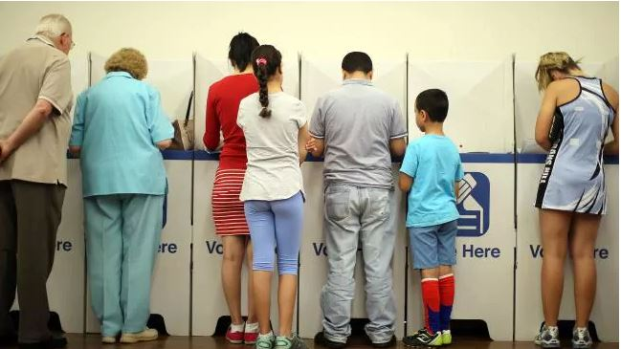
Who can vote?
You must:
be 18 years old or over
be an Australian citizen
be correctly enrolled – you can enrol at 16 years
Voting is compulsory
in Australia
Northern Territory Electoral Commission
www.ntec.nt.gov.au
Notes:
Ask students “Who can vote”
To elaborate: “When we talk about ‘the people’ we actually don’t mean every single person in Australia, or the Northern Territory, there are some rules about who can vote.” “For example, can you vote?”
Elicit first two points from students, and explain the third point.
On last click ask students: “What does compulsory mean?” In Australia, the law says you must vote, and being compulsory means there is a consequence if you don’t vote. Ask students if they know what it is. Talk about the fine – not supposed to be a punishment for doing something bad, or criminal, but the fine is trying to prevent people from not voting, or encouraging them to vote.

Slide 8
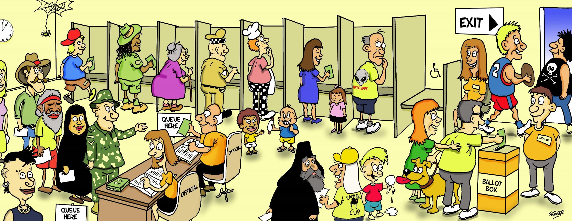
All votes are secret
No names on the ballot papers
Northern Territory Electoral Commission
www.ntec.nt.gov.au
Notes:
Ask students: “who has been to a voting centre before, maybe with your parents?”
Talk about what happens in a voting centre: First you need to get your name ticked off from the list of voters (point to the line), then you will be given the correct ballot paper for where you live, because you are voting for a decision maker to represent your area (point to ballot paper being given to voter), then you go to these things which are called voting screens (point to screens in picture) to write down your vote.
Ask students: “Why do people go to a voting screen, a private area, to make their vote?”
Elicit answer and elaborate: “It’s very important that people are free to choose who they want as a decision maker. If no one can see who you vote for, then you can’t be bullied or threatened to vote for certain people.” Give further examples.
Back to the picture: “Once you have voted, you must put your ballot paper in the ballot box” (Point to ballot box). Tell students ballot means election, so we are referring to the election paper and the election box.

Slide 9
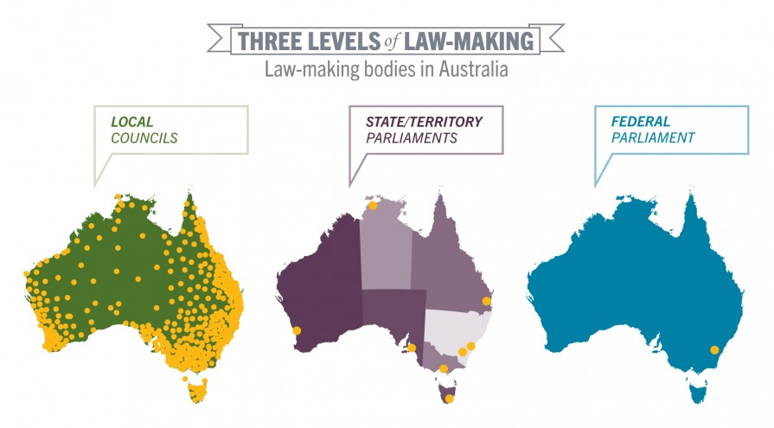
Levels of government
Northern Territory Electoral Commission
www.ntec.nt.gov.au
Notes:
Tell students: “We know that in a democracy, it’s the people who vote for our decision makers, and these are the people in government. But, in Australia, there are three levels of government, and we vote for the decisions makers at all three levels.”
Ask students: “What are the three levels of government in Australia?”
Go through each slide as students give answers, though they may give them in a different order to the slides!
Federal: “The federal parliament and government make decisions for all over Australia, so the people from all over Australia vote for their representatives in this parliament”
(May want to ask “where are they based?” Point to dot on map.)

Slide 10
Levels of government
Northern Territory Electoral Commission
www.ntec.nt.gov.au
Notes:
State/Territory: “The NT parliament and government makes decisions jsut for the NT, people from all over the NT get to vote for their representative” “All the states in Australia (plus 2 territories) have their own governments and parliaments”.

Slide 11
Levels of government
Northern Territory Electoral Commission
www.ntec.nt.gov.au
Notes:
Local: “Local councils just make decisions for their local areas, like Darwin, or Palmerston, or Alice Springs. The people in these local areas vote for the decision makers on council.”
(If any student asks, there are about 560 local councils across Australia).

Slide 12
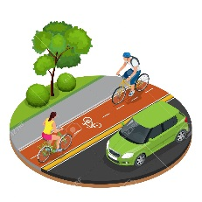

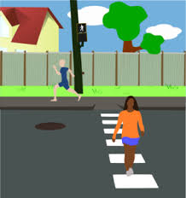

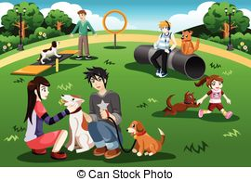




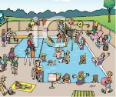
Government responsibilities
LOCAL COUNCILS
Footpaths and cycle paths
Libraries
Local roads
Parking
Parks and ovals
Playgrounds
Pet and animal control
Rubbish and recycling collection
Swimming pools
Northern Territory Electoral Commission
www.ntec.nt.gov.au
Notes:
ACTIVITY: Show the students the pictorial clues and have them tell you some of the responsibilities, or decisions, that the local government level has.
Then show the answers.

Slide 13

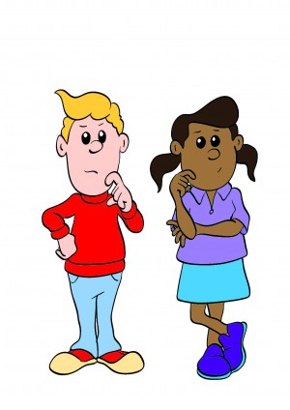
Voting systems
First past the post
Preferential
Hmm, what order do I want?
Northern Territory Electoral Commission
www.ntec.nt.gov.au
Notes:
Tell students: “There are a few different ways to vote and count votes, and we will discuss 2 of these.”
Bring up the first one, use the picture to explain ‘first past the post’ elections. Tell students the first horse past the finish line wins, it doesn’t matter how fast or slow the race was.
Ask students “If we are talking about an election, and using election words, who wins a first past the post election?” If they need help say “the person with the most……?” Confirm that the person with the most votes win. It doesn’t matter how many votes.
Tell students: “This is not the system of voting we use in Australia for our government and council elections. We use the preferential system, (show name and picture) where the voter needs to put everyone on their paper in an order, using numbers. What number would you put next to the person you want to choose?”
Tell students: “you must put a number next to every person on your ballot paper. You must put everyone in order. If you don’t number every box, we can’t count your vote”.

Slide 14
First past the post
SAM 30
MAYA 25
CARINA 10
LEE 35
TOTAL 100
BALLOT PAPER
SAM
MAYA
CARINA
LEE
1
65 voters out of 100 did not want Lee to win
Northern Territory Electoral Commission
www.ntec.nt.gov.au
Notes:
Ask students: ‘If this was a first past the post election, and the person with the most votes wins, who wins this election?”
Tell students: “Yes, Lee wins this election, Lee got more votes than anyone else, Lee is now the representative for those 100 people that voted.”
Point out that A LOT of people did not vote for Lee. Click to show blue writing.
Tell students: “A lot of people didn’t vote for Lee, almost double those who did vote for Lee. Way more than half the voters chose someone else, and yet Lee is their representative.” “In Australia, this is the reason we do not use first past the post voting for government and council elections.”

Slide 15
Who wins a preferential election?
The winner must get more than half of all the votes counted.
50% + 1
Northern Territory Electoral Commission
www.ntec.nt.gov.au
Northern Territory Electoral Commission
www.ntec.nt.gov.au
Notes:
Tell students: “We use preferential voting for government elections. To win a preferential election, you must get more than half the votes, this means the winner must get 50% + 1 of the votes. Perhaps give 1 or 2 examples, like if we have 200 people voting, what is the absolute majority someone needs to win.

Slide 16
How to vote in a preferential election
Put a number in every square
Put the numbers in order of your choice
1 is for your favourite, 2 is for your second favourite
Do not put your name on the ballot paper
BALLOT PAPER
BALLOT PAPER
BALLOT PAPER
SAM
MAYA
CARINA
LEE
2
SAM
MAYA
CARINA
LEE
1
SAM
MAYA
CARINA
LEE
4
3
4
1
4
2
3
1
3
2
Northern Territory Electoral Commission
www.ntec.nt.gov.au
Notes:
Tell students: These are your instructions for how to vote.
Show picture: For preferential elections, we use numbers to vote, like this…
Ask students: Can you see any ticks? Crosses? Empty squares? Coloured in squares? You cannot vote this way.
Click to get 1st dot point: You must write a number in the square next to every person on the voting paper, don’t leave one out.
2nd dot point: The numbers should be in order, so the order of your choice.
3rd dot point: Write number 1 next to your favourite person, your first choice, the one you want to make decisions in government. Write number 2 next to your second choice, write number 3 next to your third choice, and you keep going until you have written a number next to every person on your paper.
4th dot point: don’t forget, you don’t need to write your name on the paper, you only have to write the numbers.

Slide 17




Mock election
What is your favourite fruit?
Watermelon
Apples
Strawberries
Bananas
Northern Territory Electoral Commission
www.ntec.nt.gov.au
Notes:
MOCK ELECTION ACTIVITY
Set the scene: “Let’s pretend that your school is going to provide you with fruit at recess for the rest of the year. It will be the same fruit every day so it’s best if you like it. You will now vote on what fruit it will be”.
Tell students: “You will be given information about each one, so you can make an informed vote. We will need 4 volunteers, one for each fruit.” Ask teachers to choose students who are confident readers and will read out loud enough for everyone to hear. Those students who may add a little drama are also good!
Provide students with prompt cards (available on our website) to read out and help where required.
Before handing out ballot papers (available on our website) reiterate voting instructions: “when you receive your ballot paper go to the voting screens. Don’t crowd, let everyone have a free vote. Number the ballot paper in the order of your choice with #1 being your favourite and first choice, and #4 the one you don’t really like. Then put your ballot paper in the ballot box here” (have a designated voting area and put your ballot box away from here to help clear students away).
Refer to Teachers instructions for vote and count for tips in conducting the election and for how to count votes in a preferential election.

Slide 18


Questions?
For further information ntec.nt.gov.au
Facebook.com/NTElectoralcommission
@NTElecComm
Northern Territory Electoral Commission
www.ntec.nt.gov.au

