Slide 1

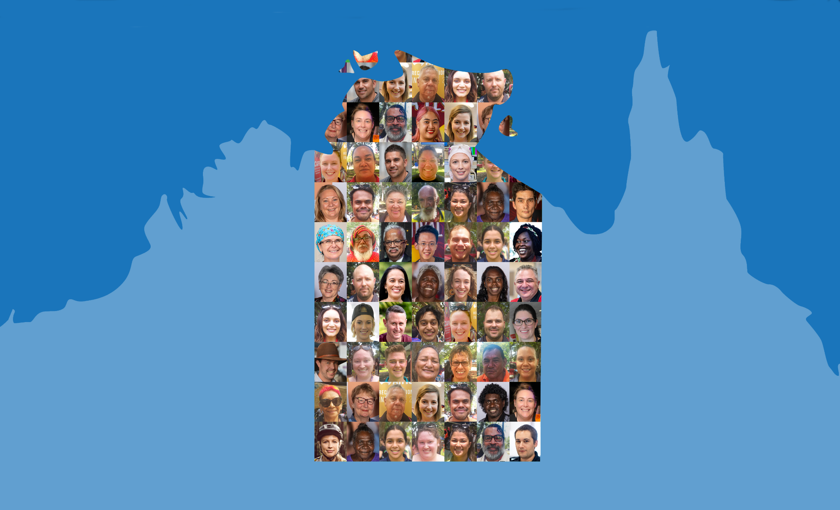

Northern Territory Electoral Commission
www.ntec.nt.gov.au

Slide 2
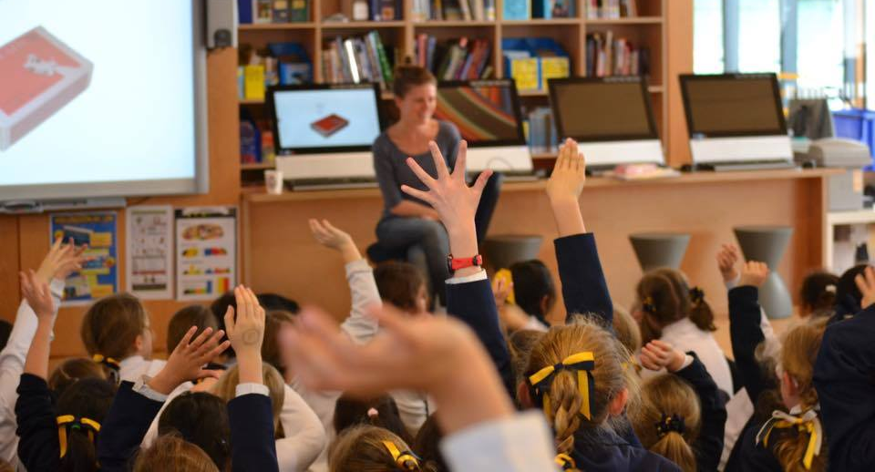
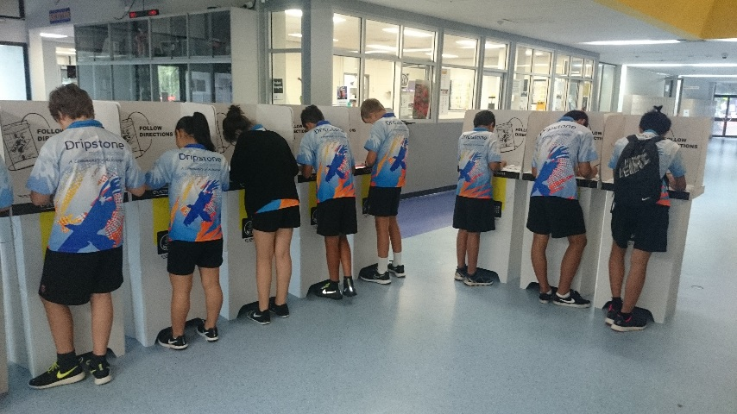
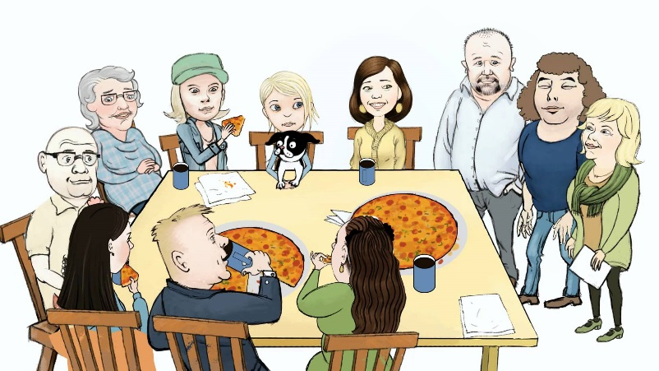
Have you ever voted before?
Northern Territory Electoral Commission
www.ntec.nt.gov.au
Notes:
Ask students: “Have you ever voted before, in any kind of election, ever?” Get a range of answers from the class. Hopefully you’ll cover the following examples…
On each click, show typical examples: class vote, student representative/house captains’ election, or maybe even a family vote.
Tell students: “Voting is a way for everyone to have their say about something, and for everyone to be involved in decision making”

Slide 3
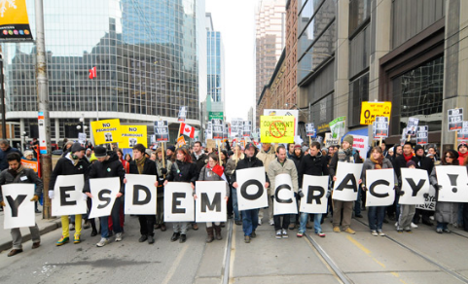
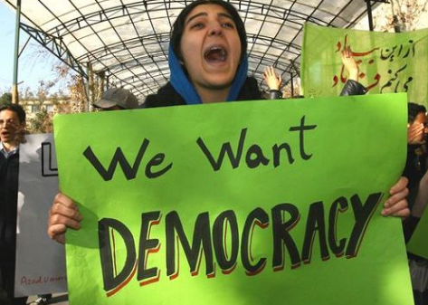
Why do we vote?
D
e
m
o
c
r
a
c
y
Northern Territory Electoral Commission
www.ntec.nt.gov.au
Notes:
Tell students: “In Australia, we vote for the big decision makers, so those people in parliament making laws, and decision makers in government and councils.”
Ask students: “Because we live in a country where we vote for the people who make our laws and decisions, it means we live in a certain kind of country, or under a certain system, that lets the people have a say on who their leaders are.” “What do we call this type of system?”
On each click you can give clues, ‘D’, ‘y’, ‘c’ if they need it.
Explain Australia is a democracy, but not all countries are, and sometimes people in those countries want to be able to have a say.

Slide 4
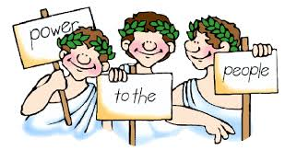
Definition of democracy
Government is the system by which a country or community is controlled
A. Government by a single ruler or group of people with no say from anyone else
B. Government by the people or by their elected representatives
C. Government by a King or Queen, who is usually born into the role. May have unlimited or limited powers.
D. Government where all decisions, including laws, are based on a religion, the rulers are usually religious leaders
From the Greek words Demos meaning people and Kratos meaning power
Northern Territory Electoral Commission
www.ntec.nt.gov.au
Notes:
Ask students: “What is the actual definition of democracy? You are going to tell me”
Explain that we are talking about a system of government, so the way a country is controlled and a system of how decisions and laws are made. Tell students they have multiple choice.
Allow students time to read each one, or read over each one individually for them. Ask them which one defines democracy. (You may want to explain that each one is a system that exists in different countries around the world.)
Correct answer is B. Ask students what the most important word in the definition is (it’s PEOPLE!).
Show/explain the ancient Greek origins of the word democracy → demos kratos

Slide 5
Features of a democracy
RIGHTS and FREEDOMS
RULE OF LAW
MAJORITY RULE
DEMOCRATIC ELECTIONS
Everybody must follow the law and everyone is equal before the law
Free, fair, open and contested elections that are held regularly
Powers to make choices about how you live your life and be treated fairly
Decisions are made when more than half agree, but minority groups are protected
Free, fair, open and contested elections that are held regularly
Northern Territory Electoral Commission
www.ntec.nt.gov.au
Notes:
Explain to students that democracy is not just being able to vote and have a say, there is more to it. Bring up the four main elements of democracy on the left of slide.
ACTIVITY: Tell students that you will bring up a definition on the right side and they have to match it with the correct feature from the left side. Arrows will appear on clicks matching the definition to the feature.
On final click, tell students that today, we are just going to focus on free, fair, open and contested elections that are held regularly (next slide will go through these definitions).

Slide 6
Democratic elections
FREE
FAIR
OPEN
CONTESTED
REGULAR
Everyone can vote
There are rules and laws to stop cheating
Voters have a choice between candidates
Elections usually held every 3 – 6 years
Voters are free to choose whoever they want
Northern Territory Electoral Commission
www.ntec.nt.gov.au
Notes:
Tell students we will now go through the definitions of each of these key words: free, fair, open, contested and regular.
ACTIVITY: Once again a definition will come up on the right hand side that students need to match to the correct word on the left.
Answers: 1. open 2. fair 3. contested 4. regular 5. free.

Slide 7
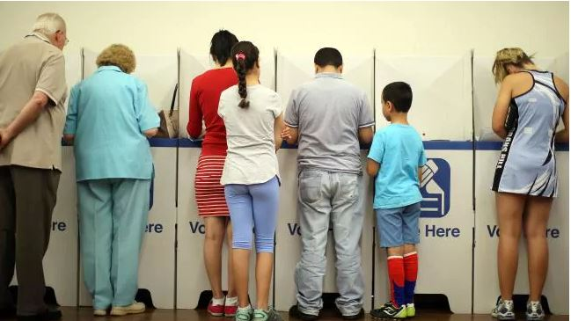
Who can vote?
You must:
be 18 years old or over
be an Australian citizen
be correctly enrolled – you can enrol at 16 years
Voting is compulsory
in Australia
Northern Territory Electoral Commission
www.ntec.nt.gov.au
Notes:
Ask students: “Who can vote in government elections in Australia?” They usually know the age criteria, but may have trouble with citizenship. Give clues if they need it.
Tell students that the third criteria is very important. You must be enrolled to vote first, this is like registering to vote, you need to give your name and address details. It’s important to register your address because when you vote, you are voting for a representative who will be the voice for the area where you live. When you change your address, you need to update your enrolment.
Bring up the last click “voting is compulsory.” Ask students what this means? Explain that for all Australian citizens who are 18 years or over, they MUST vote by law. Discuss the penalties ($20 fine for federal elections, $25 fine for NT parliamentary elections, $50 fine for NT council elections. If you have a good reason for no voting, you do not have to pay the fine.) Students are often surprised at the low amounts, I usually add “the fine is not a punishment for doing something bad, or criminal, it is more of an incentive to go and vote”.

Slide 8
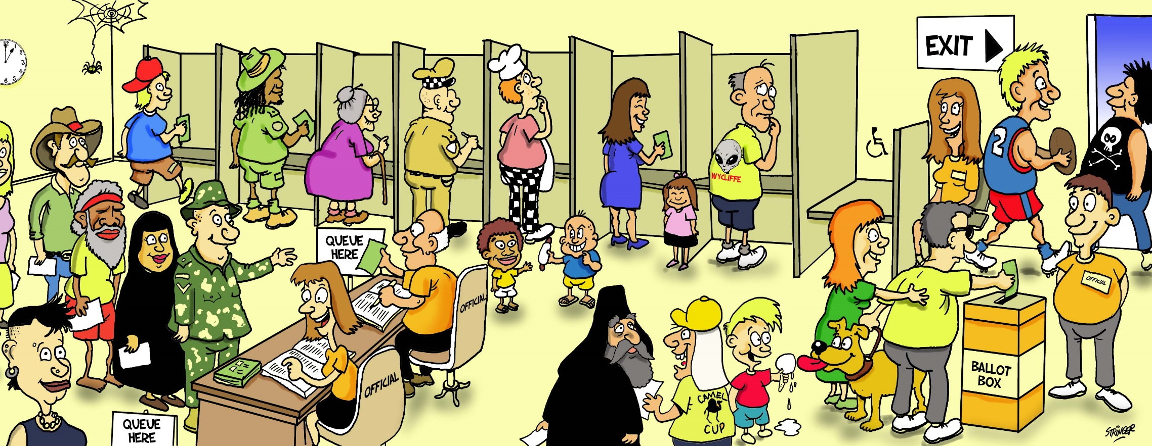
All votes are secret
No names on the ballot papers
Northern Territory Electoral Commission
www.ntec.nt.gov.au
Notes:
Ask students: “Who has been to a voting centre before, maybe with your parents?”
Tell students what happens in a voting centre: “First you need to get you name ticked off from the list of voters (point to the line), then you are given the correct ballot paper for where you live, because you are voting for a decision maker to represent your area (point to ballot paper being given to voter), then you go to these things (point to line of voting screens) to make your vote.”
Ask students: “Why do people go to a voting screen, a private area, to make their vote?”
Elicit answer and elaborate: “It’s very important that people are free to choose who they want to vote for. If no one can see who you vote for, then you can’t be bullied or threatened to vote for certain people.” Give further examples.
“Once you have voted, you must put your ballot paper in the ballot box” (Point to ballot box) Tell students that ballot means vote, so you have a voting paper and a voting box.

Slide 9
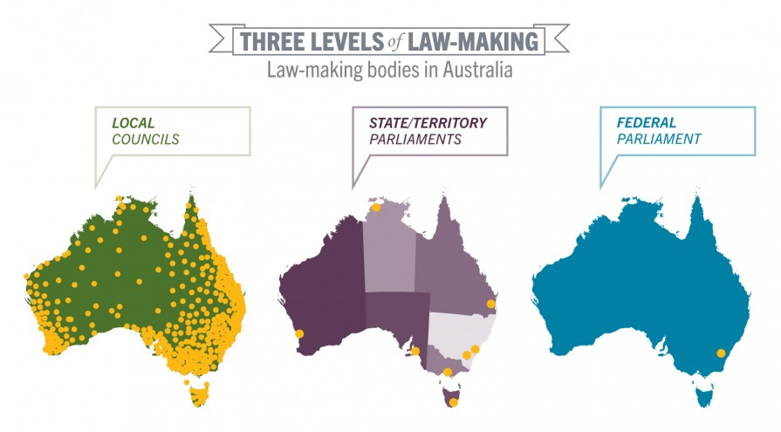
Levels of government
Northern Territory Electoral Commission
www.ntec.nt.gov.au
Notes:
Tell students: “We know that in a democracy, it’s the people who vote for our decision makers, so the people in government. But, in Australia, there are three levels of government, and we vote for the decisions makers at all three levels.”
Ask students: “What are the three levels of government in Australia?”
Go through each level once students have provided answers, they may give them in a different order.
Elaborations:
Federal - They make decisions for all over Australia, and people from all over Australia vote for their representatives there. Where are they based? How many NT representatives are there at the federal level? (2 in upper house, 2 in lower house = 4)
State/Territory – The Territory parliament just makes laws for the NT, and people from all over the NT vote for their representative in this parliament. How many state and territory parliaments are there in Australia? (6 state, 2 territory = 8) You may like to ask how many territories are there in Australia. (Good trivia question!) There are 10, but only 2 have their own parliaments and make laws for themselves like states. (Some other territories are Christmas Island, Cocos Island, Norfolk Island, Pitcairn Island.)
Local councils – local governments make decisions that affect their local areas. Do you know the name of your local council? How many local councils are there in Australia? (Bit of a joke question, but there are about 560. We have 17 in the NT.)

Slide 10







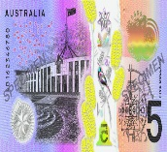


Government responsibilities
AUSTRALIAN FEDERAL GOVERNMENT
Aboriginal Affairs
Airports and air safety
Communications – phones, post, TV, radio, internet
Defence
Foreign affairs and trade
Immigration and customs/border security
Money/currency
Passports
Taxes (like income tax, GST) and income support (Centrelink)
Northern Territory Electoral Commission
www.ntec.nt.gov.au
Notes:
Tell students: “The three levels of government make laws and decisions about different things”
ACTIVITY: Show the students the pictorial clues and have them tell you some of the responsibilities, or decisions, that the federal level has. Then show the answers. The federal level is the most difficult for students to guess – they are not as everyday as the other responsibilities.
(Aboriginal affairs in reality is shared by federal and state, but for the NT → Aboriginal land rights is very much a federal responsibility with no say from NT Parliament.)

Slide 11
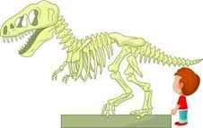
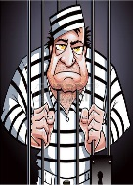






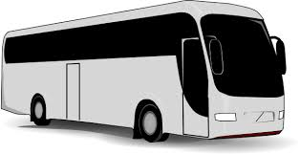

Government responsibilities
STATE/TERRITORY GOVERNMENT
Arts and Museums
Courts and Prisons
Education/schools
Health/hospitals
Housing
Police, Fire and Emergency Services
Power and Water
Transport including traffic rules, public transport, taxis
Roads (main) and railways
Northern Territory Electoral Commission
www.ntec.nt.gov.au
Notes:
ACTIVITY: Show the students the pictorial clues and have them tell you some of the responsibilities, or decisions, that the state or territory level has.
Then show the answers.

Slide 12
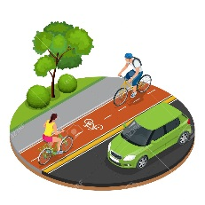

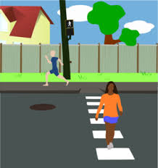

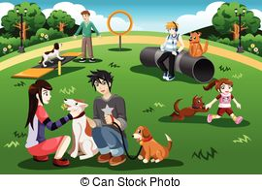
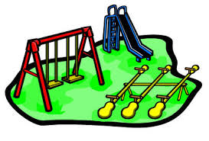

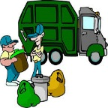

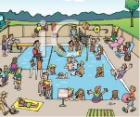
Government responsibilities
LOCAL COUNCILS
Footpaths and cycle paths
Libraries (most)
Local roads
Parking
Parks and ovals
Playgrounds
Pet and animal control
Rubbish and recycling collection
Swimming pools
Northern Territory Electoral Commission
www.ntec.nt.gov.au
Notes:
ACTIVITY: Show the students the pictorial clues and have them tell you some of the responsibilities, or decisions, that the local government level has.
Then show the answers.

Slide 13
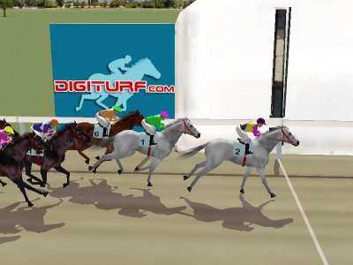
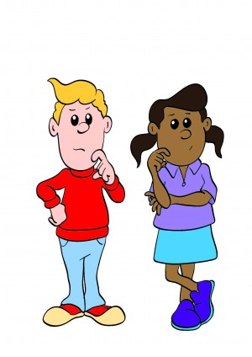
Voting systems
First past the post
Preferential
Hmm, what order do I want?
Northern Territory Electoral Commission
www.ntec.nt.gov.au
Notes:
Tell students: “There are a few different ways to vote and count votes, and we will discuss 2 of these.”
Use the horse racing picture to explain ‘first past the post’: the first horse past the finish line wins, it doesn’t matter how fast or slow the race was.
Ask students: “If we are talking about an election, and using election words, who wins a first past the post election?” If they need help, say “the person with the most……?” Confirm that the person with the most votes wins. It doesn’t matter how many votes they get, as long as they get more than everyone else.
Tell students: “This is NOT the system of voting we use in Australia for our government and council elections. We use the preferential system, where the voter needs to put everyone on their voting paper in an order, using numbers. What number would you put next to the person you want to choose?”
Tell students: “You must put a number next to every person on your ballot paper. You must put everyone in order. If you don’t number every box, we can’t count your vote.”

Slide 14
First past the post
SAM 30
MAYA 25
CARINA 10
LEE 35
TOTAL 100
BALLOT PAPER
SAM
MAYA
CARINA
LEE
1
65 voters out of 100 did not want Lee to win
Northern Territory Electoral Commission
www.ntec.nt.gov.au
Notes:
Ask students: “If this was a first past the post election, and the person with the most votes wins, who wins this election?”
“Yes, Lee wins this election, Lee got more votes than anyone else, Lee is now the representative for those 100 people that voted.”
Point out that A LOT of people did not vote for Lee. Click to show the sentence in blue.
Tell students: “A lot of people didn’t vote for Lee, more than half the voters chose someone else, and yet Lee is their representative.” “In Australia, this is the reason we do not use first past the post voting for government and council elections.”

Slide 15
Who wins a preferential election?
The winner must get more than half of all the votes counted.
50% + 1
Northern Territory Electoral Commission
www.ntec.nt.gov.au
Northern Territory Electoral Commission
www.ntec.nt.gov.au
Notes:
Tell students: “We use preferential voting for government elections. To win a preferential election, you must get more than half the votes, this means the winner must get 50% + 1 of the votes. Perhaps give 1 or 2 examples, like if we have 200 people voting, what is the absolute majority someone needs to win.

Slide 16
How to vote in a preferential election
Put a number in every square
Put the numbers in order of your choice
1 is for your favourite, 2 is for your second favourite
Do not put your name on the ballot paper
BALLOT PAPER
BALLOT PAPER
BALLOT PAPER
SAM
MAYA
CARINA
LEE
2
SAM
MAYA
CARINA
LEE
1
SAM
MAYA
CARINA
LEE
4
3
4
1
4
2
3
1
3
2
Northern Territory Electoral Commission
www.ntec.nt.gov.au
Notes:
Tell students: These are your instructions for how to vote.
Show picture: For preferential elections, we use numbers to vote, like this…
Ask students: Can you see any ticks? Crosses? Empty squares? Coloured in squares? You cannot vote this way.
Click to get 1st dot point: You must write a number in the square next to every person on the voting paper, don’t leave one out.
2nd dot point: The numbers should be in order, so the order of your choice.
3rd dot point: Write number 1 next to your favourite person, your first choice, the one you want to make decisions in government. Write number 2 next to your second choice, write number 3 next to your third choice, and you keep going until you have written a number next to every person on your paper.
4th dot point: don’t forget, you don’t need to write your name on the paper, you only have to write the numbers.

Slide 17
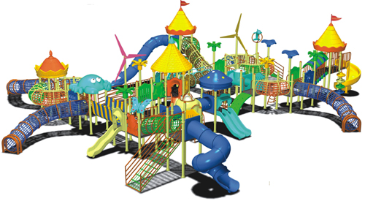


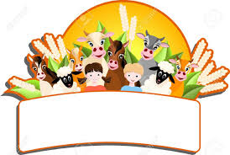

Mock election
How would you improve your school?
Big playground
Sports Centre
ICT upgrade
School farm
School farm
Northern Territory Electoral Commission
www.ntec.nt.gov.au
Notes:
MOCK ELECTION ACTIVITY – tell students it is now time to vote!
Set the scene: “Let’s pretend that the NT Government is going to give your school a sum of money to build something big, what they build will be students’ choice. Here are your choices….” Read out each one as you click them onto the screen.
Tell students: “You will be given information about each one, so that you can make an informed vote. We will need 4 volunteers, one for each option.”
Teachers to choose students who are confident readers and will read out loud enough for everyone to hear. Those students who may add a little drama are also good!
Provide students with prompt cards (available on our website) to read out, help where required.
Before handing out ballot papers (available on our website) reiterate voting instructions: “when you receive your ballot paper go to the voting screens. Don’t crowd, let everyone have a free vote. Number the ballot paper in the order of your choice with #1 being your favourite and first choice, and #4 the one you don’t really like. Then put your ballot paper in the ballot box here” (have a designated voting area and put your ballot box away from here to help clear students away).
Refer to Teachers instructions for vote and count for tips in conducting the election and for how to count votes in a preferential election.

Slide 18


Questions?
For further information ntec.nt.gov.au
Facebook.com/NTElectoralcommission
@NTElecComm
Northern Territory Electoral Commission
www.ntec.nt.gov.au

