Slide 1

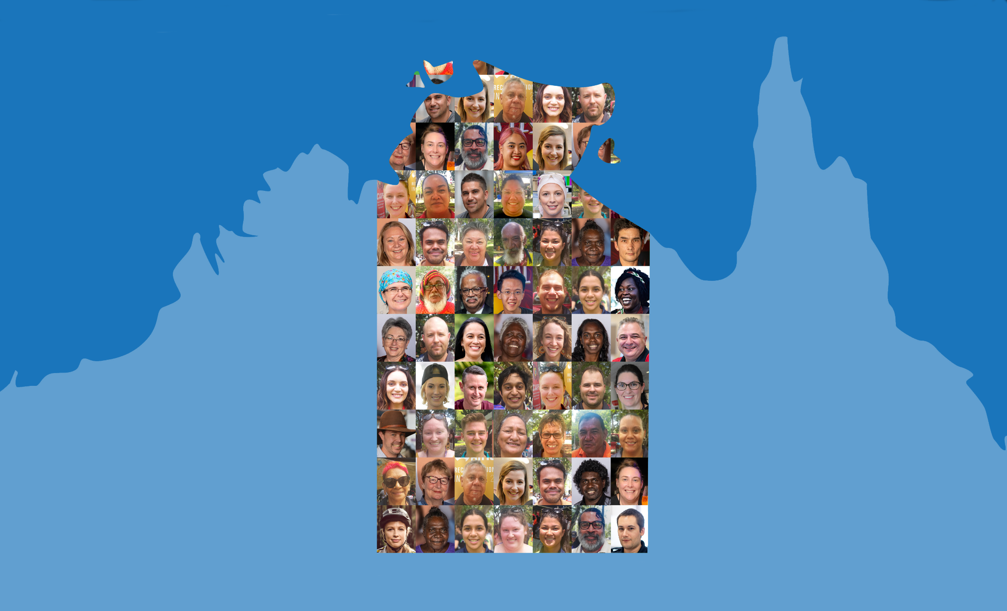

Northern Territory Electoral Commission
www.ntec.nt.gov.au

Slide 2
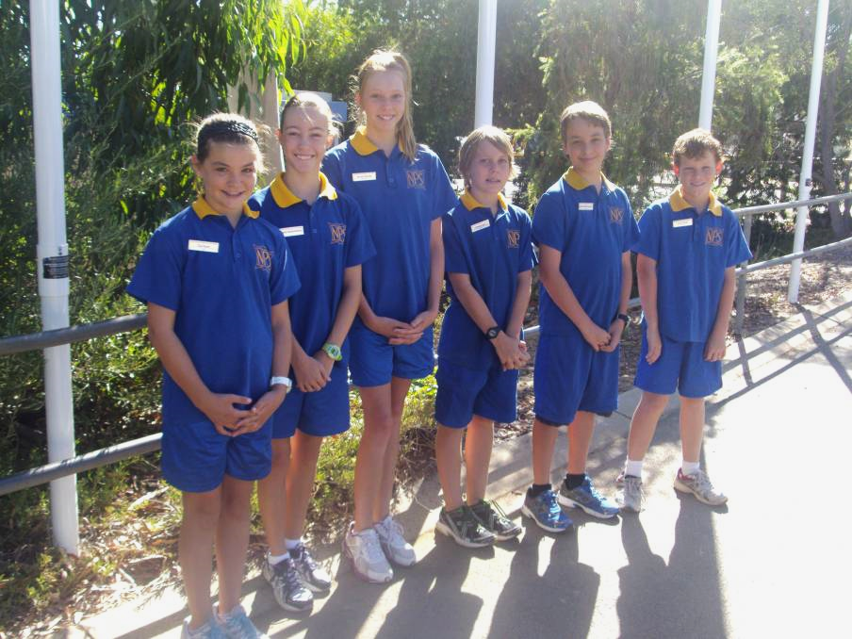
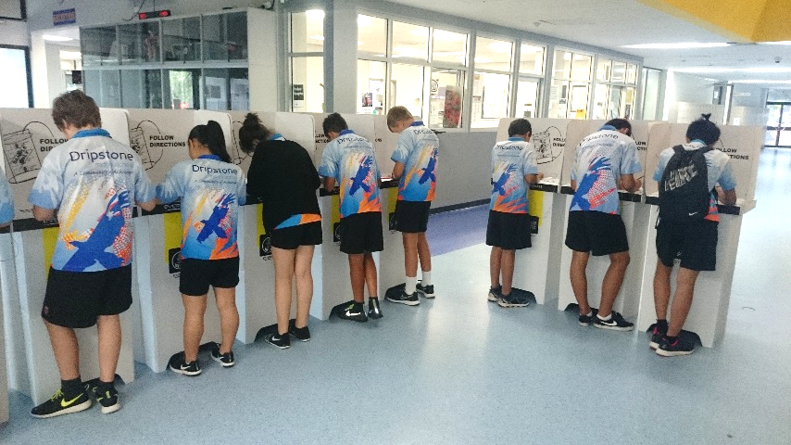
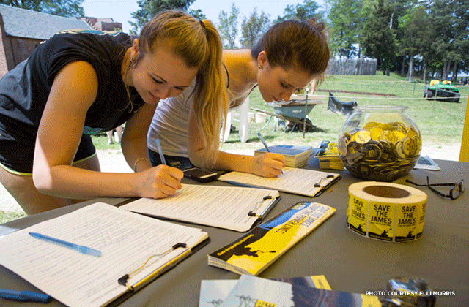
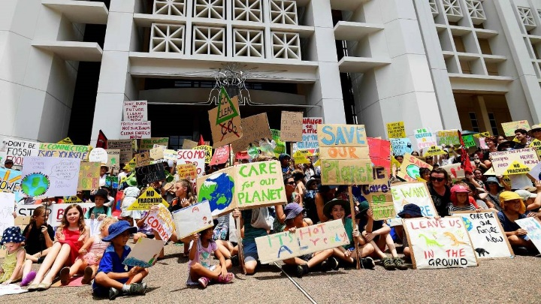
Have you ever participated in….?
Northern Territory Electoral Commission
www.ntec.nt.gov.au
Notes:
Start by asking students if they have ever… (each picture will come through with click)
1st picture: “Voted in a school based election?” – maybe for student representatives or house captains?
2nd picture: “Run as a candidate or been voted in as a student representative or house captain?”
3rd picture: Start by asking students what are these girls doing? (Signing a petition.) Ask what a petition is. Then ask “has anyone ever signed a petition?”
4th picture: Ask students what are these students doing? (Protesting/doing rally or march) Ask “has anyone ever participated in a protest/rally/march?” Ask “what issue were you protesting?”

Slide 3
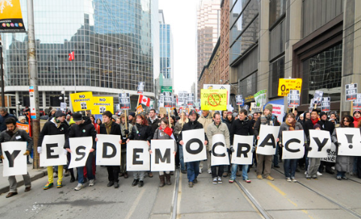
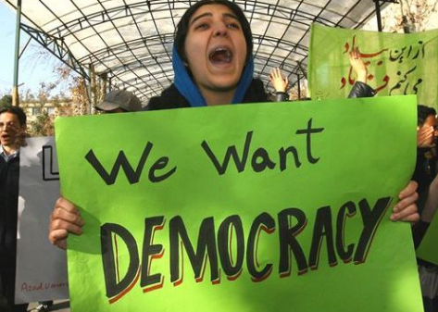
Why do we vote?
D
e
m
o
c
r
a
c
y
Northern Territory Electoral Commission
www.ntec.nt.gov.au
Notes:
Tell students: “In Australia, we vote for our decision makers, so the people in parliament making laws, and decision makers in government and councils.”
Ask students: “Because we live in a country where we vote for the people who make laws and decisions, it means we live in a certain kind of country, or under a certain system that lets the people have a say on who their leaders are.” “What do we call this type of system?”
On each click you can give clues, ‘D’, ‘y’, ‘c’ if they need it.
Explain Australia is a democracy, but not all countries are, and sometimes people in those countries want to be able to have a say, and may even be punished for doing so.

Slide 4
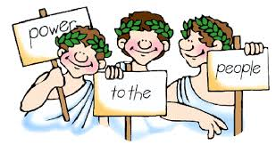
Democracy definition
Government by the people, or by their elected representatives
“Government of the people, by the people, for the people”
- Abraham Lincoln
From the Greek words Demos meaning people and Kratos meaning power
Northern Territory Electoral Commission
www.ntec.nt.gov.au
Notes:
Ask students: “What is democracy? Can anyone give me a definition?” Give assistance and prompts if required. Show answer on click. Ask students what the most important word in the definition is → people.
Show the famous quote about democracy, read it out loud and tell students this is a very famous saying by a very famous leader. Who was he? Show answer on click.
Show/explain the ancient Greek origins of the word democracy → demos kratos

Slide 5
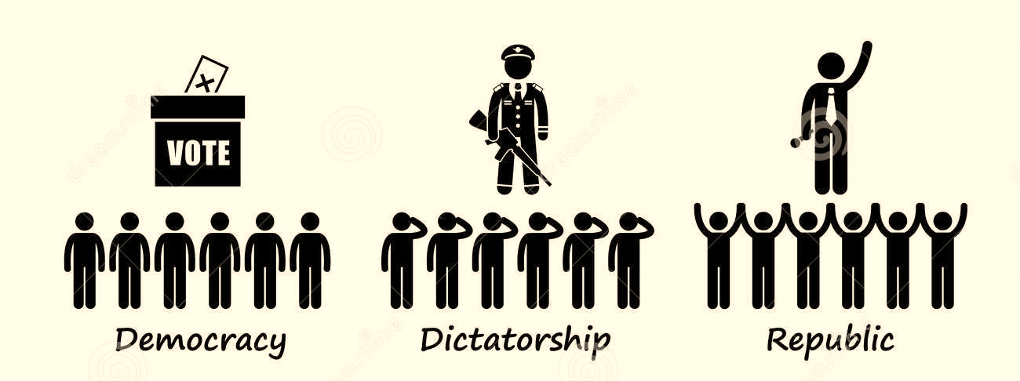
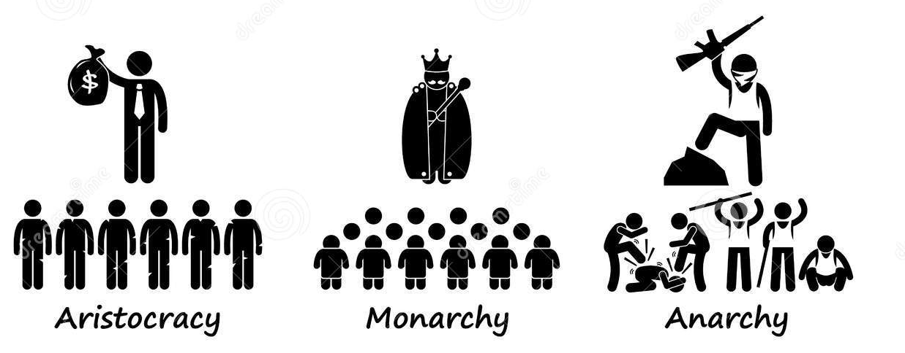
Features of a democracy
RIGHTS and FREEDOMS
RULE OF LAW
MAJORITY RULE
DEMOCRATIC ELECTIONS
Everybody must follow the law and everyone is equal before the law
Free, fair, open and contested elections that are held regularly
Powers to make choices about how you live your life and be treated fairly
Decisions are made when more than half agree, but minority groups are protected
Northern Territory Electoral Commission
www.ntec.nt.gov.au
Notes:
Explain to students that democracy is not just being able to vote and have a say, there is more to it. Bring up the four main elements of democracy on the left of slide.
ACTIVITY: Tell students that you will bring up a definition on the right side and they have to match it with the correct feature from the left side. Arrows will appear on clicks matching the definition to the feature.

Slide 6

Democratic rights & freedoms
SPEECH
EXPRESSION
INFORMATION
RELIGION
ASSEMBLY
ASSOCIATION
THE PRESS
right to hold and practise any religion or belief without interference
right of newspapers, TV and online media to report the news without being controlled by the government
right to say whatever you want without being punished by the government
right to access government documents
right to give an opinion without being punished by the government, including non-verbal means: clothing, art, music, books etc.
right to form and join groups to pursue common goals, including political parties and trade unions
right of individuals and groups to meet and engage in peaceful protest.
Northern Territory Electoral Commission
www.ntec.nt.gov.au
Notes:
Before bringing up the list, ask students if they know of any democratic rights and freedoms (may come up with freedom of speech, may need prompts!) Show the list of rights and confirm which ones they have heard of. (Likely to know freedom of speech, freedom of information)
ACTIVITY: Tell students that like before, on the right hand side you will bring up a definition and they have to match it to the correct freedom on the left. Starting with an easy one! Go through each definition.
Answers: a) religion, b) press, c) speech, d) information, e) expression, f) association g) assembly

Slide 7

Rule of Law
“Justice is blind”
Everyone is equal before the law
Laws protect human and property rights
Laws are clear and easily available
Processes of making and enforcing the law are transparent and fair
Judiciary is independent with a jury of peers
Northern Territory Electoral Commission
www.ntec.nt.gov.au
Notes:
Ask students if they have seen this picture/symbol before. It is an ancient Greek symbol for justice. Click to show expression “justice is blind.”
Ask students what does this expression mean? (Also point out the blindfold which symbolises the same thing) → that justice should be impartial and everyone is treated the same before the law, e.g. judges/police can’t give friends or rich and powerful people special treatment.
Ask students what the scales symbolise → that all sides of the case are considered
Tell (or ask, though it’s less obvious) students about the meaning of the sword → symbol of authority.
Go through each dot point and read through it. May need to explain meaning of ‘jury of peers’, try to elicit the role of a jury.

Slide 8

Majority rule, minority rights
MAJORITY RULE: decisions must have the support of more than half to be made – elections, government, laws.
MINORITY RIGHTS: to avoid tyranny of the majority the rights of individuals and minority groups are protected by law.
Minority groups include Aboriginal and Torres Strait Islander people, youth, CALD backgrounds, regional and remote areas, disabled,
non-Christian religions, and the LGBTIQ+ community.
Northern Territory Electoral Commission
www.ntec.nt.gov.au
Notes:
Ask students what does ‘majority’ mean → in democracy terms it does not mean ‘most’ but more than half.
On clicks, bring up the meanings for ‘majority rule’ and ‘minority rights’ and read out loud.
Before the third click, try to elicit the main minority groups in Australia. May help to describe the ‘majority group’ i.e. ‘white’, middle aged, finished Year 12, married with 2 kids, living in a capital city (according to 2016 census).
Click and show the list. Youth is 15 – 25 years, CALD means culturally and linguistically diverse, i.e. migrants from non-English speaking countries.

Slide 9
Democratic elections
FREE
FAIR
OPEN
CONTESTED
REGULAR
Everyone can vote
Elections usually held every 3 – 6 years
Voters have a choice between candidates
Electors are free to choose whoever they want
There are rules and laws to stop cheating
Northern Territory Electoral Commission
www.ntec.nt.gov.au
Notes:
Tell students a democratic election should be free, fair, open, contested and regular.
ACTIVITY: Once again a definition will come up on the right hand side that students need to match to the correct word on the left.
Answers: 1. open 2. regular 3. contested 4. free 5. fair.

Slide 10
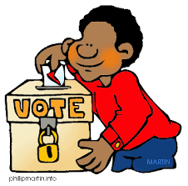




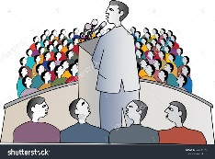
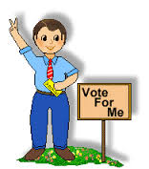
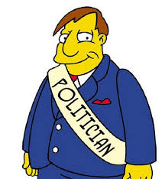



Participating in a democracy
How can you participate in Australia’s democracy?
Vote in elections (parliament, council, referendums, others)
Write to newspaper – letters to the editor
Give opinion through online forums and social media
Start or sign a petition
Start or join a protest rally or demonstration
Attend public meetings
Become a member of parliament or council
Communicate with members and councillors
Join a political party
Email
Phone
Meet
Northern Territory Electoral Commission
www.ntec.nt.gov.au
Notes:
Tell students there are lots of opportunities to participate and be involved in a democracy, people have the right to give their opinion publically, to criticise government, and to try to be involved in decision making.
ACTIVITY: Show picture clues on left hand side. Using the clues, students need to tell you some of the ways people can participate in a democracy (i.e. ways to be an ‘active citizen’).
Try to elicit all of them from students, then show the answers on click.

Slide 11
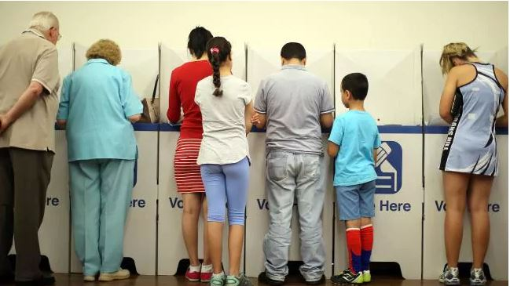
Who can vote?
You must:
be 18 years old or over
be an Australian citizen
be correctly enrolled – you can enrol at 16 years
Voting is compulsory
in Australia
Northern Territory Electoral Commission
www.ntec.nt.gov.au
Notes:
Ask students “Who can vote in government elections in Australia?”
Elicit first two points from students, and explain the third point.
Enrolment – to enrol for the first time you need to sign a form, so you can’t do it online unless you can sign on a touchscreen. You can enrol for the first time once you are 16 years, just can’t vote until you’re 18 years. Once your enrolled, you can easily update your enrolment (like when you move address) online.
On last click ask students: “What does compulsory mean?” Explain that voting is compulsory which means there is a consequence if you don’t vote. Talk about fine.

Slide 12
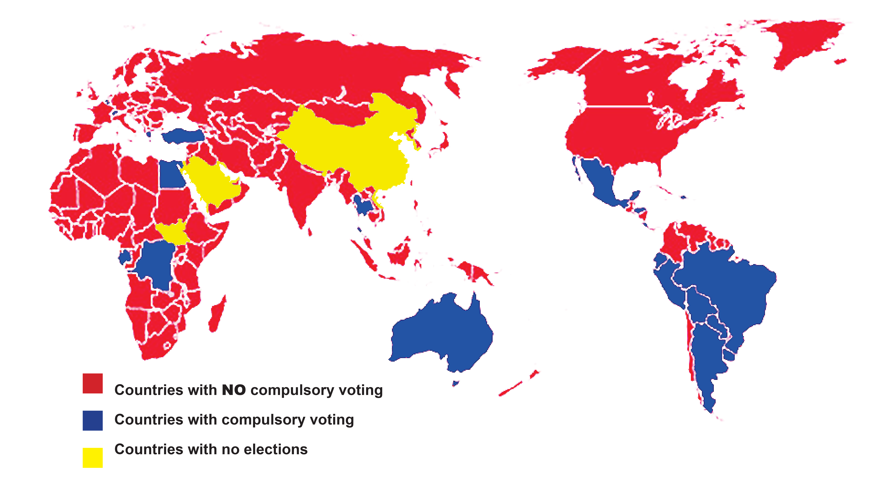
Voting is compulsory in Australia
When voting is optional these groups of people often do not vote:
- poor people
- young people
- Indigenous people
- migrants.
Compulsory voting helps
to protect these groups.
Northern Territory Electoral Commission
www.ntec.nt.gov.au
Notes:
Tell students Australia is not the only country with compulsory voting.
Elaborate: Most South American countries have compulsory voting, and a few other countries. There are about 22 countries that make voting compulsory. Most countries have optional voting, a there are some countries with no voting.
Elaborate: Compulsory voting is advantageous in countries with a diverse population like Australia. Research shows that when voting is optional certain groups of people consistently don’t vote in large numbers and can be therefore left out of the decision making process. Some of these groups are the minority groups we were just talking about: young people, Aboriginal people, migrants and, in large numbers, poor people do not vote. Compulsory voting also improves voting services, making elections as “open” as possible, and therefore more democratic.

Slide 13
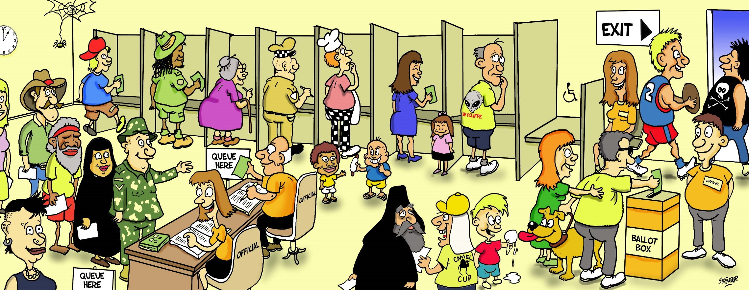
All votes are secret
No names on the ballot papers
Northern Territory Electoral Commission
www.ntec.nt.gov.au
Notes:
Ask students: “Who has been to a voting centre before, maybe with your parents?”
To elaborate: “When you go to vote, you first need to get your name ticked off from the list of voters (point to the line) which is called the electoral roll. You are then given the correct ballot paper for where they live, because you are voting for a person to represent your area (point to ballot paper being given to voter), then you go to a private screened area (point to line of voting screens) to make your vote.”
Ask students: “Why go to a voting screen, a private area, to make your vote?”
Elicit answer and elaborate: “It’s very important that people are free to choose who they want to vote for. If no one can see who you vote for, then you can’t be bullied or threatened to vote for certain people.” Give further examples.
“Once you have voted, you must put your ballot paper in the ballot box” (Point to ballot box)

Slide 14






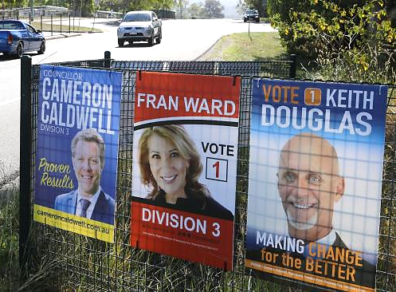
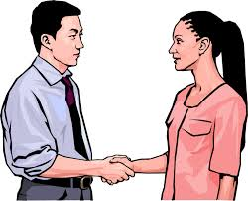

Being an informed voter
How can you learn about candidates in order to make an informed vote?
Media: newspaper, radio, TV, online
Advertising: posters, newspaper, TV, radio, online, letterbox
Social media
Public debate between leaders of major parties
Vote Compass (ABC) or YourVote (SMH)
Political party campaigns
Opinion polls
Interest groups
Meet candidates at events or door knocking
Some Electoral Commissions put information on website
Northern Territory Electoral Commission
www.ntec.nt.gov.au
Notes:
Tell students it is up to electors to make an informed vote. There’s a lot of information available during election campaigns, sometimes these are directly sent to you, but sometimes you have to go looking for them.
ACTIVITY: Show picture clues. Elicit from students what the clues represent, and discuss ways to get informed as a voter.
There is no picture for one of the listed items: Vote Compass (ABC) and YourVote (SMH). These are apps that gave users a series of questions about current issues and attitudes. By answering the questions the app will let you know which party your views are most aligned to.

Slide 15
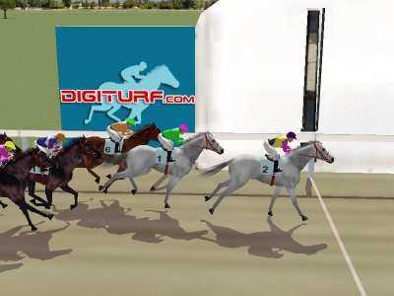
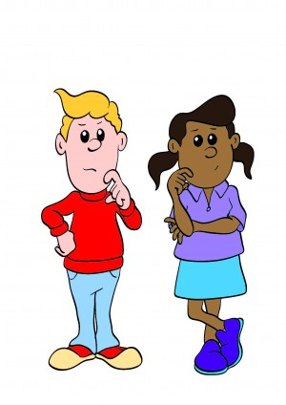
Voting systems
First past the post
Preferential
Hmm, what order do I want?
Northern Territory Electoral Commission
www.ntec.nt.gov.au
Notes:
Tell students: “There are a few different ways to vote and count votes, and we will discuss 2 of these.”
Use the horse racing picture to explain ‘first past the post’: the first horse past the finish line wins, it doesn’t matter how fast or slow the race was.
Ask students: “If we are talking about an election, and using election words, who wins a first past the post election?” If they need help, say “the person with the most……?” Confirm that the person with the most votes win. It doesn’t matter how many votes they get, as long as they get more than everyone else.
Tell students: “This is NOT the system of voting we use in Australia for our government and council elections. We use the preferential system, where the voter needs to put everyone on their voting paper in an order, using numbers. What number would you put next to the person you want to choose?”
Tell students: “You must put a number next to every person on your ballot paper. You must put everyone in order. If you don’t number every box, we can’t count your vote.”

Slide 16
First past the post
SAM 30
MAYA 25
CARINA 10
LEE 35
TOTAL 100
BALLOT PAPER
SAM
MAYA
CARINA
LEE
1
65 voters out of 100 did not want Lee to win
Northern Territory Electoral Commission
www.ntec.nt.gov.au
Notes:
Ask students: ‘If this was a first past the post election, and the person with the most votes wins, who wins this election?”
“Yes, Lee wins this election, Lee got more votes than anyone else, Lee is now the representative for those 100 people that voted.”
Point out that A LOT of people did not vote for Lee. Click to show the sentence in blue.
Tell students: “A lot of people didn’t vote for Lee, almost double those who did vote for Lee. Way more than half the voters chose someone else, and yet Lee is their representative.” “In Australia, this is the reason we do not use first past the post voting for government and council elections.”

Slide 17
Who wins a preferential election?
The winner must get more than half of all the votes counted.
50% + 1
Northern Territory Electoral Commission
www.ntec.nt.gov.au
Northern Territory Electoral Commission
www.ntec.nt.gov.au
Notes:
Tell students: “We use preferential voting for government elections. To win a preferential election, you must get more than half the votes, this means the winner must get 50% + 1 of the votes. Perhaps give 1 or 2 examples, like if we have 200 people voting, what is the absolute majority someone needs to win.

Slide 18
How to vote in a preferential election
Put a number in every square
Put the numbers in order of your choice
1 is for your favourite, 2 is for your second favourite
Do not put your name on the ballot paper
BALLOT PAPER
BALLOT PAPER
BALLOT PAPER
SAM
MAYA
CARINA
LEE
2
SAM
MAYA
CARINA
LEE
1
SAM
MAYA
CARINA
LEE
4
3
4
1
4
2
3
1
3
2
Northern Territory Electoral Commission
www.ntec.nt.gov.au
Notes:
Tell students: These are your instructions for how to vote.
Show picture: For preferential elections, we use numbers to vote, like this…
Ask students: Can you see any ticks? Crosses? Empty squares? Coloured in squares? You cannot vote this way.
Click to get 1st dot point: You must write a number in the square next to every person on the voting paper, don’t leave one out.
2nd dot point: The numbers should be in order, so the order of your choice.
3rd dot point: Write number 1 next to your favourite person, your first choice, the one you want to make decisions in government. Write number 2 next to your second choice, write number 3 next to your third choice, and you keep going until you have written a number next to every person on your paper.
4th dot point: don’t forget, you don’t need to write your name on the paper, you only have to write the numbers.

Slide 19
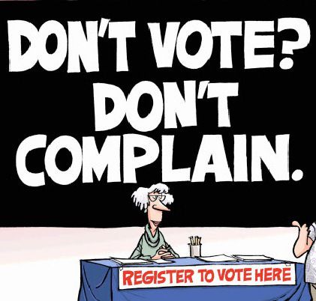
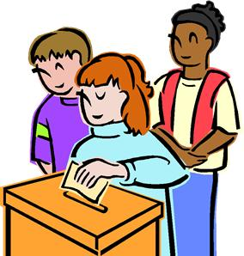
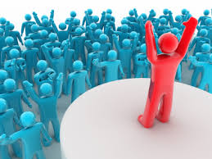



Mock election
What characteristics are the most important
in a government representative?
MR LEADERSHIP
MS COMMUNITY
Charisma and leadership qualities
Passion for their community
MR PEOPLE
MS EXPERIENCE
Communication and people skills
Previous experience in government
Northern Territory Electoral Commission
www.ntec.nt.gov.au
Notes:
MOCK ELECTION ACTIVITY: Tell students it is now time to vote and learn how votes are counted.
Students will be voting on what’s important to them in their government representatives. Click them in one at a time and read them out.
Tell students they will be making an informed vote and that 4 volunteers are required to act as candidates to learn more about each one. Choose four appropriate students and provide them with the prompt cards to read out.
Once the students have finished, reiterate voting instructions: when you receive your ballot paper go to the voting area (have an area set up where students can make a private vote). Don’t crowd, let everyone have a free vote. Number the ballot paper in the order of your choice with #1 being your favourite and first choice, and #4 the one you don’t think is important. Then put your ballot paper in the ballot box (separate from voting screens to help clear students away).
Refer to Teachers instructions for vote and count.

Slide 20


Questions?
For further information ntec.nt.gov.au
Facebook.com/NTElectoralcommission
@NTElecComm
Northern Territory Electoral Commission
www.ntec.nt.gov.au

